Slide 1
How to Use this Powerpoint
These slides have been designed to be used in Powerpoint as a Slide Show.
There are text and images that will overlap and cause confusion, if used in desktop mode.
To open this in Slide Show mode, please click “Slide Show” on the menu above and then “From Beginning”.
Thank you from the Emile Team.
If you have any feedback, or would just like to say “hello”, please email us at: hello@emile-education.com

Slide 2
Extending Sentences

Slide 3
A sentence is a group of words that we say with one breath.

Slide 4
A sentence can express 1 or more ideas.
These are quite simple (boring?) sentences:
A girl threw a ball.
A boy sat in class.
The cat walks in the street.
How many ideas are in each sentence?
There is one idea in each sentence.

Slide 5
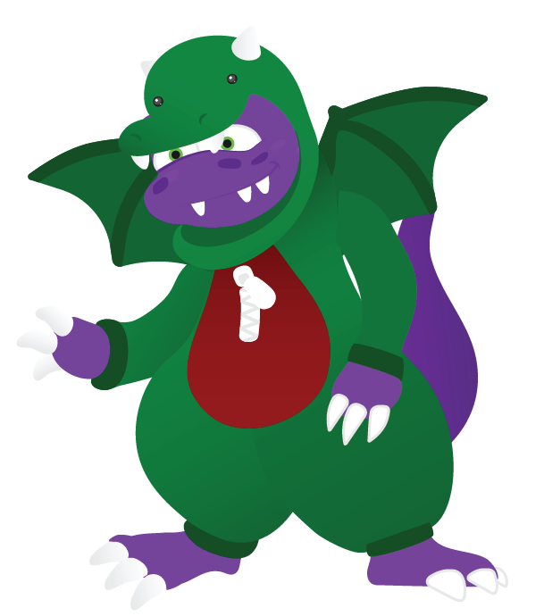
Two sentences can be joined by using the word “and”.

Slide 6
I’m going to join two sentences.
Can you spot two things in this sentence?
1. The boy kicks a ball
2. The bell rang.
The boy kicks a ball and the bell rang.
Can you see how the sentences have been joined?

Slide 7
Let’s practise. Let’s join the sentences:
Mark likes cars.
Paul likes dolls.
Mark likes cars and Paul likes dolls.

Slide 8
Can you join two of the sentences to make one sentence?
The boy kicks a ball.
The bell rang.
The car parks itself.
The girl sang a song.
The man dances.

Slide 9
The boy kicks a ball.
The bell rang.
The car parks itself.
The girl sang a song.
The man dances.
The boy kicks a ball and the bell rang.
The car parks itself and the girl sang a song.
The girl sang a song and the man dances.

Slide 10
The boy kicks a ball and the bell rang.
“and” is a joining word because it can join two sentences or ideas together.
There are lots of joining words.
Can you think of anymore joining words?

Slide 11
Other joining words include:
when
if
or
but

Slide 12
Can you join the two ideas into
one sentence using the joining word?
when
if
or
but
1. The man dances.
when
2. The girl sings.
The man dances when the girl sings.
1. The man dances.
if
2. The girl sings.
The man dances if the girl sings.

Slide 13
Can you join the two ideas into
one sentence using the joining word?
when
if
or
but
1. The man dances.
or
2. The girl sings.
The man dances or the girl sings.
1. The man dances.
but
2. The girl sings.
The man dances but the girl sings.

Slide 14
Let’s not join more than two ideas until we know more about sentences.
Beth plays at school and
Zara goes home and Paul likes dolls and Mark likes cars and Barry wants sweets and Malia wants cakes.

Slide 15
Below are 3 sentences and 4 joining words. In 1 minute, how many different sentences can you make?
GO!
Time’s Up!
1 Minute Timer
1. Aimee is clever.
2. Emile is brave.
3. Scrambler is scared.
when
if
or
but
Last 15 seconds!
GO!
Start
TIME’S UP!

Slide 16
How about?
1 Minute Timer
1. Aimee is clever and Emile is brave.
2. Emile is brave when Scrambler is scared.
3. Scrambler is scared but Aimee is clever.
4. Emile is brave or Aimee is clever.
5. Scrambler is scared and Emile is brave.
TIME’S UP!
There are even more combinations!

