Slide 1
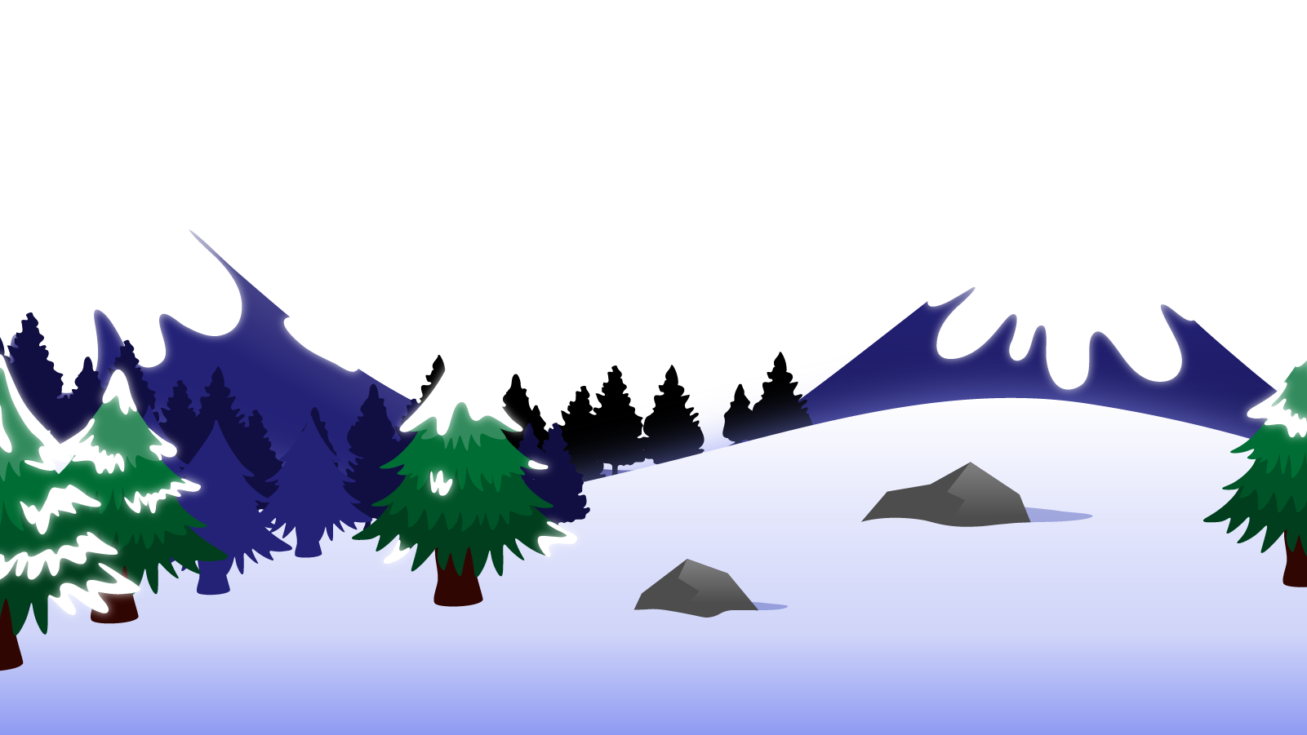
How to Use this Powerpoint
These slides have been designed to be used in Powerpoint as a Slide Show.
There are text and images that will overlap and cause confusion, if used in desktop mode.
To open this in Slide Show mode, please click “Slide Show” on the menu above and then “From Beginning”.
Thank you from the Emile Team.
If you have any feedback, or would just like to say “hello”, please email us at: hello@emile-education.com

Slide 2
Forming nouns

Slide 3
Does anyone remember what a noun is?
A noun is a thing or an object.
Can you think of
any examples of nouns?

Slide 4
These words are ALL nouns.
table
Monday
bravery
pride of lions
chair
England
loneliness
pack of lies
room
December
courage
school of fish
brother
London
sadness
gaggle of geese
teacher
Emile
happiness
army of ants
Nouns can be quite dull and uninteresting.

Slide 5
Which of these words are nouns?
teacher
student - noun
teacher - noun
student
listen
computer - noun
listen - verb
computer
TV - noun
TV
like - verb
like
girl
girl - noun
boy- noun
boy
learn - verb
courage
sea - noun
courage - noun
sea
learn
collect - verb
collect
brother
brother - noun
London
Aimee
London - noun
Aimee - noun
whiteboard- noun
whiteboard
confidence - noun
teacher
Emile
confidence
teacher - noun
Emile - noun
army of ants
army of ants - noun

Slide 6
Can you spot the nouns in this sentence?
Can you spot two things in this sentence?
Students like school.
The word “students” is a noun.
The word “school” is a noun.
Teachers drive cars.
The word “teachers” is a noun.
The word “cars” is a noun.

Slide 7
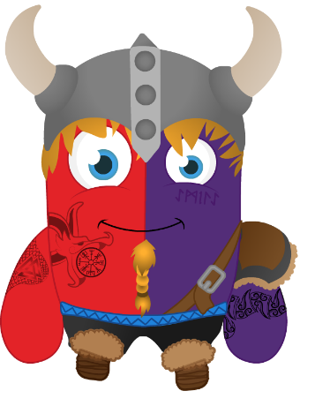
Does anyone know what a suffix is?

Slide 8
A suffix is a group of letters that go at the end of a root word and change the meaning of the word.
Root word
ing
Suffix
do
do + ing = doing

Slide 9
Lots of nouns are made by adding suffixes.
It’s a great way to learn how to spell longer words!

Slide 10
A useful suffix can be “er”.
play
+
er
=
player
teach
+
er
=
teacher
sing
+
er
=
singer

Slide 11
A useful suffix can be “ness”.
kind
+
ness
=
kindness
ill
+
ness
=
illness
dry
+
ness
=
dryness
fit
+
ness
=
fitness
dark
+
ness
=
darkness

Slide 12
You have 1 minute to work out the words being made!
GO!
1 Minute Timer
sick
+
ness
=
sickness
sad
+
ness
=
sadness
black
+
ness
=
blackness
football
+
er
=
footballer
Last 15 seconds!
farm
+
er
=
farmer
GO!
Start
TIME’S UP!

