Slide 1
How to Use this Powerpoint
These slides have been designed to be used in Powerpoint as a Slide Show.
There are text and images that will overlap and cause confusion, if used in desktop mode.
To open this in Slide Show mode, please click “Slide Show” on the menu above and then “From Beginning”.
Thank you from the Emile Team.
If you have any feedback, or would just like to say “hello”, please email us at: hello@emile-education.com

Slide 2
Compound nouns

Slide 3
Sometimes we combine two words to make one new word.
Can you think of any?

Slide 4
There are tomato plants in the greenhouse.
greenhouse

Slide 5
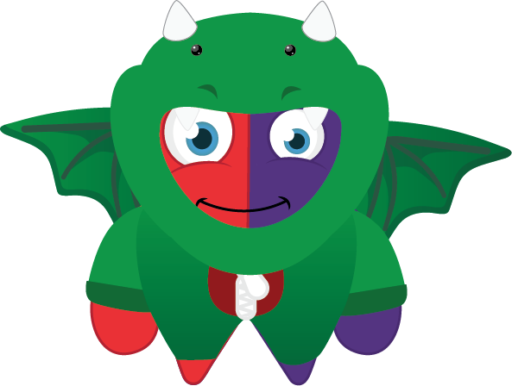
Flour is kept in the cupboard.
cupboard

Slide 6
This game is for everybody.
everybody

Slide 7
Scrambler sees trouble everywhere.
everywhere

Slide 8
Can everyone hear the teacher?
everyone

Slide 9
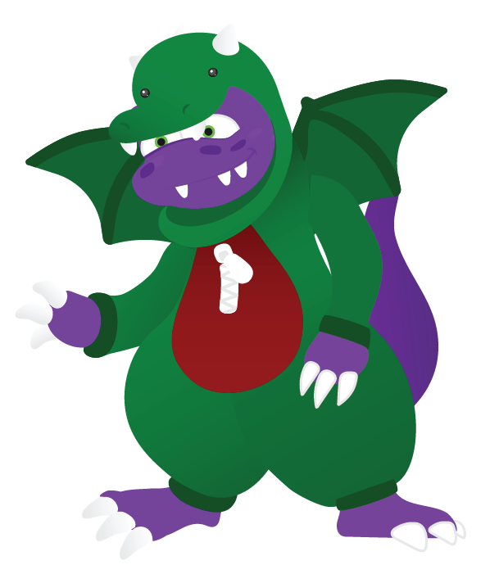
Can anyone see my pen?
anyone

Slide 10
The sail has fallen off the windmill.
windmill

Slide 11
Please put rubbish in the dustbin.
dustbin

Slide 12
I have blue curtains in my bedroom.
bedroom

Slide 13
There are twelve desks in the classroom.
classroom

Slide 14
I ate popcorn when I watched a film.
popcorn

Slide 15
I went swimming this weekend.
weekend

Slide 16
I enjoy playing football.
football

Slide 17
The children were in the playground.
playground

Slide 18
The cows were in the farmyard.
farmyard

Slide 19
I must tidy my bedroom.
bedroom

Slide 20
I picked a blackberry from the bush.
blackberry

Slide 21
I can see a rainbow.
rainbow

Slide 22
I found a starfish on the beach.
starfish

Slide 23
It is worthwhile doing your homework.
homework

Slide 24
I had a slice of pineapple cake.
pineapple

Slide 25
I felt an earthquake.
earthquake

Slide 26
I ate popcorn when I watched a film.
popcorn

Slide 27
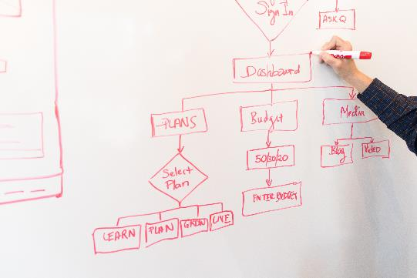
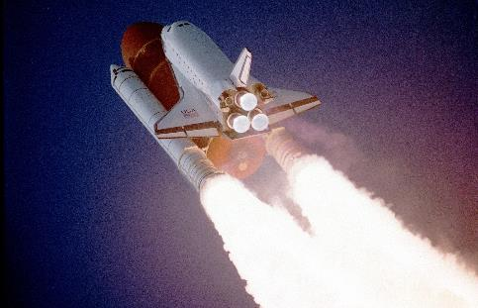
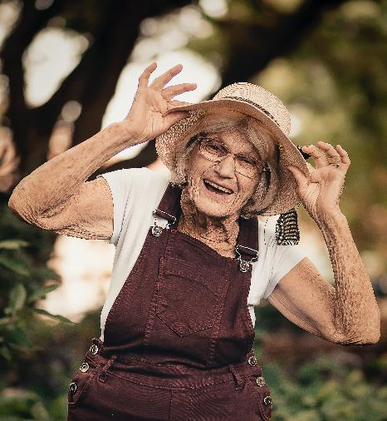
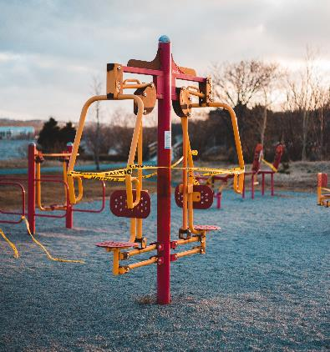
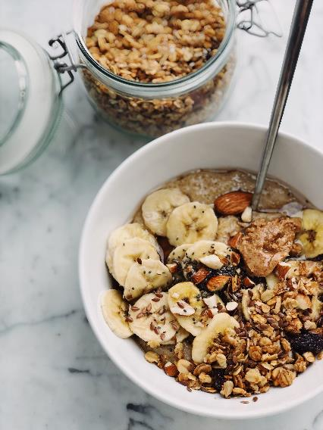
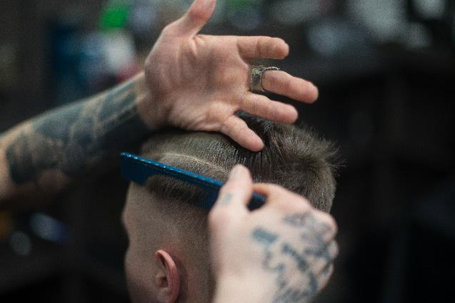
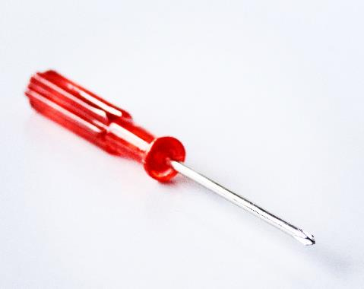
How many compound words can you see in these photo’s?

