Slide 1
How to Use this Powerpoint
These slides have been designed to be used in Powerpoint as a Slide Show.
There are text and images that will overlap and cause confusion, if used in desktop mode.
To open this in Slide Show mode, please click “Slide Show” on the menu above and then “From Beginning”.
Thank you from the Emile Team.
If you have any feedback, or would just like to say “hello”, please email us at: hello@emile-education.com

Slide 2
Apostrophes for singular nouns.

Slide 3
Does anyone remember what a noun is?
A noun is a thing or an object.
Can you think of
any examples of nouns?

Slide 4
These words are ALL nouns.
table
Monday
bravery
pride of lions
chair
England
loneliness
pack of lies
room
December
courage
school of fish
brother
London
sadness
gaggle of geese
teacher
Emile
happiness
army of ants

Slide 5
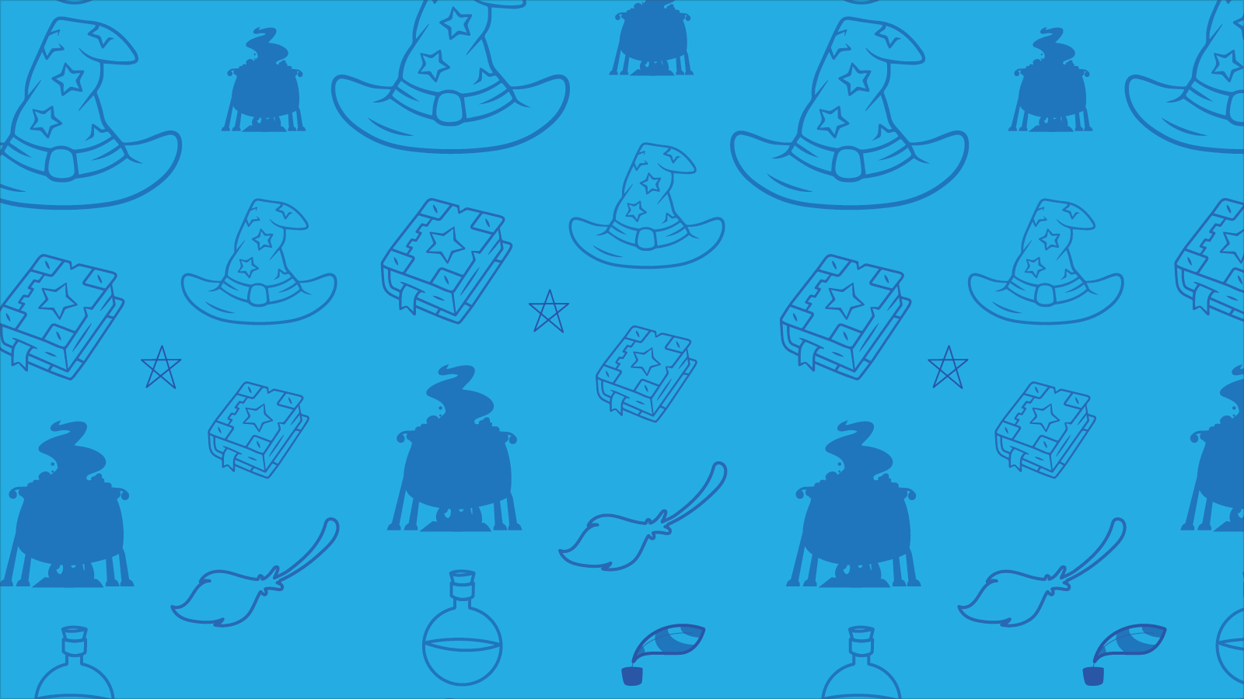
Which of these words are NOT nouns?
football
student - noun
student
listen
computer - noun
football - noun
listen - verb
computer
TV - noun
TV
like - verb
like
girl
girl - noun
boy- noun
boy
courage
sea - noun
courage - noun
sea
learn
learn - verb
collect - verb
collect
brother
brother - noun
London
Aimee
London - noun
Aimee - noun
whiteboard- noun
whiteboard
confidence - noun
teacher
Emile
confidence
teacher - noun
Emile - noun
army of ants
army of ants - noun

Slide 6
Can you spot the nouns in this sentence?
Can you spot two things in this sentence?
Students like school.
The word “students” is a noun.
The word “school” is a noun.
Teachers drive cars.
The word “teachers” is a noun.
The word “cars” is a noun.

Slide 7
Can you spot the nouns in this sentence?
Can you spot two things in this sentence?
Children play games.
The word “children” is a noun.
The word “games” is a noun.
Hannah watches TV.
The word “Hannah” is a noun.
The word “TV” is a noun.

Slide 8
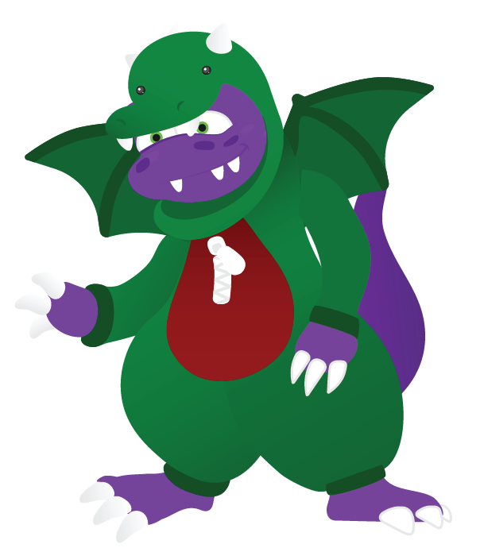
What’s the difference between the green nouns and the blue nouns?
table
tables
chair
chairs
room
rooms
child
children
teacher
teachers

Slide 9
The nouns on the green blocks relate to one object and are called singular nouns.
The nouns on the blue blocks relate to more than one object.
table
tables
chair
chairs
room
rooms
child
children
teacher
teachers

Slide 10
The nouns in green boxes are singular nouns because they only relate to one object.
You have 1 minute to spot which nouns are singular noun!
GO!
table
table
cars
car
1 Minute Timer
cars
car
boy
boy
pens
rooms
pens
rooms
girls
child
girls
child
houses
houses
tables
adults
home
tables
adults
home
teacher
teacher
game
ball
game
ball
Last 15 seconds!
GO!
Start
TIME’S UP!

