Slide 1
How to Use this Powerpoint
These slides have been designed to be used in Powerpoint as a Slide Show.
There are text and images that will overlap and cause confusion, if used in desktop mode.
To open this in Slide Show mode, please click “Slide Show” on the menu above and then “From Beginning”.
Thank you from the Emile Team.
If you have any feedback, or would just like to say “hello”, please email us at: hello@emile-education.com

Slide 2
Adjectives – Suffixes “ful” and “less”.

Slide 3
Does anyone remember what a noun is?
A noun is a thing or an object.
Can you think of
any examples of nouns?

Slide 4
These words are ALL nouns.
table
Monday
bravery
pride of lions
chair
England
loneliness
pack of lies
room
December
courage
school of fish
brother
London
sadness
gaggle of geese
teacher
Emile
happiness
army of ants
Nouns can be quite dull and uninteresting.

Slide 5
Which of these words are NOT nouns?
teacher
student - noun
teacher - noun
student
listen - verb
listen
computer - noun
computer
TV - noun
TV
like
like - verb
girl
girl - noun
boy- noun
boy
courage
sea - noun
courage - noun
sea
learn
learn - verb
collect - verb
collect
brother
brother - noun
London
Aimee
London - noun
Aimee - noun
whiteboard- noun
whiteboard
confidence - noun
teacher
Emile
confidence
teacher - noun
Emile - noun
army of ants
army of ants - noun

Slide 6
Can you spot the nouns in this sentence?
Can you spot two things in this sentence?
Students like school.
The word “students” is a noun.
The word “school” is a noun.
Teachers drive cars.
The word “teachers” is a noun.
The word “cars” is a noun.

Slide 7
Does anyone know what an adjective is?
An adjective is a word that describes a noun.
Can you think of any
examples of adjectives?

Slide 8
These words are ALL adjectives.
brave
few
flat
American
happy
some
round
French
short
many
spherical
English
heavy
young
red
wood
fast
old
blue
metal
Adjectives make nouns more interesting!

Slide 9
Can you spot the adjectives in this sentence?
Can you spot two things in this sentence?
Girls play fantastic football.
The word “fantastic” is an adjective as it describes the noun “football”.
Boys write scary stories.
The word “scary” is an adjectives as it describes the noun “stories”.

Slide 10
How can we make these sentences
even more interesting?
More adjectives!
How can we make these sentences more interesting?
One way is to introduce adjectives!
Can you spot two things in this sentence?
Girls play football.
Girls play attacking football.
Older girls play attacking football.
Older, brave girls play attacking and attractive football.
Boys write stories.
Imaginative boys write scary stories.
Imaginative boys write scary and mysterious stories.

Slide 11
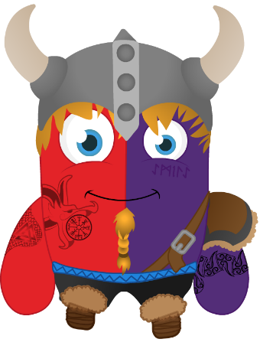
Does anyone know what a suffix is?

Slide 12
A suffix is a group of letters that go at the end of a root word and change the meaning of the word.
Root word
ing
Suffix
do
do + ing = doing

Slide 13
Lots of adjectives are made by adding suffixes.
It’s a great way to learn how to spell longer words!

Slide 14
A useful suffix can be “ful”.
care
+
ful
=
careful
colour
+
ful
=
colourful
doubt
+
ful
=
doubtful
hate
+
ful
=
hateful
pain
+
ful
=
painful

Slide 15
A useful suffix can be “less”.
blame
+
less
=
blameless
effort
+
less
=
effortless
harm
+
less
=
harmless
help
+
less
=
helpless
joy
+
less
=
joyless

Slide 16
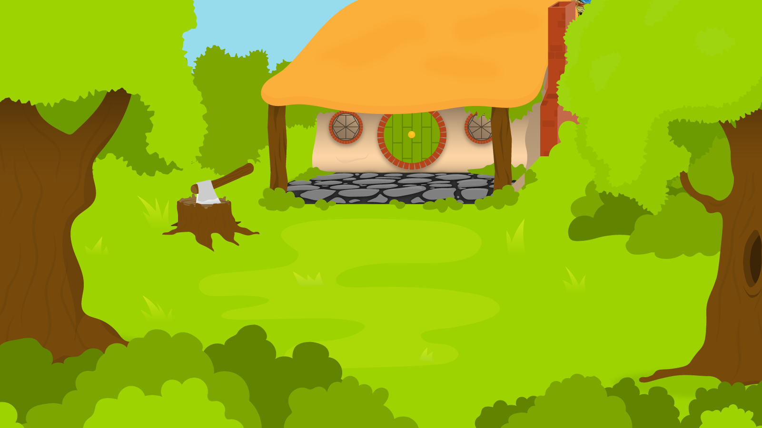
Below are 5 words. Turn these into adjectives using the suffixes “ful” or “less”.
1 Minute Timer
GO!
Time’s Up!
Power
Wonder
Thank
End
Truth
GO!
Last 15 seconds!
TIME’S UP!
Start

Slide 17
Power + ful = powerful or Power + less = powerless
Wonder + ful = wonderful
Thank + ful = thankful or Thank +less = thankless
End + less = endless
Truth + ful = truthful
1 Minute Timer
TIME’S UP!

