Slide 1
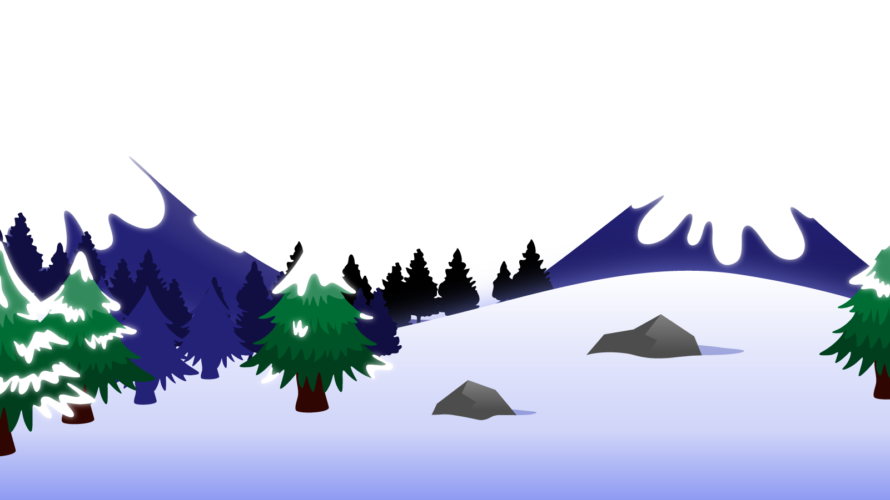
How to Use this Powerpoint
These slides have been designed to be used in Powerpoint as a Slide Show.
There are text and images that will overlap and cause confusion, if used in desktop mode.
To open this in Slide Show mode, please click “Slide Show” on the menu above and then “From Beginning”.
Thank you from the Emile Team.
If you have any feedback, or would just like to say “hello”, please email us at: hello@emile-education.com

Slide 2
Comparatives

Slide 3
Does anyone remember what a noun is?
A noun is a thing or an object.
Can you think of
any examples of nouns?

Slide 4
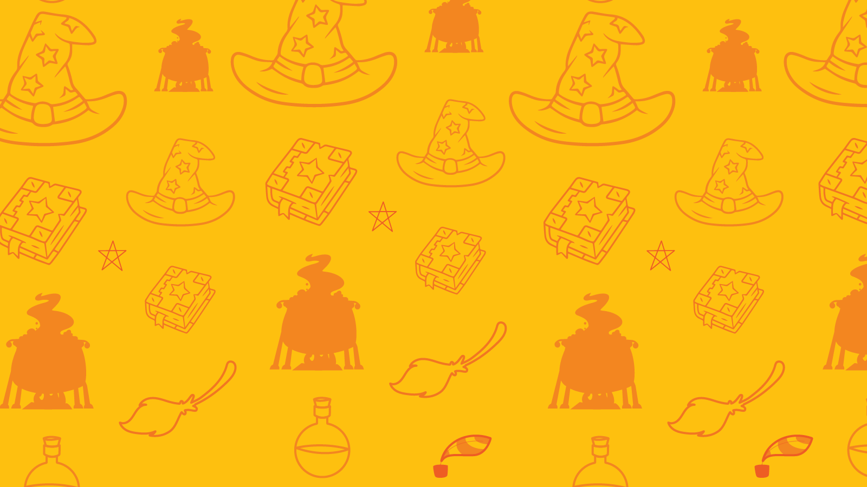
Can you spot the nouns in these sentences?
Can you spot two things in this sentence?
Adults play games.
The word “adults” is a noun.
The word “games” is a noun.
Plumbers fit bathrooms.
The word “plumbers” is a noun.
The word “bathrooms” is a noun (and a compound word).

Slide 5
Does anyone know what an adjective is?
An adjective is a word that describes a noun.
Can you think of any
examples of adjectives?

Slide 6
Can you spot the adjectives in this sentence?
Can you spot two things in this sentence?
The teacher has a beautiful smile.
The word “beautiful” is an adjective as it describes the noun “smile”.
The old dog barked crazily.
The word “old” is an adjectives as it describes the noun “dog”.

Slide 7
There is a special group of adjectives called “comparative adjectives”.
A comparative adjectives are used to compare two nouns.

Slide 8
The underlined words are the
comparative adjectives.
For example, can you think of a sentence where you compare two cars?
The blue car is faster than the red car.
Mercedes cars are more expensive than BMW cars.
I think Minis look better than Fiats.
The blue car is faster than the red car.
Mercedes cars are more expensive than BMW cars.
I think Minis look better than Fiats.

Slide 9
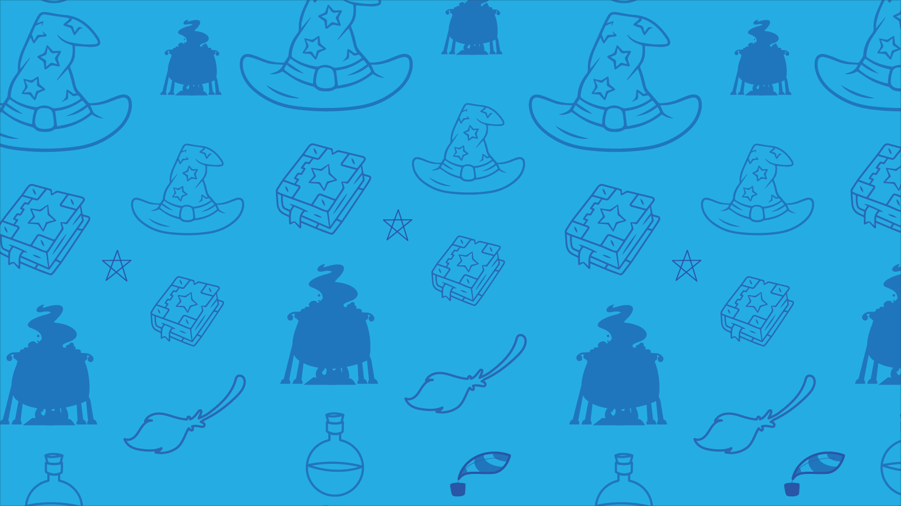
Comparative adjectives can be made by adding “er” as a suffix or using the word “more”.
The blue car is faster than the red car.
Mercedes cars are more expensive than BMW cars.
I think Minis look better than Fiats.

Slide 10
These words are ALL comparative adjectives.
worse
earlier
poorer
smaller
more beautiful
fewer
quicker
softer
bigger
healthier
richer
taller
more clever
lower
sadder
weaker
colder
more polite
shorter
younger
Can you see they end in “er” or use “more”?

Slide 11
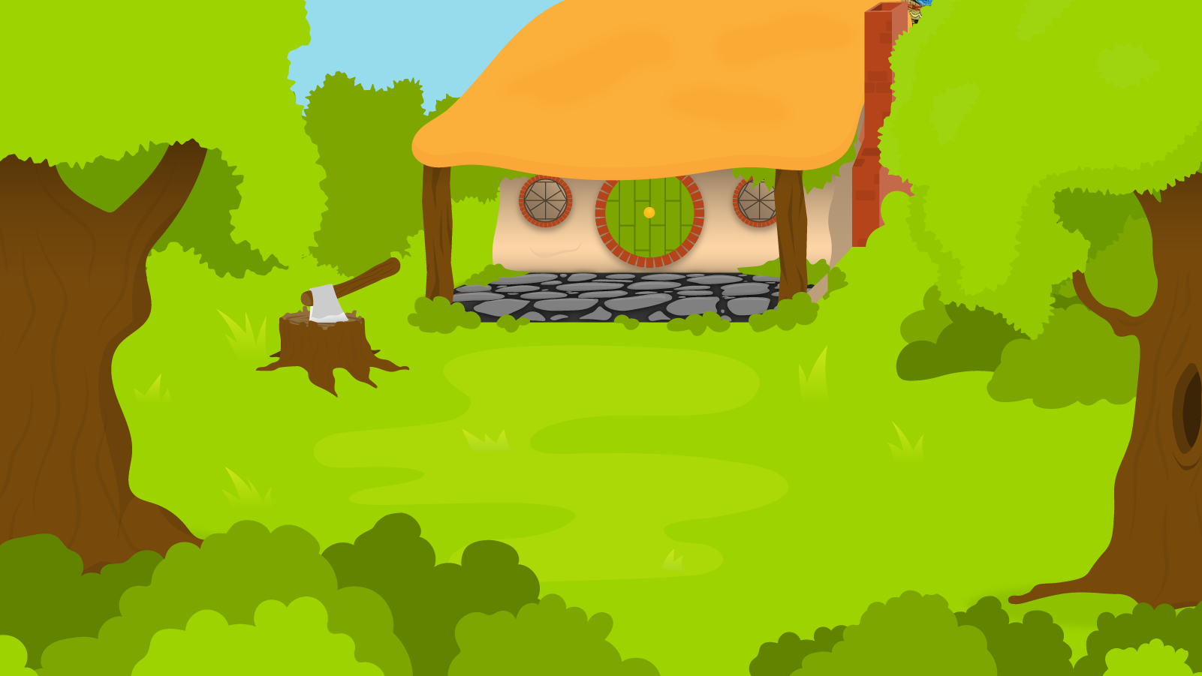
You have 1 minute to think of 5 more comparative adjectives!
1 Minute Timer
GO!
Hint: words ending in “er” or using “more”.
How about:
shorter, angrier, sleepier, stronger,
ruder, quicker, cleaner, dirtier,
more prepared, more organised,…
GO!
Last 15 seconds!
TIME’S UP!
Start

