Slide 1
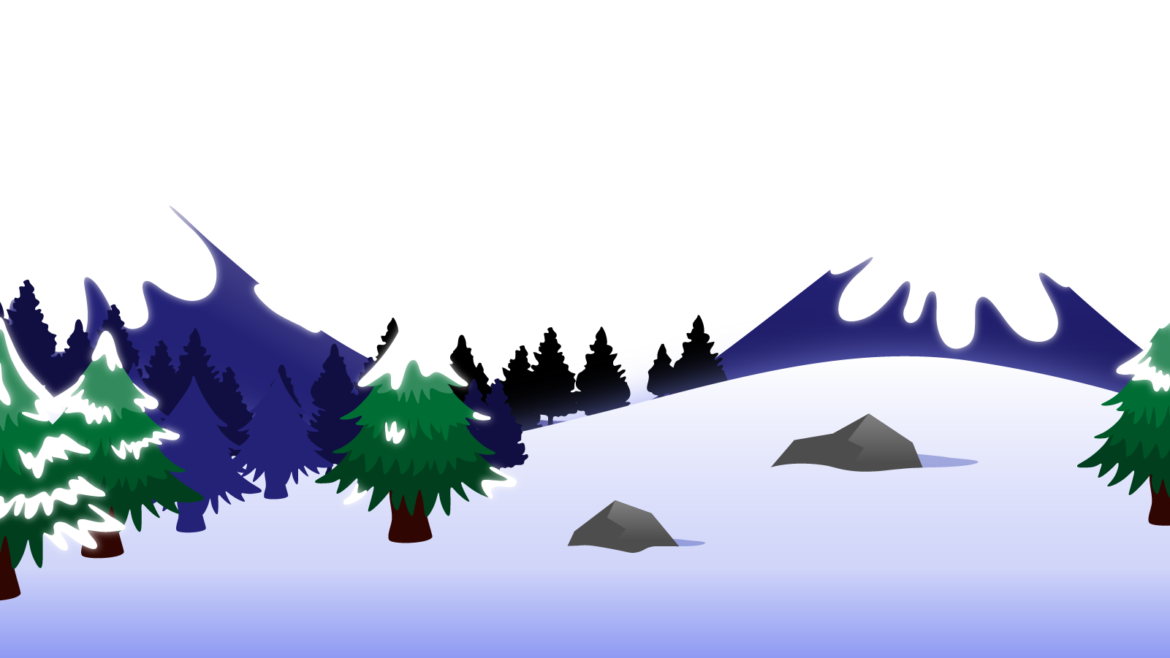
How to Use this Powerpoint
These slides have been designed to be used in Powerpoint as a Slide Show.
There are text and images that will overlap and cause confusion, if used in desktop mode.
To open this in Slide Show mode, please click “Slide Show” on the menu above and then “From Beginning”.
Thank you from the Emile Team.
If you have any feedback, or would just like to say “hello”, please email us at: hello@emile-education.com

Slide 2
Verb Tenses in Writing

Slide 3
The cat sat on the mat.
Does anyone remember what type of word “sat” is?
Action words are called verbs.
“sat” is the verb in this sentences.

Slide 4
What is the difference between
theses two sentences?
The cat sits on the mat.
The cat sat on the mat.
When did the cat sit on the mat in each sentence?
In both sentences, the cat is on the mat.
In one sentence, the cat is on the mat now.
In one sentence, the cat was on the mat in the past.

Slide 5
Present vs Past
Present
Past
Happening now
Happened in the past
I like books.
I liked books.
I play football.
I played football.
Usually ends in “ed”

Slide 6
Past
Present
My mother loved Raggedy Ann.
My mother loves Raggedy Ann.
In the past.
Happening now.
Now
The present
The past
The future

Slide 7
Which paragraph is using the present tense and which paragraph is using the past? How do you know?
Past
Present
My mother loved Raggedy Ann.
In my room, Raggedy Ann sat, a trifle loppy and loose-jointed.
Evidently, Raggedy ate chocolate as there was some smeared on her face.
My mother loved Raggedy Ann.
In my room, Raggedy Ann sat, a trifle loppy and loose-jointed.
Evidently, Raggedy ate chocolate as there was some smeared on her face.
My mother loves Raggedy Ann.
In my room, Raggedy Ann sits, a trifle loppy and loose-jointed.
Evidently, Raggedy eats chocolate as there is some smeared on her face.
My mother loves Raggedy Ann.
In my room, Raggedy Ann sits, a trifle loppy and loose-jointed.
Evidently, Raggedy eats chocolate as there is some smeared on her face.
The past happened in the past.
The present happens now.

Slide 8
Identify the verb.
Identify the verb.
What tense is the paragraph below written in?
It was Basil who thought of it first. Basil was a little boy with impudent blue eyes and a turned-up nose and Mary hated him. She played by herself under a tree. She made heaps of earth and paths for a garden and Basil came and stood near to watch her.
It was Basil who thought of it first. Basil was a little boy with impudent blue eyes and a turned-up nose and Mary hated him. She played by herself under a tree. She made heaps of earth and paths for a garden and Basil came and stood near to watch her.
The Secret Garden

Slide 9
Identify the verb.
Identify the verb.
What tense are the paragraphs below written in?
There she sits, a trifle loppy and loose-jointed. She looks me squarely in the face in a straightforward, honest manner, a twinkle where her shoe-button eyes reflect the electric light.
She smiles happily and continuously.
There she sits, a trifle loppy and loose-jointed. She looks me squarely in the face in a straightforward, honest manner, a twinkle where her shoe-button eyes reflect the electric light.
She smiles happily and continuously.
Adapted from Raggedy Anne

Slide 10
Can you hear what’s wrong below?
Identify the verb.
Mrs Fenton was born next door to a school and felt destined to be a teacher. Her mother was a teacher and trains her daughters every day. The teacher life seems to suit Elizabeth, who thrived in a classroom.
Mrs Fenton was born next door to a school and felt destined to be a teacher. Her mother was a teacher and trains her daughters every day. The teacher life seems to suit Elizabeth, who thrived in a classroom.
Some of the verbs are in the present tense.
Some of the verbs are in the past tense.
It confuses the reader as to when things are happening.

Slide 11
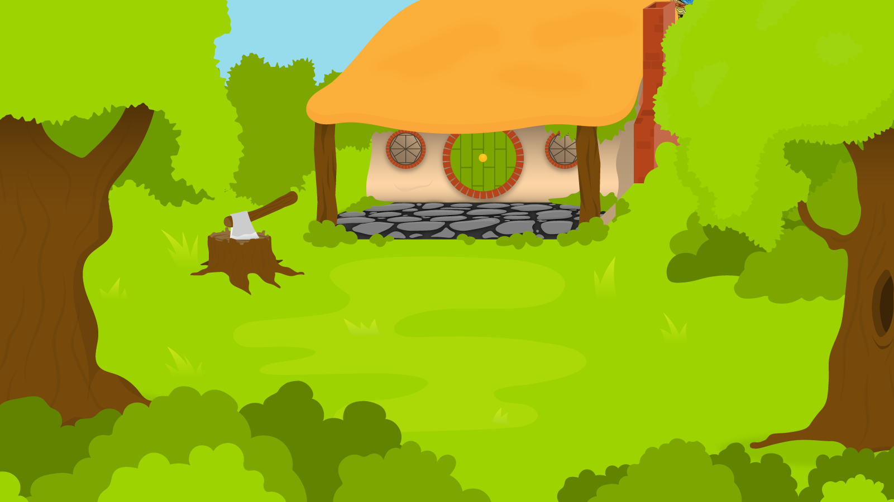
Can you fix the tenses of the verbs in the below sentences?
1 Minute Timer
GO!
Time’s Up!
Glen worked hard and takes lots of breaks.
Zach loved to play and loves to run.
Hannah played piano and sings.
GO!
Last 15 seconds!
TIME’S UP!
Start

Slide 12
How about?
1 Minute Timer
Glen worked hard and took lots of breaks.
Glen works hard and takes lots of breaks.
2. Zach loves to play and loves to run.
Zach loved to play and loved to run.
3. Hannah played piano and sang.
Hannah plays piano and sings.
TIME’S UP!

