Slide 1
How to Use this Powerpoint
These slides have been designed to be used in Powerpoint as a Slide Show.
There are text and images that will overlap and cause confusion, if used in desktop mode.
To open this in Slide Show mode, please click “Slide Show” on the menu above and then “From Beginning”.
Thank you from the Emile Team.
If you have any feedback, or would just like to say “hello”, please email us at: hello@emile-education.com

Slide 2
Adverbs

Slide 3
Does anyone remember what a verb is?
A verb is an action word.
Can you think of
any examples of verbs?

Slide 4
These words are ALL verbs.
to cook
to talk
to run
cooking
talking
running
cooked
talked
ran
Verbs can be quite dull and uninteresting.

Slide 5
Which of these words are verbs?
to walk
to walk - verb
student - noun
to listen
studying - verb
student
to listen - verb
studying
to watch
to watch - verb
to like
to like - verb
to study - verb
to study
studied - verb
studied
to wander - verb
to learn - verb
courage
to collect - verb
to wander
to learn
courage - noun
to collect
winning - verb
winning
London - noun
to work - verb
whiteboard - noun
London
to work
whiteboard
to win - verb
wanted
to entertain
to win
wanted - verb
to entertain
to play - verb
to play

Slide 6
Can you spot the verbs in these sentences?
Can you spot two things in this sentence?
Students like school.
The word “students” is a noun.
The word “school” is a noun.
The word “like” is a verb.
Teachers drive cars.
The word “teachers” is a noun.
The word “cars” is a noun.
The word “drive” is a verb.

Slide 7
Does anyone know what an adverb is?
An adverb is a word that describes a verb.
Can you think of any
examples of adverbs?

Slide 8
These words are ALL adverbs.
angrily
usually
today
easily
happily
never
soon
gladly
quickly
sometimes
eventually
honestly
wisely
here
first
really
bravely
anywhere
hourly
very
Adverbs make verbs more interesting!

Slide 9
How can we make these sentences more interesting?
One way is to introduce adverbs!
Can you spot two things in this sentence?
More adverbs!
How can we make these sentences
even more interesting?
Girls play football.
Girls boldly play football.
Girls boldly and passionately play football.
Boys write stories.
Boys excitedly write stories.
Boys excitedly and secretly write stories.

Slide 10
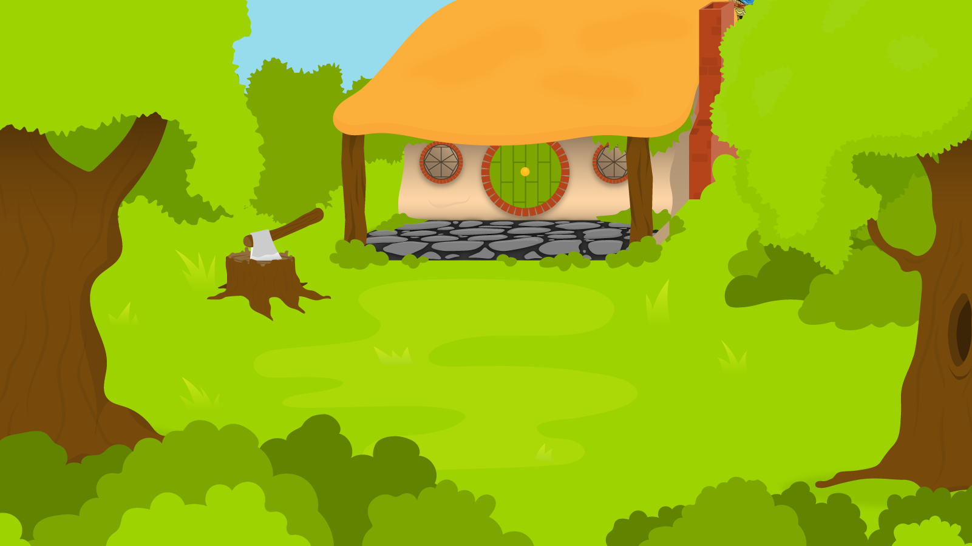
Below are 3 sentences. You have 1 minute to think of an adverb to add each sentence!
1 Minute Timer
GO!
Time’s Up!
1. Aimee flies above the ground.
2. The boy talks in the classroom.
3. The girl chats on her phone.
GO!
Last 15 seconds!
TIME’S UP!
Start

Slide 11
How about?
1 Minute Timer
1. Aimee flies calmly above the ground.
2. The boy talks excitedly in the classroom.
3. The girl rarely chats on her phone.
TIME’S UP!

