Slide 1
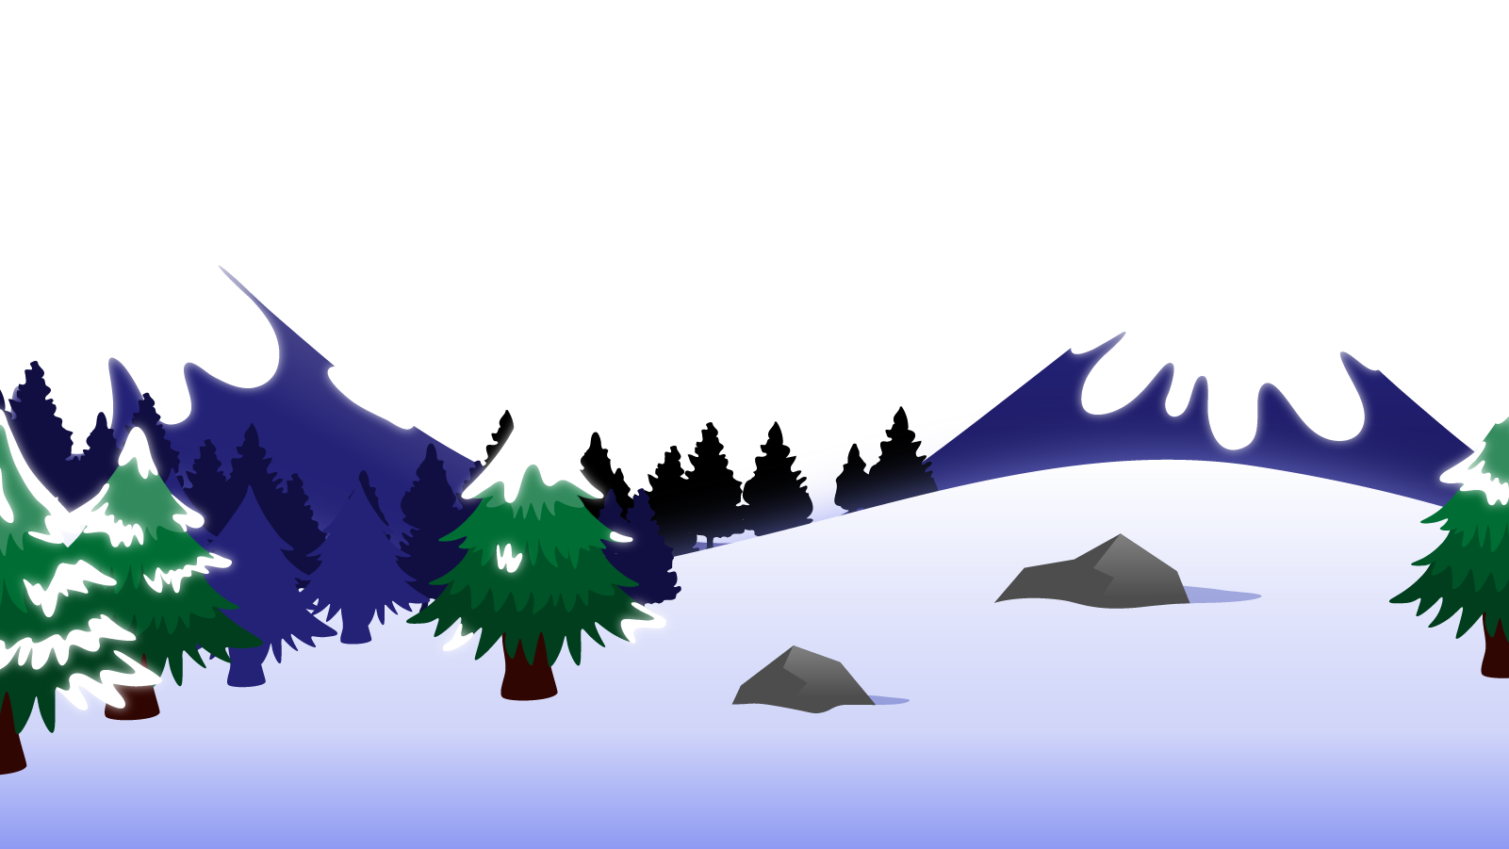
How to Use this Powerpoint
These slides have been designed to be used in Powerpoint as a Slide Show.
There are text and images that will overlap and cause confusion, if used in desktop mode.
To open this in Slide Show mode, please click “Slide Show” on the menu above and then “From Beginning”.
Thank you from the Emile Team.
If you have any feedback, or would just like to say “hello”, please email us at: hello@emile-education.com

Slide 2
Creating nouns using prefixes

Slide 3
Can anyone remember what a
prefix is?

Slide 4
A prefix is a group of letters that go at the beginning of a root word and change the meaning of the word.
prefix
root word
dis
agree
dis + agree = disagree

Slide 5
What sort of words are these?
These words are all verbs.
Can anyone think of any prefixes and examples?
The prefix dis-
disagree
disobey
The prefix mis-
misbehave
mislead
The prefix re-
redo
refresh

Slide 6
What about making nouns with the prefixes below?
Can you think of any?
The prefix dis-
discovery
disease
The prefix mis-
misjudgement
mistake
The prefix re-
reflection
rejection
This is a great way to learn how to spell more words and be able to work out the meaning of new words!

