Slide 1
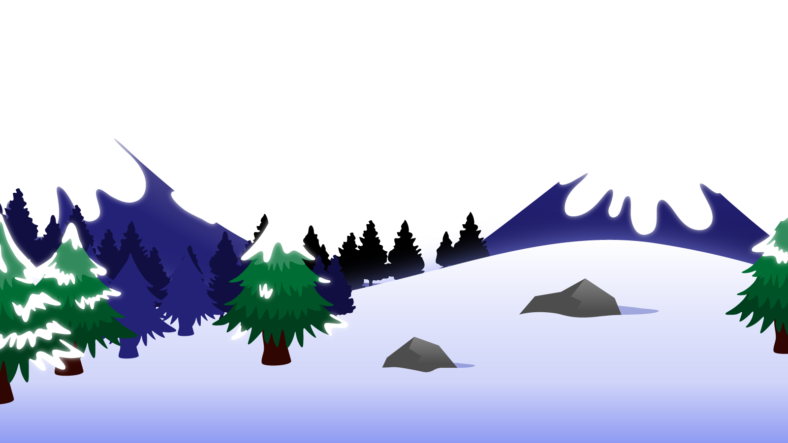
How to Use this Powerpoint
These slides have been designed to be used in Powerpoint as a Slide Show.
There are text and images that will overlap and cause confusion, if used in desktop mode.
To open this in Slide Show mode, please click “Slide Show” on the menu above and then “From Beginning”.
Thank you from the Emile Team.
If you have any feedback, or would just like to say “hello”, please email us at: hello@emile-education.com

Slide 2
Present Perfect & Simple Past

Slide 3
The cat sat on the mat.
Does anyone remember what type of word “sat” is?
Action words are called verbs.
“sat” is the verb in this sentences.

Slide 4
What is the difference between
these two sentences?
The cat has sat on the mat.
The cat sat on the mat.
When did the cat sit on the mat in each sentence?
In both sentences, the cat sat on the mat in the past.
In one sentence, the cat is still sat on the mat now.
In one sentence, the cat may no longer be sat on the mat.

Slide 5
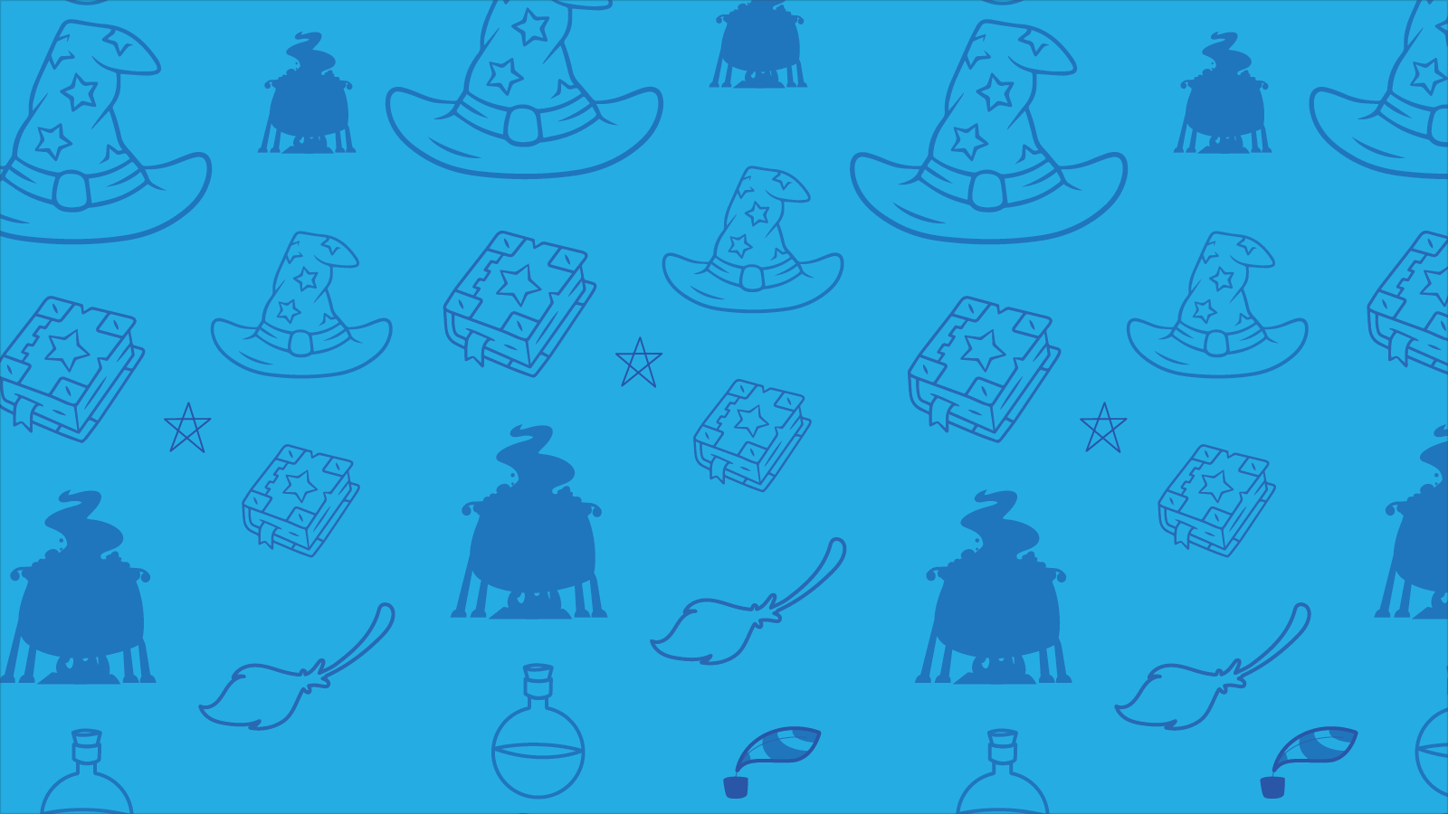
Present Perfect vs Simple Past
Present perfect
Simple Past
Happened in the past and
may continue now.
Happened in the past and stopped.
Uses “has” or “have”.
Usually ends in “ed”.
I have played football since I could walk.
I played football last year.

Slide 6
Simple past
Present perfect
My mother loved Raggedy Ann.
My mother has loved Raggedy Ann.
Started and finished in the past.
Started in the past and still ongoing.
(
Now
The present
The past
The future
Present perfect
has loved
Simple past
loved

Slide 7
Which paragraph is using the present perfect and which paragraph is using the simple past? How do you know?
Simple past
Present perfect
My mother loved Raggedy Ann.
In my room, Raggedy Ann sat, a trifle loppy and loose-jointed.
Evidently, Raggedy ate chocolate as there was some smeared on her face.
My mother has loved Raggedy Ann.
In my room, Raggedy Ann has sat, a trifle loppy and loose-jointed.
Evidently, Raggedy has eaten chocolate as there was some smeared on her face.
My mother loved Raggedy Ann.
In my room, Raggedy Ann sat, a trifle loppy and loose-jointed.
Evidently, Raggedy ate chocolate as there was some smeared on her face.
My mother has loved Raggedy Ann.
In my room, Raggedy Ann has sat, a trifle loppy and loose-jointed.
Evidently, Raggedy has eaten chocolate as there was some smeared on her face.
The simple past happened in the past and stopped.
The present perfect happened in the past and continues.

Slide 8
Which tense is used in each sentence?
Identify the verbs.
The boy has played football yesterday.
The boy has played football yesterday
The boy played football yesterday
The boy has played football yesterday. Present perfect tense.
The boy played football yesterday.
The boy played football yesterday.
Simple past tense.
The girl arrived home just now.
The girl arrived home just now.
The girl has arrived home just now.
The girl has arrived home just now.
Present perfect tense.
The girl has arrived home just now.
The girl arrived home just now.
Simple past tense.
At Christmas, the children have received lots of presents.
Present perfect tense.
At Christmas, the children have received lots of presents.
At Christmas, the children have received lots of presents.
At Christmas, the children received lots of presents.
Simple past tense.
At Christmas, the children received lots of presents.
At Christmas, the children received lots of presents.

Slide 9
Identify the verb.
Identify the verb.
Change the verb from the simple past
to the present perfect tense.
A ball bounced.
A ball bounced.
A ball has bounced.
The girl kicked.
The girl kicked.
The girl has kicked.
The dog barked.
The dog barked.
The dog has barked.
The boys sang.
The boys sang.
The boys have sung.
The teachers smiled.
The teachers smiled.
The teachers have smiled.

Slide 10
Identify the verb.
Identify the verb.
Change the verb from
the present perfect to the simple past tense.
A man has walked.
A man has walked.
A man walked.
The women has shouted.
The women has shouted.
The women shouted.
The cat has purred.
The cat has purred.
The cat purred.
A girl has run.
A girl has run.
A girl ran.
The king has thought.
The king has thought.
The king thought.

