Slide 1
How to Use this Powerpoint
These slides have been designed to be used in Powerpoint as a Slide Show.
There are text and images that will overlap and cause confusion, if used in desktop mode.
To open this in Slide Show mode, please click “Slide Show” on the menu above and then “From Beginning”.
Thank you from the Emile Team.
If you have any feedback, or would just like to say “hello”, please email us at: hello@emile-education.com

Slide 2
Conjunctions – Co-ordinating & Subordinating

Slide 3
Does anyone remember what
a co-ordinating conjunction is?
A co-ordinating conjunction is a word that is used to join two sentences.
Sentence
1
Sentence
2
Compound
Sentence
Conjunction

Slide 4
When a sentence becomes part of another sentence, it becomes an “independent clause”.
(You can’t have a sentence inside another sentence as there would be too many capital letters and full stops!)
Sentence
1
Co-ordinating
conjunction
Sentence
2
Compound
Sentence
This is better/more correct:
Independent
clause 1
Co-ordinating
conjunction
Independent
clause 2
Compound
Sentence

Slide 5
Join the two sentences below
using the co-ordinating conjunction “and”.
Emile is an alien.
and
Aimee is a robot.
Independent
clause 1
Co-ordinating
Conjunction
Independent
clause 2
Emile is an alien and Aimee is a robot.
It is a compound sentence.
What type of sentence is this?

Slide 6
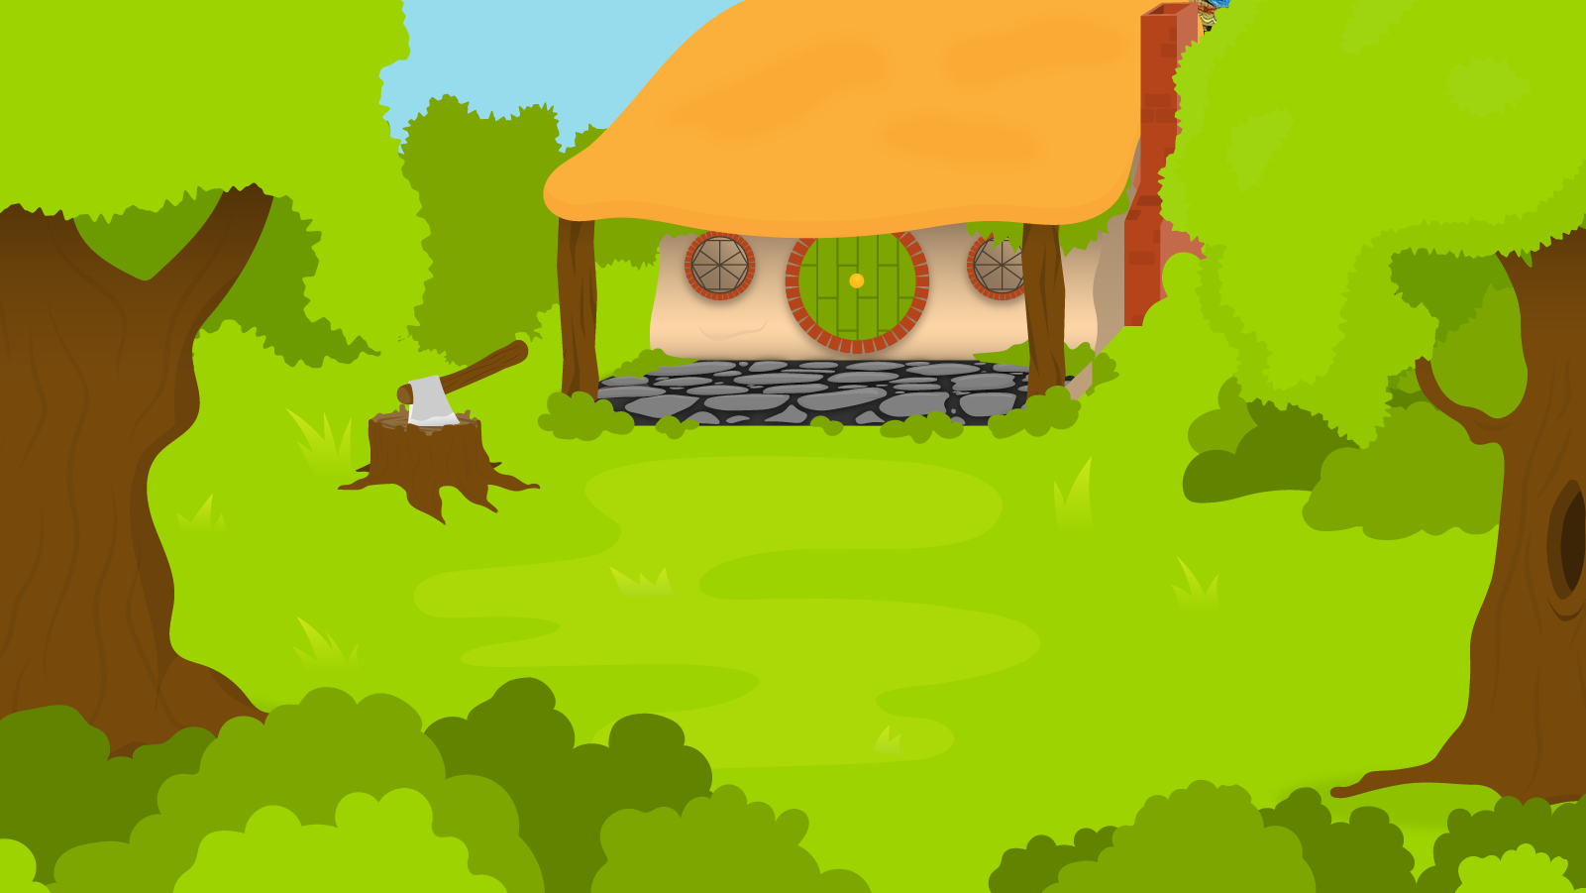
Below are the 7 co-ordinating conjunctions. You have 1 minute to memorise them! (Remember FANBOYS)
1 Minute Timer
GO!
Time’s Up!
1. For
2. And
3. Nor
4. But
5. Or
6. Yet
7. So
GO!
Last 15 seconds!
TIME’S UP!
Start

Slide 7
How many did you remember?
1 Minute Timer
1.
2.
3.
4.
5.
6.
7.
For
Or
And
Yet
Nor
So
But
TIME’S UP!

Slide 8
Sentences are not just made up of independent clauses!
I loved grammar lessons when I was a child.
An independent clause as it expresses a whole thought.
It would be fine as a sentence on its own.
Not an independent clause as it does not express a whole thought.
It does not make sense as a sentence on its own.

Slide 9
A clause which does not express a complete thought is called a “subordinate clause”.
Subordinating conjunction
The cat meowed happily until it saw a dog.
An independent clause as it expresses a whole thought.
It would be fine as a sentence on its own.
Not an independent clause as it does not express a whole thought.
It does not make sense as a sentence on its own.

Slide 10
When you join two sentences,
you use a co-ordinating conjunction to join them
and make a compound sentence.
Independent
Clause
Co-ordinating
Conjunction
Independent
Clause
Compound
Sentence
When you join a sentence to a subordinate clause,
you use a subordinating conjunction to join them,
and make a complex sentence.
Independent
clause
Subordinating
Conjunction
Subordinate
Clause
Complex
Sentence

Slide 11
Can you fill in the gaps?
Independent
clause
Co-ordinating
Conjunction
Independent
clause
Compound
Sentence
Independent
clause
Subordinating
Conjunction
Subordinating
clause
Complex
Sentence
Independent
clause
Subordinating Conjunction
Subordinating
clause
Complex Sentence
Subordinating Conjunction
Subordinating
clause
,
Independent
clause
Complex Sentence

