Slide 1
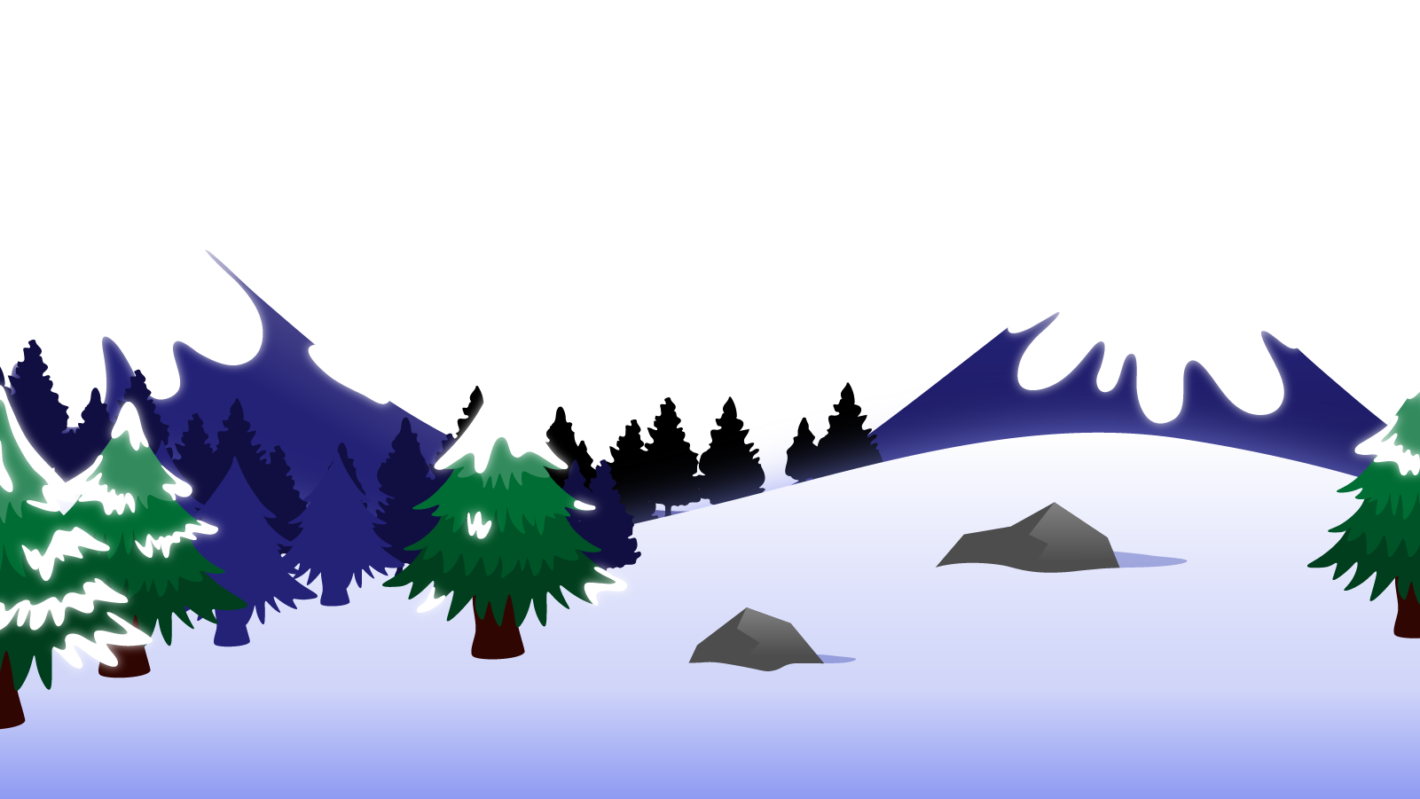
How to Use this Powerpoint
These slides have been designed to be used in Powerpoint as a Slide Show.
There are text and images that will overlap and cause confusion, if used in desktop mode.
To open this in Slide Show mode, please click “Slide Show” on the menu above and then “From Beginning”.
Thank you from the Emile Team.
If you have any feedback, or would just like to say “hello”, please email us at: hello@emile-education.com

Slide 2
Adverbs

Slide 3
Can anyone remember what an adverb is?
An adverb is a word that
describes a verb.
Adverbs usually end in the suffix “ly”.

Slide 4
Can you spot the adverb this sentence?
Can you spot the verb this sentence?
“Quietly” describes the verb - how Emile sat.
It is the adverb.
Emile sat quietly in the rocket.
“sat” is the verb

Slide 5
Can you spot the adverb this sentence?
Can you spot the verb this sentence?
“Carefully” describes the verb - how Aimee thought.
It is the adverb.
Aimee thought carefully about the question.
“Thought” is the verb

Slide 6
Most adverbs describe the manner in which a verb is performed.
A man walks quickly.
A man walks confidently.
A man walks thoughtlessly.
A man walks funnily.
A man walks clumsily.
A man walks gracefully.
A man walks jauntily.
A man walks cautiously.
A man walks purposely.
A man walks slowly.
A man walks cheerfully.
A man walks gingerly.
A man walks energetically.
A man walks aimlessly.
A man walks casually.
These adverbs of manner nearly always end in “ly”.

Slide 7
There are other types of adverbs.
Three common types of adverb are:
Adverbs of place
Adverbs of time
Adverbs of cause
Near,
There,
Here,
Behind
Soon,
Yesterday,
Every day,
Often
Because,
As,
However,
So that
These adverbs rarely end in “ly”.

Slide 8
Adverbs of place
Adverbs of place tell you where the verb happened.
Near,
There,
Here,
Behind
Can you think of a sentence that uses an adverb of place?

Slide 9
Adverbs of place
Can you spot the adverb of place?
Near,
There,
Here,
Behind
I will be playing football there.
I will be playing football there.
I play football behind the school.
I play football behind the school.
I played football near the school.
I played football near the school.

Slide 10
Adverbs of time
Adverbs of time tell you when the verb happened, how long it happened for or how often it happens.
Soon,
Yesterday,
Every day,
Often
Can you think of a sentence that uses an adverb of time?

Slide 11
Adverbs of time
Can you spot the adverb of time?
Soon,
Yesterday,
Every day,
Often
I will be playing football soon.
I will be playing football soon.
I play football often.
I play football often.
I played football yesterday.
I played football yesterday.

Slide 12
Adverbs of cause
Adverbs of cause tell you why the verb happened.
Because,
As,
However,
So that
Can you think of a sentence that uses an adverb of cause?

Slide 13
Adverbs of cause
Can you spot the adverb of cause?
Because,
As,
However,
So that
I play football because I like to.
I play football because I like to.
I play football so that I improve.
I play football so that I improve.
I played football, however, I would like to play cricket.
I played football, however, I would like to play cricket.

Slide 14
Below are five adverbs. Can you tell if they are adverbs of time, place or cause? You have 1 minute!
1 Minute Timer
Time’s Up!
GO!
Later
Consequently
Today
Nearby
Everywhere
GO!
Last 15 seconds!
TIME’S UP!
Start

Slide 15
How many did you get correct?
1 Minute Timer
Later
Consequently
Today
Nearby
Everywhere
= adverb of time
= adverb of place
= adverb of place
= adverb of time
= adverb of cause
TIME’S UP!

