Slide 1
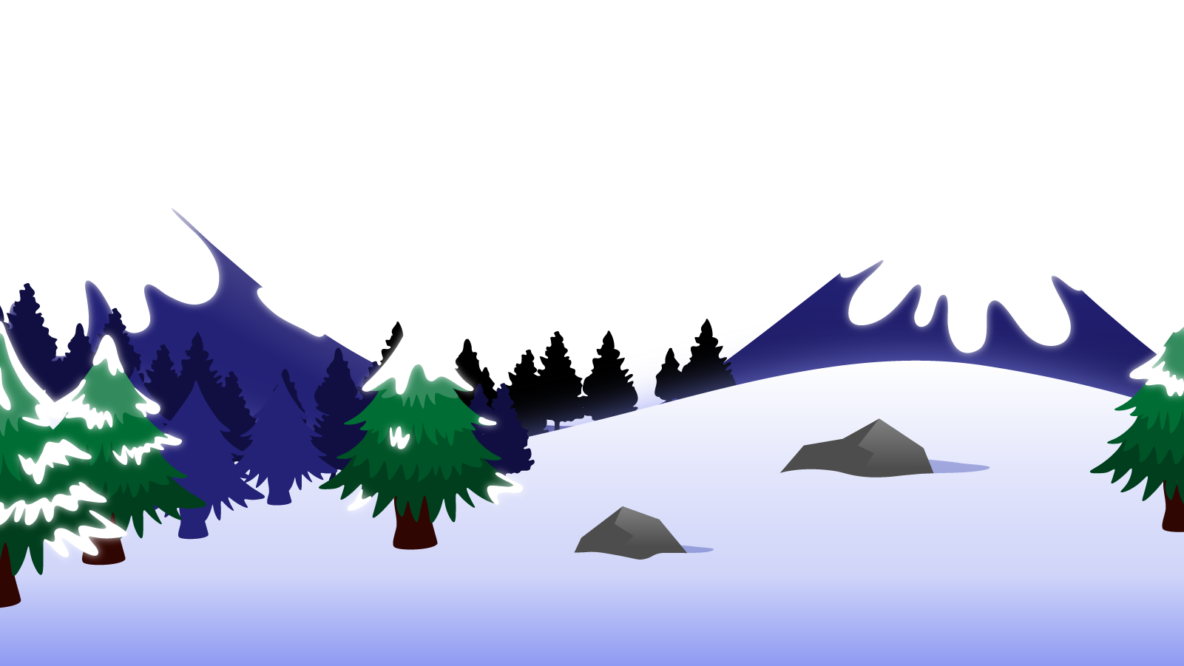
How to Use this Powerpoint
These slides have been designed to be used in Powerpoint as a Slide Show.
There are text and images that will overlap and cause confusion, if used in desktop mode.
To open this in Slide Show mode, please click “Slide Show” on the menu above and then “From Beginning”.
Thank you from the Emile Team.
If you have any feedback, or would just like to say “hello”, please email us at: hello@emile-education.com

Slide 2
Prepositions

Slide 3
Does anyone know what a preposition is?
A preposition is a word that describes where or when something is in relation to something else.
Noun 1
Noun 2
Preposition

Slide 4
Which word describes where Emile is in relation to the rocket?
Can you spot the verb this sentence?
Can you spot two nouns in this sentence?
“In” describes where Emile is in relation to the rocket.
It is the preposition.
Emile sat in the rocket.
Noun 1 is Emile
Noun 2 is the rocket
“Sat” is the verb

Slide 5
Can you spot the verb this sentence?
Which word describes where Scrambler is in relation to the planet?
Can you spot two nouns in this sentence?
“On” describes where Scrambler is in relation to the planet.
It is the preposition.
Scrambler landed on the planet.
Noun 1 is Scrambler
Noun 2 is the planet
“landed” is the verb

Slide 6
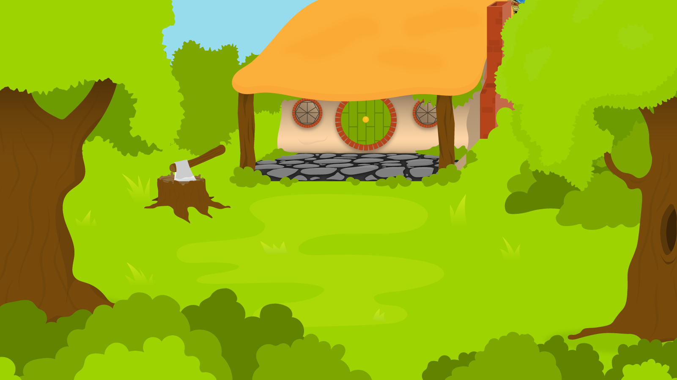
Below are 3 sentences each with one preposition. You have 1 minute to find them!
1 Minute Timer
Time’s Up!
GO!
1. Aimee flies above the ground.
2. The boy was in the classroom.
3. The girl was on her phone.
GO!
Last 15 seconds!
TIME’S UP!
Start

Slide 7
How many did you find?
1 Minute Timer
1. Aimee flies above the ground.
2. The boy was in the classroom.
3. The girl was on her phone.
TIME’S UP!

