Slide 1
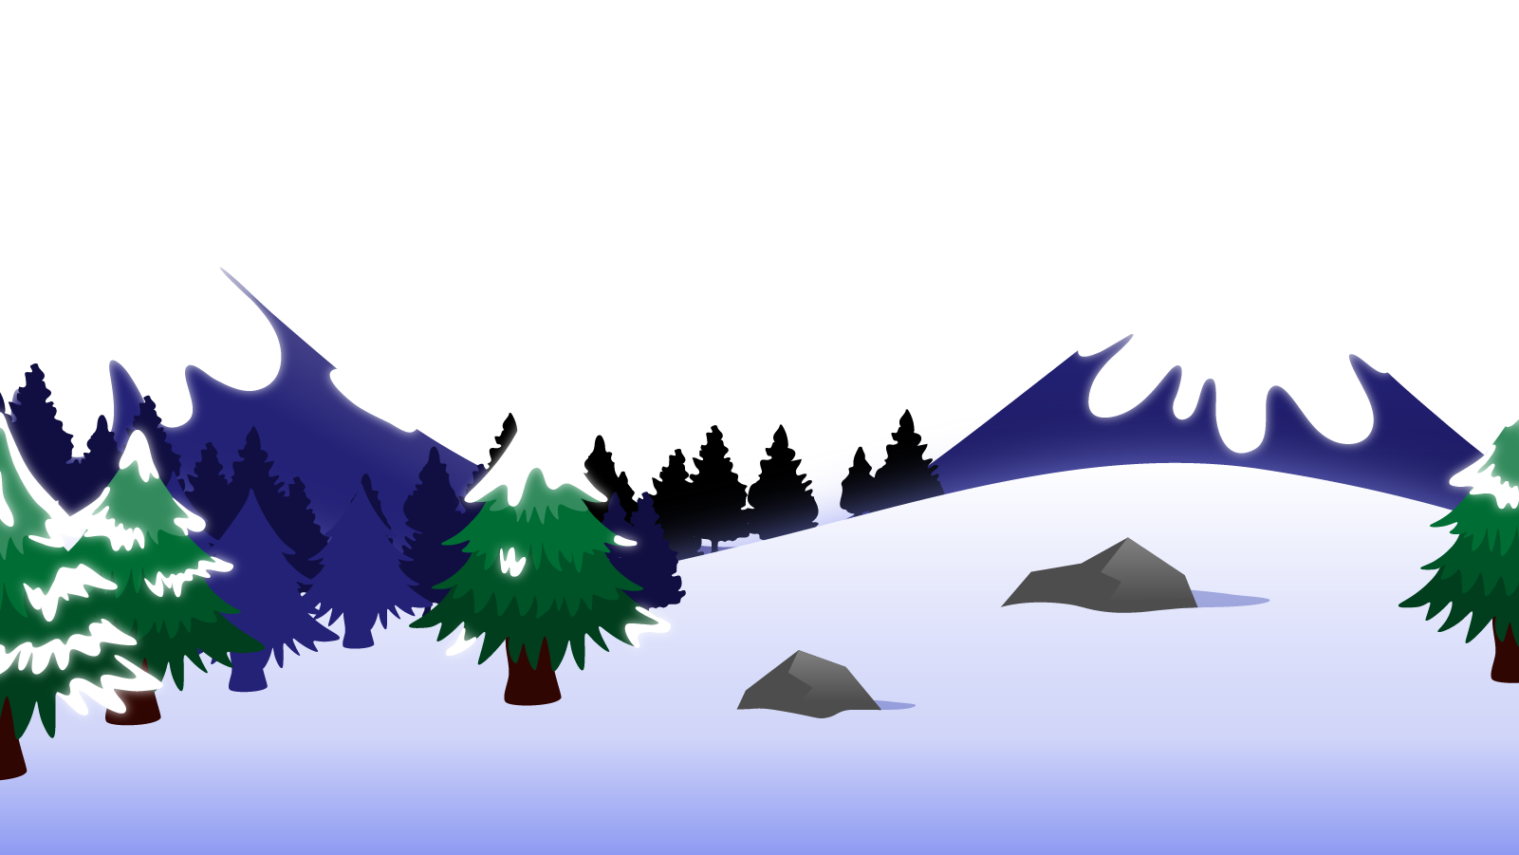
How to Use this Powerpoint
These slides have been designed to be used in Powerpoint as a Slide Show.
There are text and images that will overlap and cause confusion, if used in desktop mode.
To open this in Slide Show mode, please click “Slide Show” on the menu above and then “From Beginning”.
Thank you from the Emile Team.
If you have any feedback, or would just like to say “hello”, please email us at: hello@emile-education.com

Slide 2
Prepositions

Slide 3
Does anyone remember what a preposition is?
A preposition is a word that describes where or when something is in relation to something else.
Noun 1
Noun 2
Preposition

Slide 4
Can you spot the verb this sentence?
Which word describes where Emile is in relation to the rocket?
Can you spot two nouns in this sentence?
“In” describes where Emile is in relation to the rocket.
It is the preposition.
Emile sat in the rocket.
Noun 1 is Emile
Noun 2 is the rocket
“Sat” is the verb

Slide 5
Prepositions can be used to describe place, time or cause between two nouns.
Preposition of place
Preposition of time
Preposition of cause
Between,
In,
On,
Behind
At,
In,
On
Due to,
For,
Because of
It can depend on the context where “in” or “on” are prepositions of place or time.

Slide 6
Can you spot the prepositions of place?
Prepositions can be used to describe place, time or cause between two nouns.
Preposition of place
I played football between the buildings.
I played football between the buildings.
I played football in a field.
I played football in a field.
Between,
In,
On,
Behind
I played football on a pitch.
I played football on a pitch.
I played football behind a school.
I played football behind a school.

Slide 7
Prepositions can be used to describe place, time or cause between two nouns.
Can you spot the prepositions of time?
Preposition of time
I played football at noon.
I played football at noon.
I played football in an hour.
I played football in an hour.
At,
In,
On
I played football on Saturday.
I played football on Saturday.
I played football in a field.
I played football on a pitch.

Slide 8
Can you spot the prepositions of cause?
Prepositions can be used to describe place, time or cause between two nouns.
Preposition of cause
I played football due to the field flooding.
I played football due to the field flooding.
I play football for a team.
I play football for a team.
Due to,
For,
Because of
I play football because of my brother.
I play football because of my brother.

Slide 9
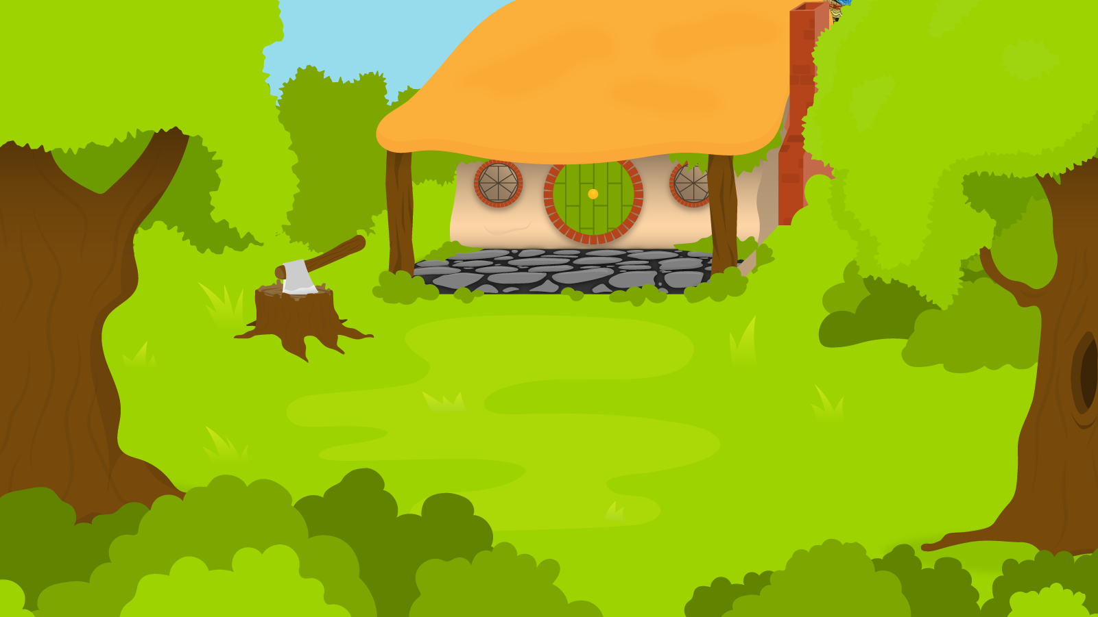
Below are 5 sentences each with one preposition. You have 1 minute to determine what type of preposition they are!
1 Minute Timer
Time’s Up!
GO!
Aimee flies between rockets.
Aimee flies at 2pm.
Aimee flies due to her jets.
Aimee flies fastest on Saturdays.
Aimee flies in the rocket.
GO!
Last 15 seconds!
TIME’S UP!
Start

Slide 10
How did you do?
1. Aimee flies between rockets.
Preposition of place.
1 Minute Timer
2. Aimee flies at 2pm.
Preposition of time.
3. Aimee flies due to her jets.
Preposition of cause.
4. Aimee flies fastest on Saturdays.
Preposition of time.
TIME’S UP!
5. Aimee flies in the rocket.
Preposition of place.

