Slide 1
How to Use this Powerpoint
These slides have been designed to be used in Powerpoint as a Slide Show.
There are text and images that will overlap and cause confusion, if used in desktop mode.
To open this in Slide Show mode, please click “Slide Show” on the menu above and then “From Beginning”.
Thank you from the Emile Team.
If you have any feedback, or would just like to say “hello”, please email us at: hello@emile-education.com

Slide 2
Paragraphs

Slide 3
Does anyone know what a paragraph is?
A paragraph is a group of sentences that talk about the same idea or topic.

Slide 4
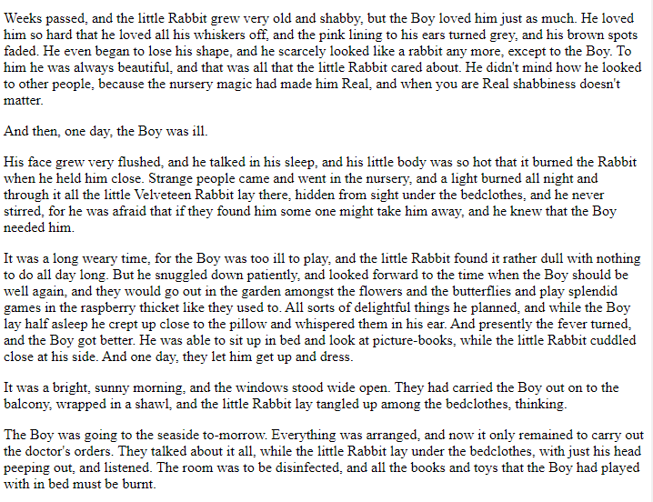
Does anyone know how to recognise when one paragraph has finished and the next has started?
Paragraphs are usually separated by a missing line.

Slide 5
1
2
How many paragraphs are shown?
3

Slide 6
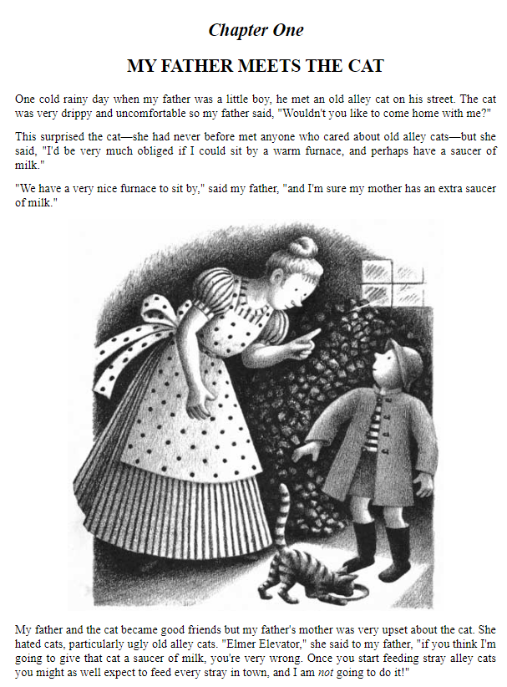
1
How many paragraphs are shown?
2
3
4

Slide 7
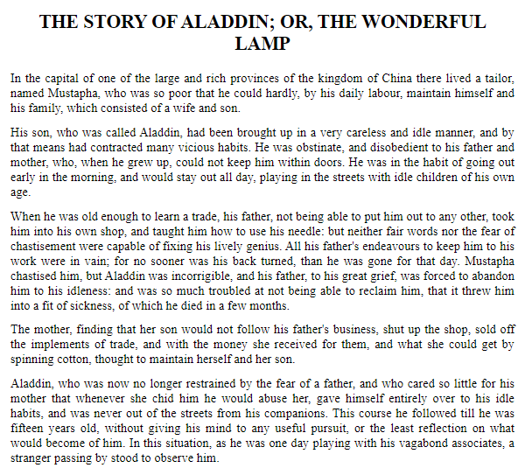
1
How many paragraphs are shown?
2
3
4
5

Slide 8
Now you know what paragraphs look like.
When will you use
paragraphs
in your writing?

Slide 9
Can you organise these sentences into paragraphs?
Computers started to appear in homes in the 1980s.
The early home computers usually included monitors, keyboards and a disc drive.
Some computers came in kits for the owner to build like Lego!
Early home computers were used for writing documents and playing games.
This was of course before the internet when games came on discs.

Slide 10
Can you organise these sentences into paragraphs?
This paragraph introduces the topic
Computers started to appear in homes in the 1980s.
The early home computers usually included monitors, keyboards and a disc drive. Some computers came in kits for the owner to build like Lego!
Early home computers were used for writing documents and playing games. This was of course before the internet when games came on discs.
This paragraph explains what parts they had.
This paragraph explains how computers were used.

Slide 11
Can you organise these sentences into paragraphs?
The Olympic Games are the world’s leading sports event held every 4 years.
Athletes from more than 200 countries compete in them.
The Olympic Games were first held in ancient Greece at a site called Olympia.
The ancient Greek Games lasted until 393 ce.
The Olympics were revived in the late 1800s.
The Games that began then are called the modern Olympics.
The International Olympic Committee (IOC) governs the modern Games.
It was founded in 1894.
Its headquarters are in Lausanne, Switzerland.
The IOC decides on the sports to include in the Olympics.
It also chooses the cities that will host the Games.
For example, London was chosen to host the Summer Olympics in 2012.
In addition to the IOC, each country has its own national Olympic committee.

Slide 12
Can you organise these sentences into paragraphs?
This paragraph introduces the topic
The Olympic Games are the world’s leading sports event held every 4 years. Athletes from more than 200 countries compete in them.
The Olympic Games were first held in ancient Greece at a site called Olympia. The ancient Greek Games lasted until 393 ce. The Olympics were revived in the late 1800s. The Games that began then are called the modern Olympics.
The International Olympic Committee (IOC) governs the modern Games. It was founded in 1894. Its headquarters are in Switzerland. The IOC decides on the sports to include in the Olympics. It also chooses the cities that will host the Games.
For example, London was chosen to host the Summer Olympics in 2012. In addition to the IOC, each country has its own national Olympic committee.
This paragraph explains about the ancient Olympic Games
This paragraph introduces the IOC.

