Slide 1
How to Use this Powerpoint
These slides have been designed to be used in Powerpoint as a Slide Show.
There are text and images that will overlap and cause confusion, if used in desktop mode.
To open this in Slide Show mode, please click “Slide Show” on the menu above and then “From Beginning”.
Thank you from the Emile Team.
If you have any feedback, or would just like to say “hello”, please email us at: hello@emile-education.com

Slide 2
Apostrophes of omission.

Slide 3
Does anyone know what an apostrophe looks like?
An apostrophe looks like this ’

Slide 4
To show who owns something, we can use an apostrophe.
The boy’s toy.
The teacher’s pen.
The girl’s ball.
Can you spot the apostrophes?

Slide 5
An apostrophe can also be used to show there are missing letters.
I cannot = I can’t
I am = I’m
I do not = I don’t
It is = It’s
Can you spot the apostrophes?

Slide 6
An apostrophe for missing letters should only be written when used informally or as part of speech.
“And so,” he went on good-naturedly, “there ought to be one fairy for every boy and girl.”
“Ought to be? Isn’t there?”
“No. You see children know such a lot now, they soon don’t believe in fairies, and every time a child says, ‘I don’t believe in fairies,’ there is a fairy somewhere that falls down dead.”
Really, he thought they had now talked enough about fairies, and it struck him that Tinker Bell was keeping very quiet. “I can’t think where she has gone to,” he said, rising, and he called Tink by name. Wendy’s heart went flutter with a sudden thrill.
“Peter,” she cried, clutching him, “you don’t mean to tell me that there is a fairy in this
room!”
“She was here just now,” he said a little impatiently. “You don’t hear her, do you?” and they both listened.
“And so,” he went on good-naturedly, “there ought to be one fairy for every boy and girl.”
“Ought to be? Isn’t there?”
“No. You see children know such a lot now, they soon don’t believe in fairies, and every time a child says, ‘I don’t believe in fairies,’ there is a fairy somewhere that falls down dead.”
Really, he thought they had now talked enough about fairies, and it struck him that Tinker Bell was keeping very quiet. “I can’t think where she has gone to,” he said, rising, and he called Tink by name. Wendy’s heart went flutter with a sudden thrill.
“Peter,” she cried, clutching him, “you don’t mean to tell me that there is a fairy in this
room!”
“She was here just now,” he said a little impatiently. “You don’t hear her, do you?” and they both listened.
Can you spot the apostrophes?

Slide 7
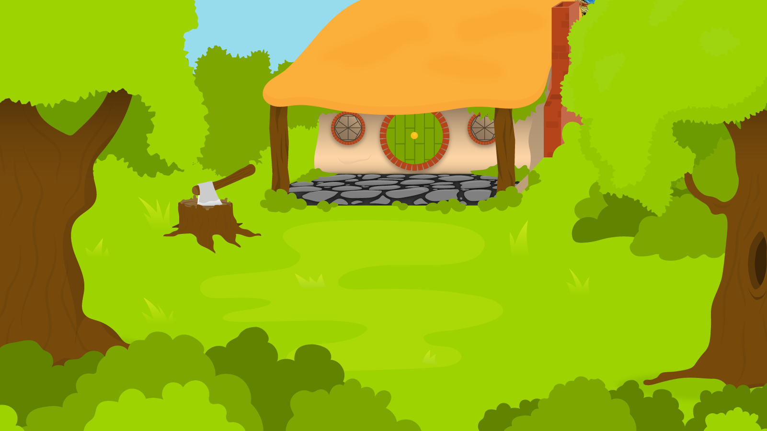
Below are 3 words with apostrophes of omission. You have 1 minute to remove the apostrophes and reveal the original words!
1 Minute Timer
GO!
Time’s Up!
1. I’m.
2. Should’ve.
3. Wouldn’t.
GO!
Last 15 seconds!
TIME’S UP!
Start

Slide 8
How did you do?
1 Minute Timer
1. I’m
= I am
2. Should’ve
= should have
3. Wouldn’t
= would not
TIME’S UP!

