Slide 1
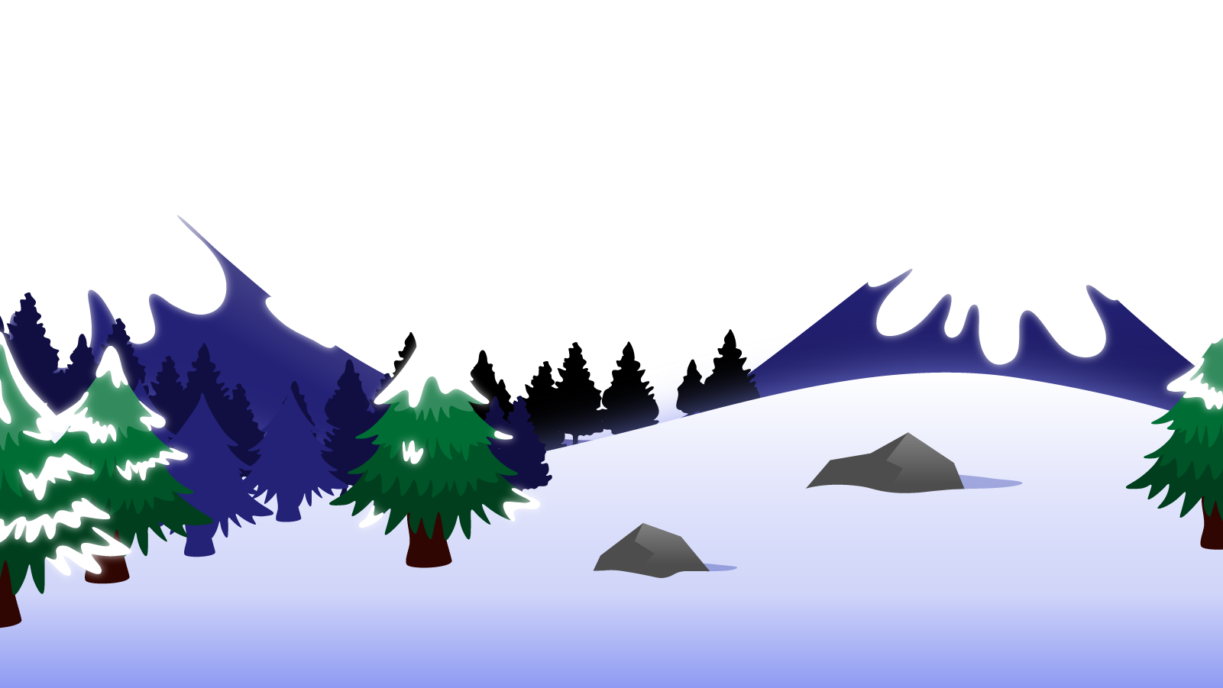
How to Use this Powerpoint
These slides have been designed to be used in Powerpoint as a Slide Show.
There are text and images that will overlap and cause confusion, if used in desktop mode.
To open this in Slide Show mode, please click “Slide Show” on the menu above and then “From Beginning”.
Thank you from the Emile Team.
If you have any feedback, or would just like to say “hello”, please email us at: hello@emile-education.com

Slide 2
Fronted Adverbials

Slide 3
Does anyone remember what a verb is?
A verb is an action word.
Can you think of
any examples of verbs?

Slide 4
These words are ALL verbs.
to cook
to talk
to run
cooking
talking
running
cooked
talked
ran
Verbs can be quite dull and uninteresting.

Slide 5
Can you spot the verbs in these sentences?
Can you spot two things in this sentence?
Students like school.
The word “students” is a plural noun.
The word “school” is a singular noun.
The word “like” is a verb.
Teachers drive cars.
The word “teachers” is a plural noun.
The word “cars” is a singular noun.
The word “drive” is a verb.

Slide 6
Does anyone know what an adverb is?
An adverb is a word that describes a verb.
Can you think of any
examples of adverbs?

Slide 7
These words are ALL adverbs.
angrily
usually
today
easily
happily
never
soon
gladly
quickly
sometimes
eventually
honestly
wisely
here
first
really
bravely
anywhere
hourly
very
Adverbs make verbs more interesting!

Slide 8
How can we make these sentences more interesting?
One way is to introduce adverbs!
Can you spot two things in this sentence?
More adverbs!
How can we make these sentences
even more interesting?
Girls play football.
Girls boldly play football.
Girls boldly and passionately play football.
Boys write stories.
Boys excitedly write stories.
Boys excitedly and secretly write stories.

Slide 9
Does anyone know what an adverbial is?
An adverbial is a word or phrase that describes a verb.

Slide 10
What is the difference between an adverb and an adverbial?
An adverbial is a word or phrase that describes a verb.
An adverb is a word that describes a verb.

Slide 11
All adverbs are adverbials.
(But not all adverbials are adverbs!)
Adverbials
(a word or phrase that describes a verb).
Adverbs
(a word that describes a verb).
A Venn diagram

Slide 12
Adverb or adverbial?
angrily
These words can all describe verbs.
happily
usually
They are all words and not phrases.
here
today
hourly
So they are all adverbs and adverbials.
really

Slide 13
Adverb or adverbial?
in a silly way
These phrases can all describe verbs.
very happily
during the week
They are all phrases and not single words.
like a baby
right here
surprisingly well
So they are all adverbials and NOT adverbs.
for health

Slide 14
Adverb or adverbial?
in a minute
This is a phrase and so is an adverbial
boldly
This is a word and so is an adverb and an adverbial
near here
This is a phrase and so is an adverbial
to find gold
This is a phrase and so is an adverbial
frighteningly
This is a word and so is an adverb and an adverbial
surprisingly
This is a word and so is an adverb and an adverbial
in the corner
This is a phrase and so is an adverbial

Slide 15
What is a fronted adverbial?
A fronted adverbial is simply
an adverbial used at the start of a sentence.
Can you use the below adverbials in a sentence so that they are fronted adverbials?
in a minute
In a minute, the film would start.
near here
Near here, there was a famous battle.
to find gold
To find gold, I dug in the field.
in the corner
In the corner, the child sat.

Slide 16
Can you identify the verb being described by the fronted adverbial?
In a minute, the film would start.
In a minute, the film would start.
Near here, there was a famous battle.
Near here, there was a famous battle.
To find gold, I dug in the field.
To find gold, I dug in the field.
In the corner, the child sat.
In the corner, the child sat.

Slide 17
Fronted adverbial – what do they do??
Fronted adverbials make your writing more interesting.
I wake up in the morning. I dress myself. I eat breakfast quickly.
In the morning, I wake up and dress myself. Quickly, I eat breakfast.
The second sentence is more interesting.

