Slide 1
How to Use this Powerpoint
These slides have been designed to be used in Powerpoint as a Slide Show.
There are text and images that will overlap and cause confusion, if used in desktop mode.
To open this in Slide Show mode, please click “Slide Show” on the menu above and then “From Beginning”.
Thank you from the Emile Team.
If you have any feedback, or would just like to say “hello”, please email us at: hello@emile-education.com

Slide 2
Inverted Commas & Direct Speech

Slide 3
Sometimes in a story we want to have our characters talking to one another.
We show speech by using
the symbols: “Hello”
at the start and end of the speech.
These symbols: “” are
called inverted commas
(sometimes called speech marks).

Slide 4
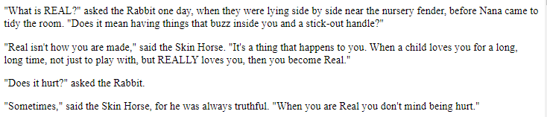
How many inverted commas can you count?
Can you spot the inverted commas?
14 inverted commas
(or 7 pairs of inverted commas)

Slide 5
Rule 1: Start & end speech
with inverted commas.

Slide 6
Rule 2: Start a new line for a new speaker.

Slide 7
Rule 3: Capital letter at the start of speech.
Can you see the capital letters at the start of each bit of speech?

Slide 8
Rule 4: Punctuate the end of speech.
Can you see the punctuation at the end of each bit of speech?

Slide 9
Rule 5: Punctuate the speech.
Can you see the punctuation during some of the speech?

Slide 10
Rule 6: Report who is saying the speech.
Can you spot how to report who is the speaker?

