Slide 1
How to Use this Powerpoint
These slides have been designed to be used in Powerpoint as a Slide Show.
There are text and images that will overlap and cause confusion, if used in desktop mode.
To open this in Slide Show mode, please click “Slide Show” on the menu above and then “From Beginning”.
Thank you from the Emile Team.
If you have any feedback, or would just like to say “hello”, please email us at: hello@emile-education.com

Slide 2
Possessive Pronouns

Slide 3
Does anyone remember what a noun is?
A noun is a thing or an object.
Can you think of
any examples of nouns?

Slide 4
These words are ALL nouns.
table
Monday
bravery
pride of lions
chair
England
loneliness
pack of lies
room
December
courage
school of fish
brother
London
sadness
gaggle of geese
teacher
Emile
happiness
army of ants
Nouns can be quite dull and uninteresting.

Slide 5
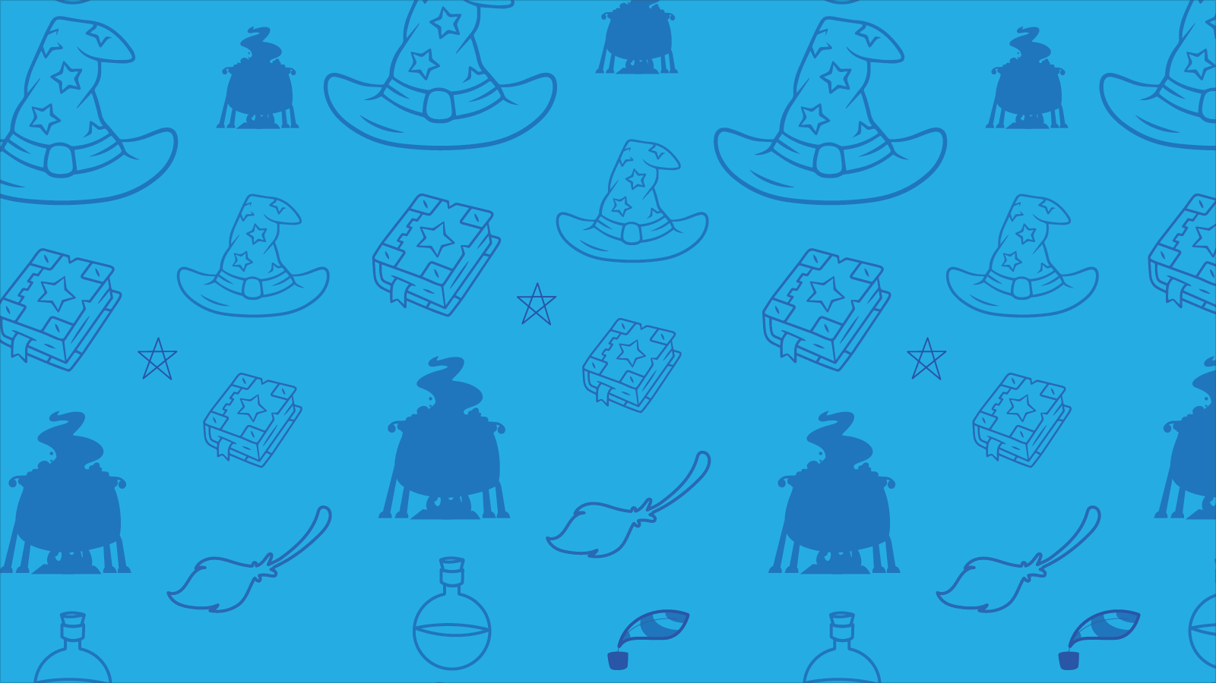
Which of these words are NOT nouns?
Inform
student - noun
Inform - verb
student
listen
computer - noun
listen - verb
computer
TV - noun
TV
like - verb
like
girl
girl - noun
boy
boy- noun
courage
sea - noun
courage - noun
sea
learn
learn - verb
collect - verb
collect
brother
brother - noun
London
Aimee
London - noun
Aimee - noun
whiteboard- noun
whiteboard
confidence - noun
teacher
Emile
confidence
teacher - noun
Emile - noun
army of ants
army of ants - noun

Slide 6
Can you spot the nouns in this sentence?
Can you spot two things in this sentence?
Girls play football.
The word “girls” is a plural noun.
The word “football” is a singular noun.
Boys write stories.
The word “boys” is a plural noun.
The word “stories” is a plural noun.

Slide 7
Does anyone remember what a pronoun is?
A pronoun is a word that takes the place of a noun.
Examples of pronouns include:
I, you, she, they, me, us, who, anybody, this, and that.

Slide 8
Can you spot the pronouns?
These are pronouns
I
What type of words are on red blocks?
I
old
old
old
people
people
people
you
you
What type of words are on purple blocks?
she
table
she
table
table
They are adjectives.
girl
girl
girl
he
he
they
they
young
young
young
They are (singular) nouns.

Slide 9
Can you spot the pronouns in this sentences?
Can you spot two things in this sentence?
Students like school. They have fun every single day!
The word “they” is a pronoun.
The word “they” is there to replace the noun “students”.
The teacher liked cars. She would like to drive a fast car.
The word “she” is a pronoun.
The word “she” is there to replace the noun “teacher”.

Slide 10
Can you spot the pronouns in this sentences?
Can you spot two things in this sentence?
The boys didn’t like football. They liked cricket.
The word “they” is a pronoun.
The word “they” is there to replace the noun “boys”.
The girl ran. She was very fast.
The word “she” is a pronoun.
The word “she” is there to replace the noun “girl”.

Slide 11
Why use pronouns in your writing?
Dave liked to take risks, but sometimes Dave got into trouble because what Dave did was dangerous.
Dave liked to take risks, but sometimes he got into trouble because what he did was dangerous.
Which one sounds best and why?

Slide 12
Pronouns need to be used carefully as they can create ambiguity (two meanings).
The girl ran towards friends. They cheered.
Who cheered?
The girl only? The friends? Or the girl and her friends?
The reader can’t tell.
It’s ambiguous.
Make sure the reader knows which noun has been replaced by the pronoun.

Slide 13
We’re looking at possessive pronouns today.
Can anyone guess an example of a possessive pronoun?
Remember a pronoun takes the place of a noun such as: I, you, he or she.
What do you think possessive means?
It means the noun is owned by someone.

Slide 14
Here is a list of possessive pronouns:
Mine, yours, ours, his, hers, theirs and its
What’s good about possessive pronouns?
Barry put Barry’s jacket on Barry’s chair.
Barry put his jacket on his chair.
What’s good about possessive pronouns?
- They improve our writing!

Slide 15
No apostrophes!!!!!
It’s really tempting to use apostrophes to show possession.
Possessive pronouns never use apostrophes.
it’s always means it is
its’ is never correct!

Slide 16
Below is a sentences. You have one minute to replace nouns with possessive pronouns!
1 Minute Timer
GO!
Time’s Up!
Hannah’s book was full with Hannah’s notes, showcasing Hannah’s beautiful handwriting.
GO!
Last 15 seconds!
TIME’S UP!
Start

Slide 17
How about?
1 Minute Timer
Hannah’s book was full with Hannah’s notes, showcasing Hannah’s beautiful handwriting.
Hannah’s book was full with her notes, showcasing her beautiful handwriting.
TIME’S UP!

Slide 18
How about?
1 Minute Timer
Hannah’s book was full with her notes, showcasing her beautiful handwriting.
We need the first “Hannah”, so we know who is the subject of the sentence.
TIME’S UP!

