Slide 1
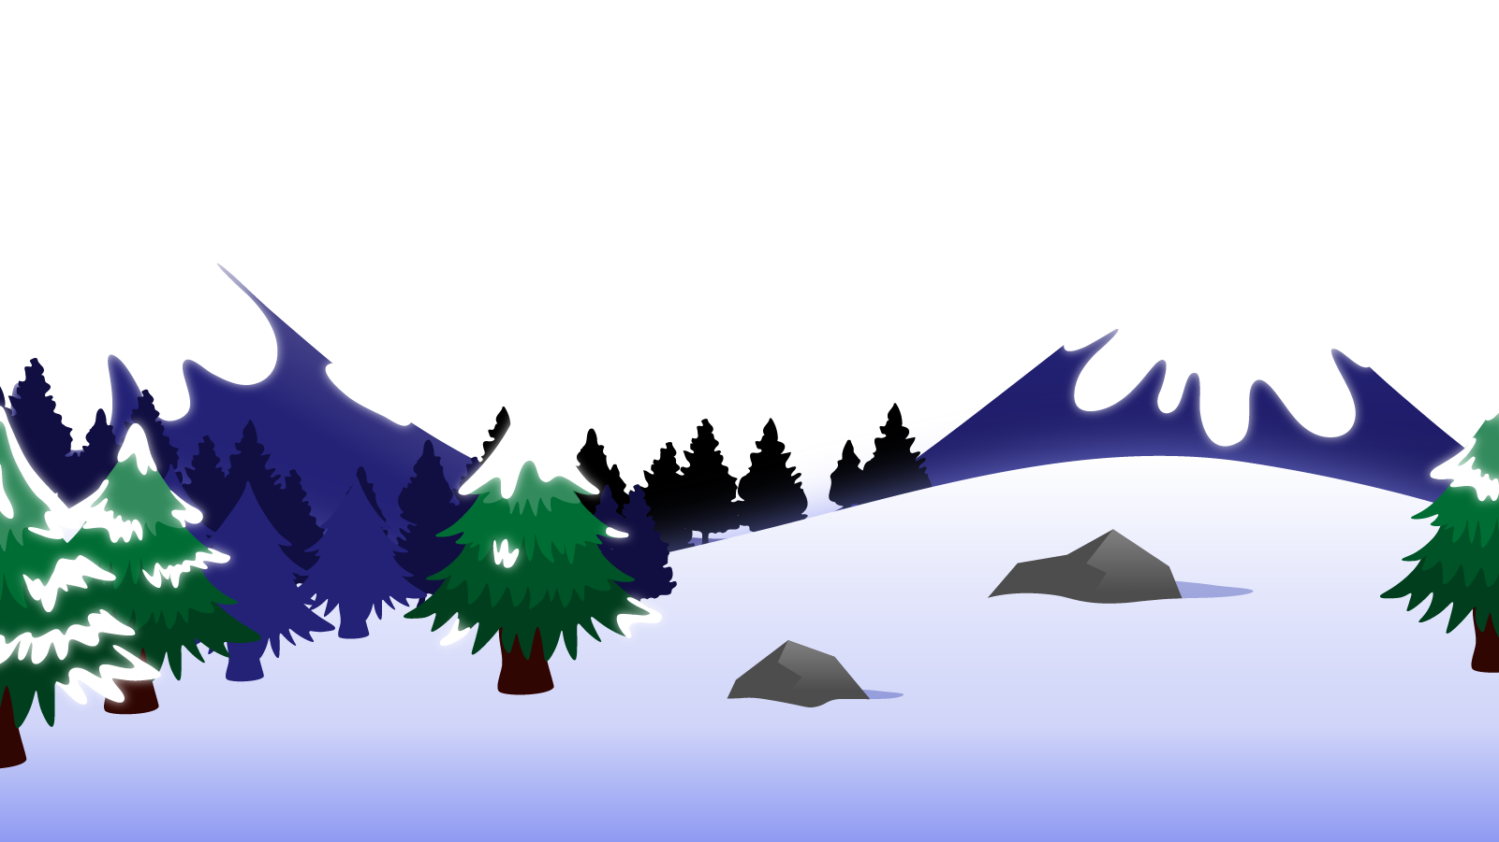
How to Use this Powerpoint
These slides have been designed to be used in Powerpoint as a Slide Show.
There are text and images that will overlap and cause confusion, if used in desktop mode.
To open this in Slide Show mode, please click “Slide Show” on the menu above and then “From Beginning”.
Thank you from the Emile Team.
If you have any feedback, or would just like to say “hello”, please email us at: hello@emile-education.com

Slide 2
Verb prefixes

Slide 3
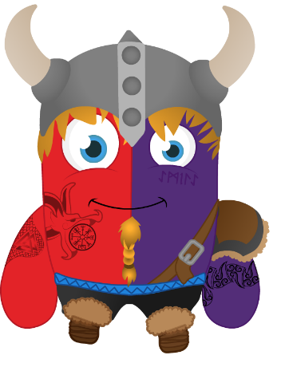
Can anyone remember what a
prefix is?

Slide 4
A prefix is a group of letters that go at the beginning of a root word and change the meaning of the word.
prefix
root word
dis
agree
dis + agree = disagree

Slide 5
The cat sat on the mat.
Does anyone remember what type of word “sat” is?
Action words are called verbs.
“sat” is the verb in this sentences.

Slide 6
Can anyone guess what a verb prefix is?
Can anyone think of an example of a verb prefix?
How about?
return
understand
preface
import
unfriend
submerge
include
misstep

Slide 7
What’s the point?
Knowing the root verb, means we can also figure out how to change the tense of the verb.
Formed, forming, etc
Transformed, transforming, etc
Basically, it helps us know spellings and meanings without having to be taught them!

Slide 8
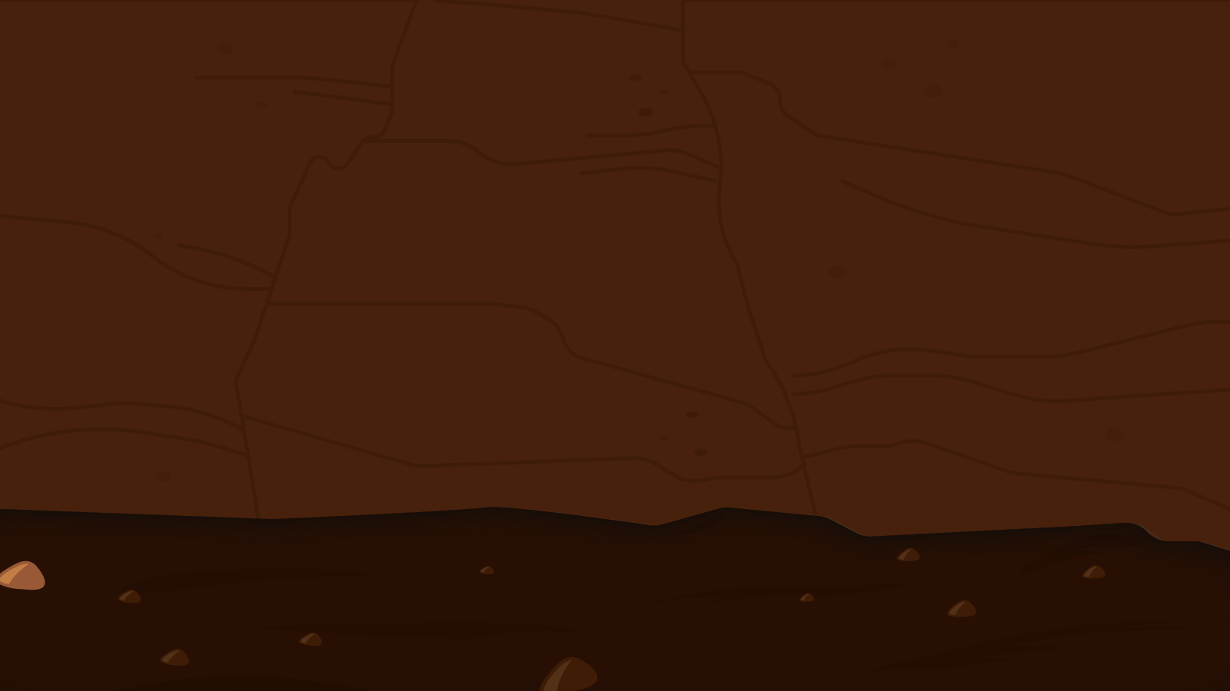
You have 2 minutes to list as many verbs with prefixes as possible!
2 Minute Timer
GO!
What verbs can you think of?
Can you think of any verbs beginning with ‘un-’, ‘re-’ or ‘mis-’?
TIME’S UP!
Last 60 seconds!
GO!
Start

Slide 9
How many did you think of?
2 Minute Timer
??
??
??
??
??
6. ??
7. ??
8. ??
9. ??
10. ??
TIME’S UP!

Slide 10
How many did you think of?
2 Minute Timer
1. unbend
2. unfasten
3. mislead
4. misinform
5. become
6. rebuild
7. revisit
8. interact
undersell
transfer
TIME’S UP!

