Slide 1
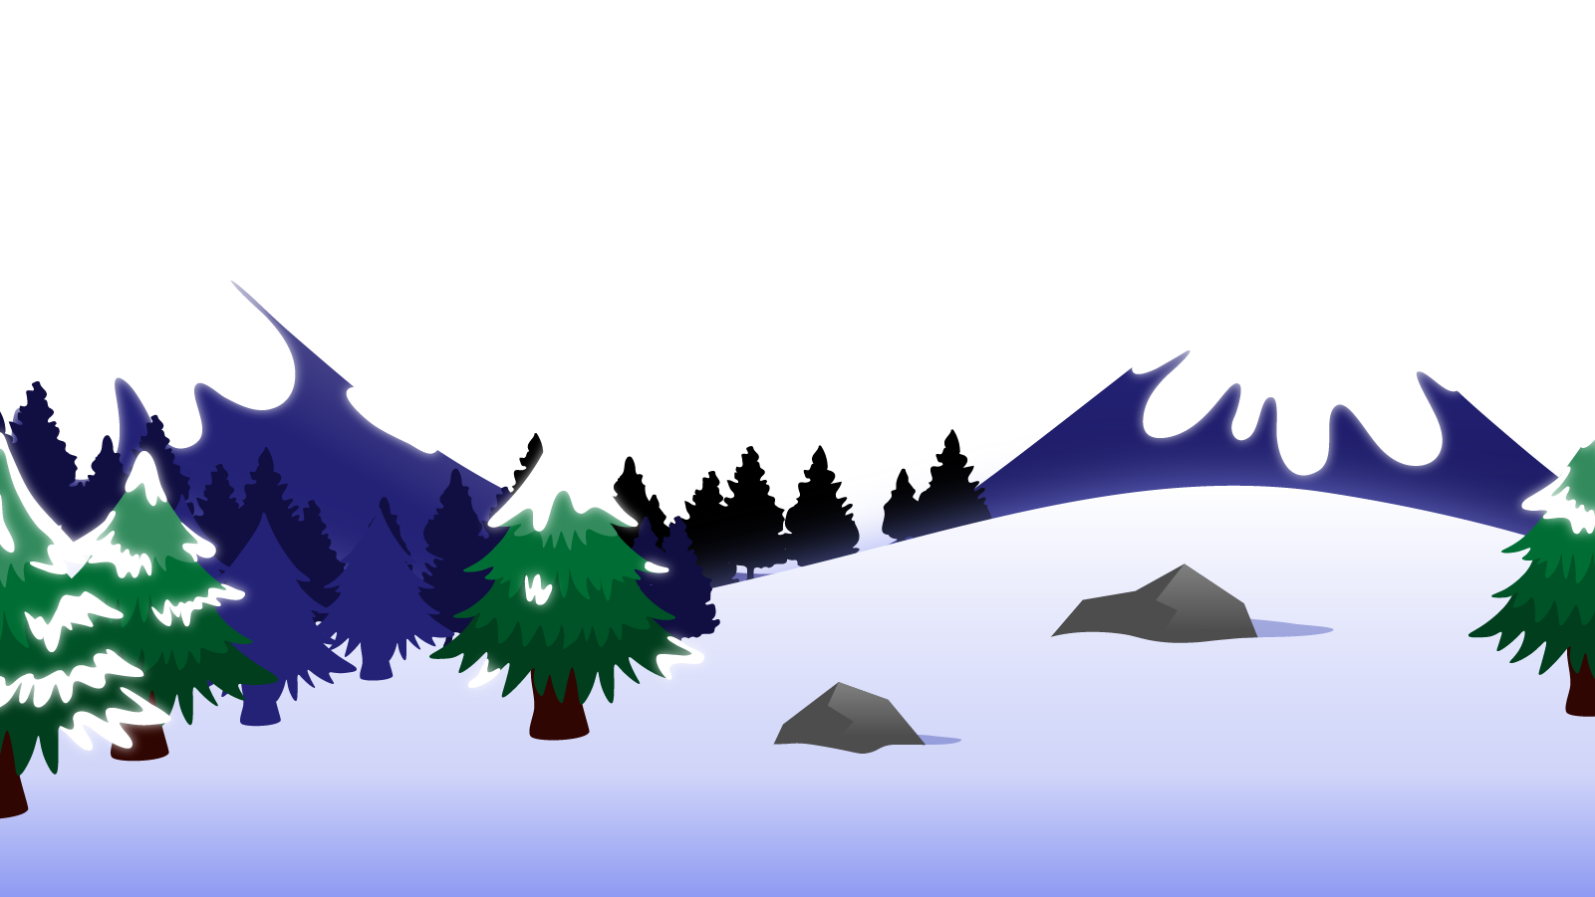
How to Use this Powerpoint
These slides have been designed to be used in Powerpoint as a Slide Show.
There are text and images that will overlap and cause confusion, if used in desktop mode.
To open this in Slide Show mode, please click “Slide Show” on the menu above and then “From Beginning”.
Thank you from the Emile Team.
If you have any feedback, or would just like to say “hello”, please email us at: hello@emile-education.com

Slide 2
Converting nouns and adjectives into verbs.

Slide 3
Does anyone remember what a noun is?
A noun is a thing or an object.
Can you think of
any examples of nouns?

Slide 4
These words are ALL nouns.
table
Monday
bravery
pride of lions
chair
England
loneliness
pack of lies
room
December
courage
school of fish
brother
London
sadness
gaggle of geese
teacher
Emile
happiness
army of ants
Nouns can be quite dull and uninteresting.

Slide 5
Which of these words are NOT nouns?
inform
student - noun
student
listen
computer - noun
inform - verb
listen - verb
computer
TV - noun
like - verb
TV
like
girl
girl - noun
boy- noun
boy
courage
sea - noun
courage - noun
sea
learn
learn - verb
collect - verb
collect
brother
brother - noun
London
Aimee
London - noun
Aimee - noun
whiteboard- noun
whiteboard
confidence - noun
teacher
Emile
confidence
teacher - noun
Emile - noun
army of ants
army of ants - noun

Slide 6
Does anyone know what an adjective is?
An adjective is a word that describes a noun.
Can you think of any
examples of adjectives?

Slide 7
These words are ALL adjectives.
brave
few
flat
American
happy
some
round
French
short
many
spherical
English
heavy
young
red
wood
fast
old
blue
metal
Adjectives make nouns more interesting!

Slide 8
Can you spot the adjectives in this sentence?
Can you spot two things in this sentence?
Girls play fantastic football.
The word “fantastic” is an adjective as it describes the noun “football”.
Boys write scary stories.
The word “scary” is an adjectives as it describes the noun “stories”.

Slide 9
The cat sat on the mat.
Does anyone remember what type of word “sat” is?
Action words are called verbs.
SO “sat” is the verb in this sentences.

Slide 10
So we have:
nouns (objects/things),
adjectives (describes things) and
verbs (actions/doing words).
We can convert some nouns and adjectives to verbs by adding a suffix.
Can anyone remember what a suffix is?

Slide 11
A suffix is a group of letters that go at the end of a root word and change the meaning of the word.
Root word
ing
Suffix
do
do + ing = doing

Slide 12
There are some super common suffixes that convert nouns and adjectives into verbs include:
-ate,
-ise,
-ify.

Slide 13
What’s the point?
Knowing the root word, means we can sometimes figure out what the new word means and how it is spelled.
Public -> Publicise
The verb to make something public.
Basically, it helps us know spellings and meanings without having to be taught them!

Slide 14
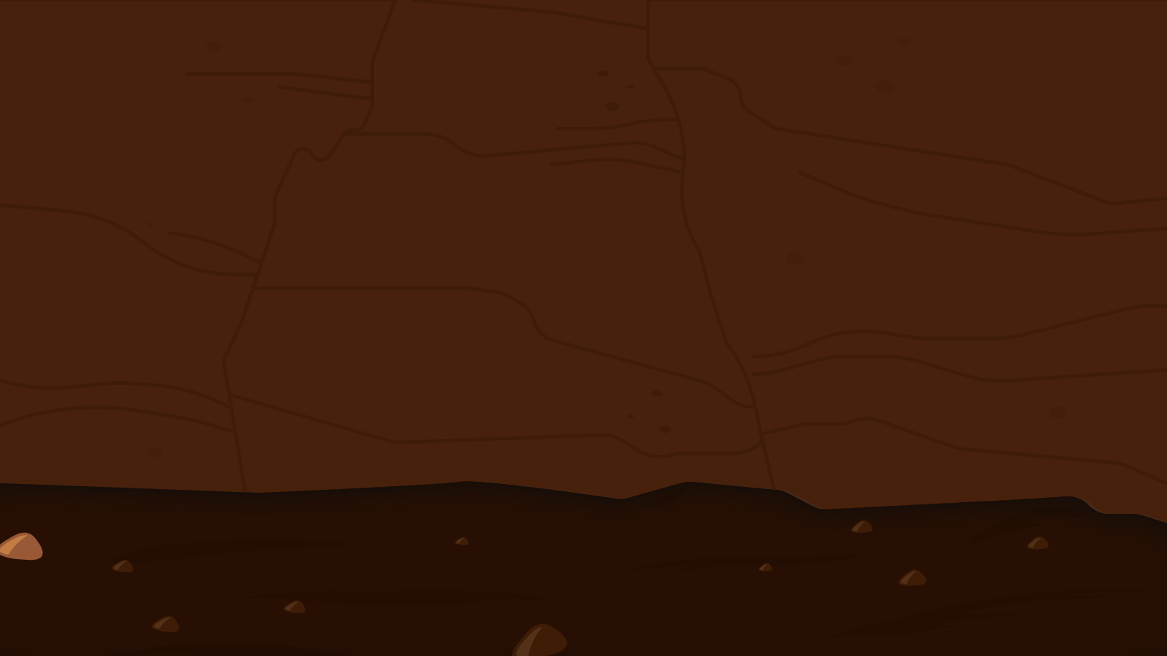
You have 2 minutes to think of as many words ending in any of the suffixes –ate, -ise or -ify!
2 Minute Timer
To put data into a table.
To be an official in charge.
To solve a calculation.
GO!
To make someone a victim.
To show sympathy to someone.
To make beginner using a magnifying glass.
TIME’S UP!
Last 60 seconds!
GO!
Start

Slide 15
You have 2 minutes to think of as many words ending in any of the suffixes –ate, -ise or -ify!
2 Minute Timer
To put data into a table - tabulate.
To be an official in charge - officiate.
To solve a calculation - calculate.
To make someone a victim - victimise.
To show sympathy to someone - sympathise.
To make bigger using a magnifying glass - magnify.
TIME’S UP!

Slide 16
A few examples….
How many words can your class think of that end in the suffix “ate”, “ise” or “ify”?
2 Minute Timer
Fortunate
Corporate
Triplicate
Regulate
Formulate
Administrate
Globalise
Publicise
Italicise
Modernise
Privatise
Centralise
Diversify
Personify
Classify
Identify
Electrify
Testify
TIME’S UP!

