Slide 1
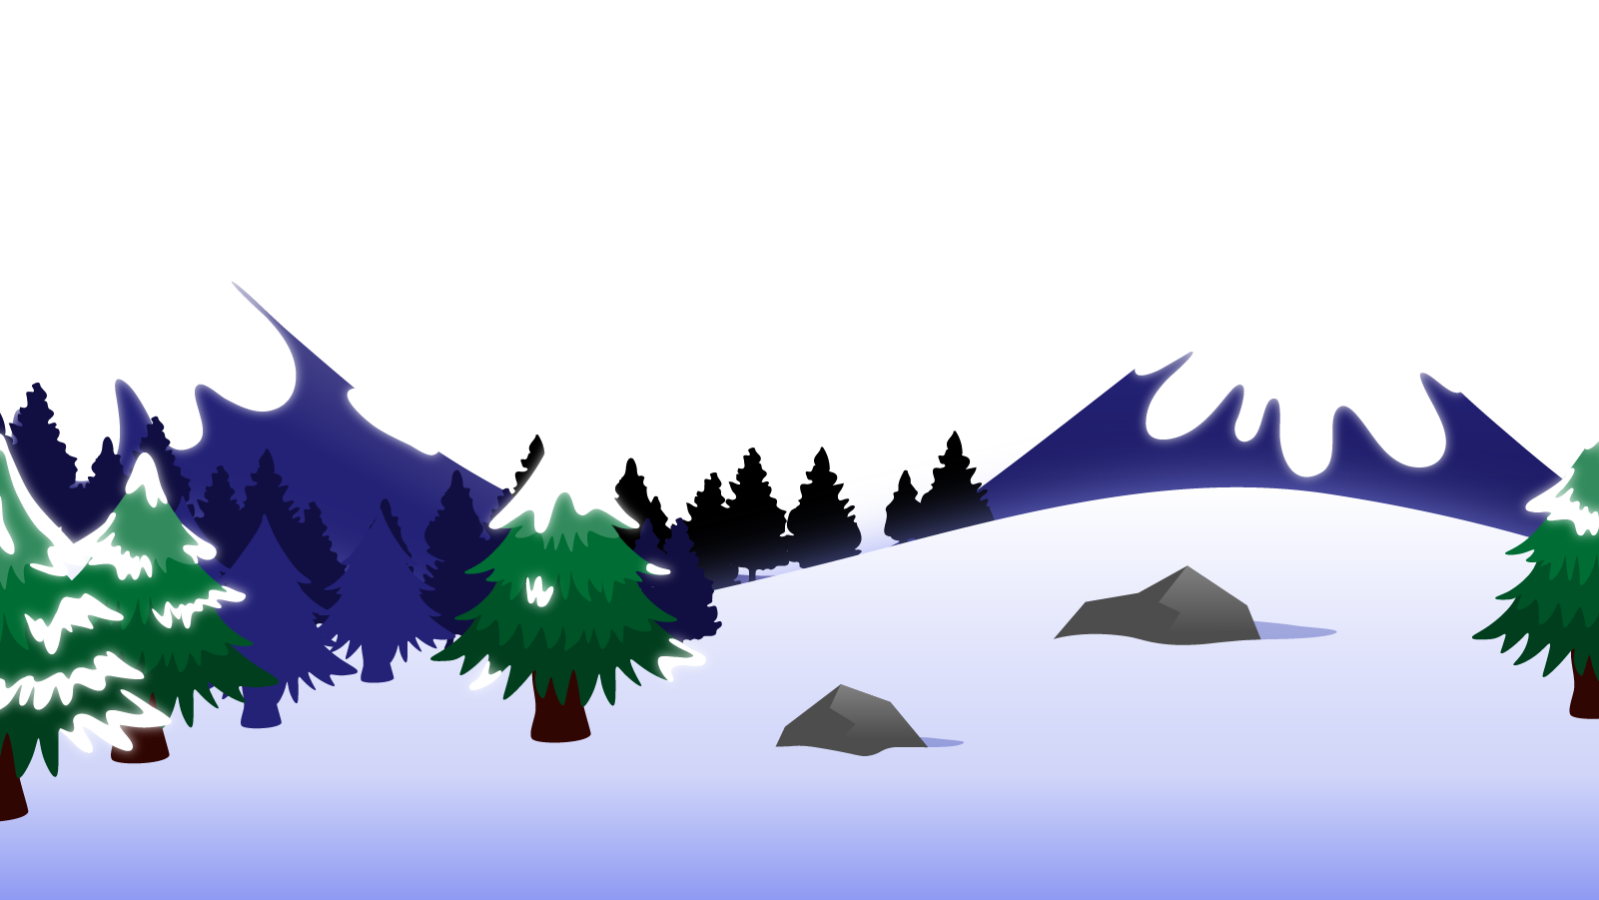
How to Use this Powerpoint
These slides have been designed to be used in Powerpoint as a Slide Show.
There are text and images that will overlap and cause confusion, if used in desktop mode.
To open this in Slide Show mode, please click “Slide Show” on the menu above and then “From Beginning”.
Thank you from the Emile Team.
If you have any feedback, or would just like to say “hello”, please email us at: hello@emile-education.com

Slide 2
Relative Clauses

Slide 3
A clause is a group of words that contains
a subject and a verb.
A verb is a doing word.
A subject is a thing (noun) that is doing the verb.

Slide 4
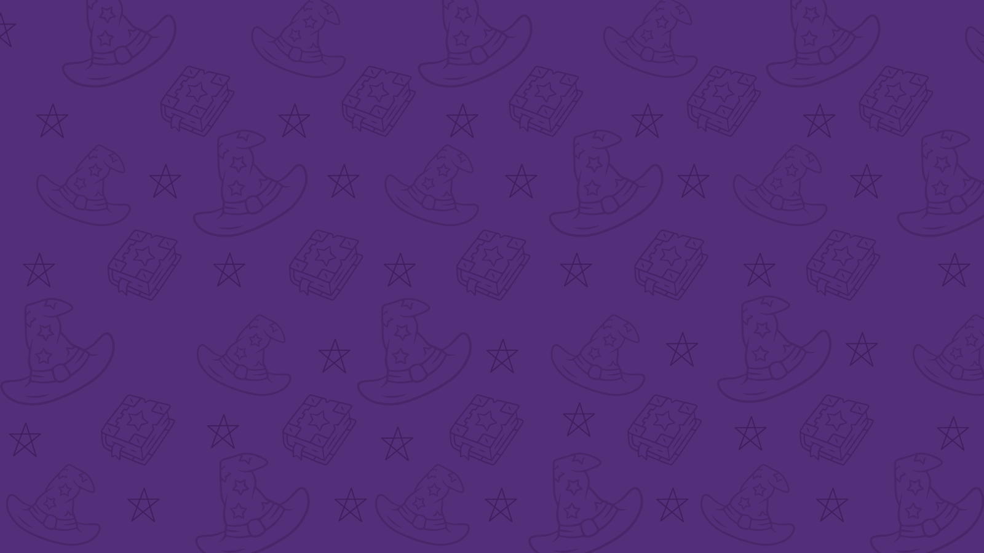
There are two types of clauses:
Independent clauses.
Subordinate clauses.
If a clause contains a complete thought, then it is an independent clause (sometimes called a main clause).
(If made into a sentence on its own, it would make sense.)
If a clause does not contain a complete clause, then it is a subordinate clause.
(If made into a sentence on its own, it would NOT make sense.)

Slide 5
Independent clause
Complete thought
Would be okay as a sentence.
Subordinate clause
Incomplete thought
Would NOT be okay as a sentence.

Slide 6
Independent clause or subordinate clause
But they did it first!
It’s an incomplete thought/not a complete sentence,
so it’s a subordinate clause.
After they got on the train,
It’s an incomplete thought /not a complete sentence,
so it’s a subordinate clause.
They got on the train at the station.
It’s a complete thought/a complete sentence,
so it’s an independent clause.

Slide 7
Independent clause or subordinate clause?
Aimee landed the rocket.
It’s a complete thought/a complete sentence,
so it’s an independent clause.
That was in the rocket.
It’s an incomplete thought/not a complete sentence,
so it’s a subordinate clause.
If you go on Saturday
It’s an incomplete thought/not a complete sentence,
so it’s a subordinate clause.

Slide 8
Do you remember any co-ordinating conjunction (FANBOYS)?
F
A
N
B
O
Y
S
For
And
Nor
But
Or
Yet
So

Slide 9
A subordinating conjunction joins an independent clause and a subordinate clause.
There are loads of subordinating conjunctions.
After
Although
As
As if
As long as
Because
Before
Even though
If
If only
Now
Now that
Once
Rather than
Since
So that
Than
That
Though
Till
Unless
Until
When
Where
Whether
Which
While

Slide 10
1. Sentences can have the structure:
Independent clause
Co-ordinating conjunction
Independent clause
Let’s have a look at an example:
The tree was trimmed but there was a lot to do.
The tree was trimmed but there was a lot to do.
The tree was trimmed but there was a lot to do.
The tree was trimmed but there was a lot to do.
Independent clause
Independent clause
Co-ordinating conjunction

Slide 11
2. Sentences can have the structure:
Independent clause
Subordinating conjunction
Subordinate clause
Let’s have a look at an example:
The tree was trimmed before it becomes too big.
The tree was trimmed before it becomes too big.
The tree was trimmed before it becomes too big.
The tree was trimmed before it becomes too big.
Independent clause
Subordinate clause
Subordinating conjunction

Slide 12
3. Sentences can have the structure:
Subordinating conjunction
Subordinate clause
Comma
Independent clause
Let’s have a look at an example:
Before it became too big , the tree was trimmed.
Before it became too big , the tree was trimmed.
Before it became too big, the tree was trimmed.
Before it became too big, the tree was trimmed.
Before it became too big, the tree was trimmed.
Subordinate clause
Independent clause
Subordinating conjunction
Comma

Slide 13
Sentence structure number 1:
Independent clause
Co-ordinating conjunction
Independent clause
Sentence structure number 2:
Independent clause
Subordinating conjunction
Subordinate clause
Sentence structure number 3:
Subordinating conjunction
Subordinate clause
Comma
Independent clause

Slide 14
There is a type of subordinate clause called a “relative clause”.
A relative clause gives you more information about a noun (acts as an adjective) and goes after the noun.
Relative clauses use a relative pronoun such as who, which, that, where, when
A relative clause can be deleted and the sentence will still make sense.

Slide 15
Let’s look at an example:
What is the relative clause?
“who is an alien” is the relative clause.
Emile, who is an alien, can speak many languages.
Emile, who is an alien, can speak many languages.
“who” is the relative pronoun.
What is the relative pronoun?
The sentence makes sense without the relative clause.
Emile can speak many languages.

Slide 16
Let’s look at another example:
What is the relative clause?
“which he has owned for a long time” is the relative clause.
Emile’s rocket, which he has owned for a long time, is incredibly fast.
Emile’s rocket, which he has owned for a long time, is incredibly fast.
What is the relative pronoun?
“which” is the relative pronoun.
The sentence makes sense without the relative clause.
Emile’s rocket is incredibly fast.

Slide 17
Co-ordinating conjunctions
Subordinating conjunctions
Relative
pronouns
FANBOYS
for,
and,
nor,
but,
or,
yet,
such
after, although, as, as if, as long as, because, before, despite, even if, even though, if, in order that, rather than, since, so that, that, though, unless, until, when, where, whereas, whether, and while…..
which, that, whose, whoever, whomever, who, and whom.
In some situations, what, when, and where can also function as relative pronouns.

