Slide 1
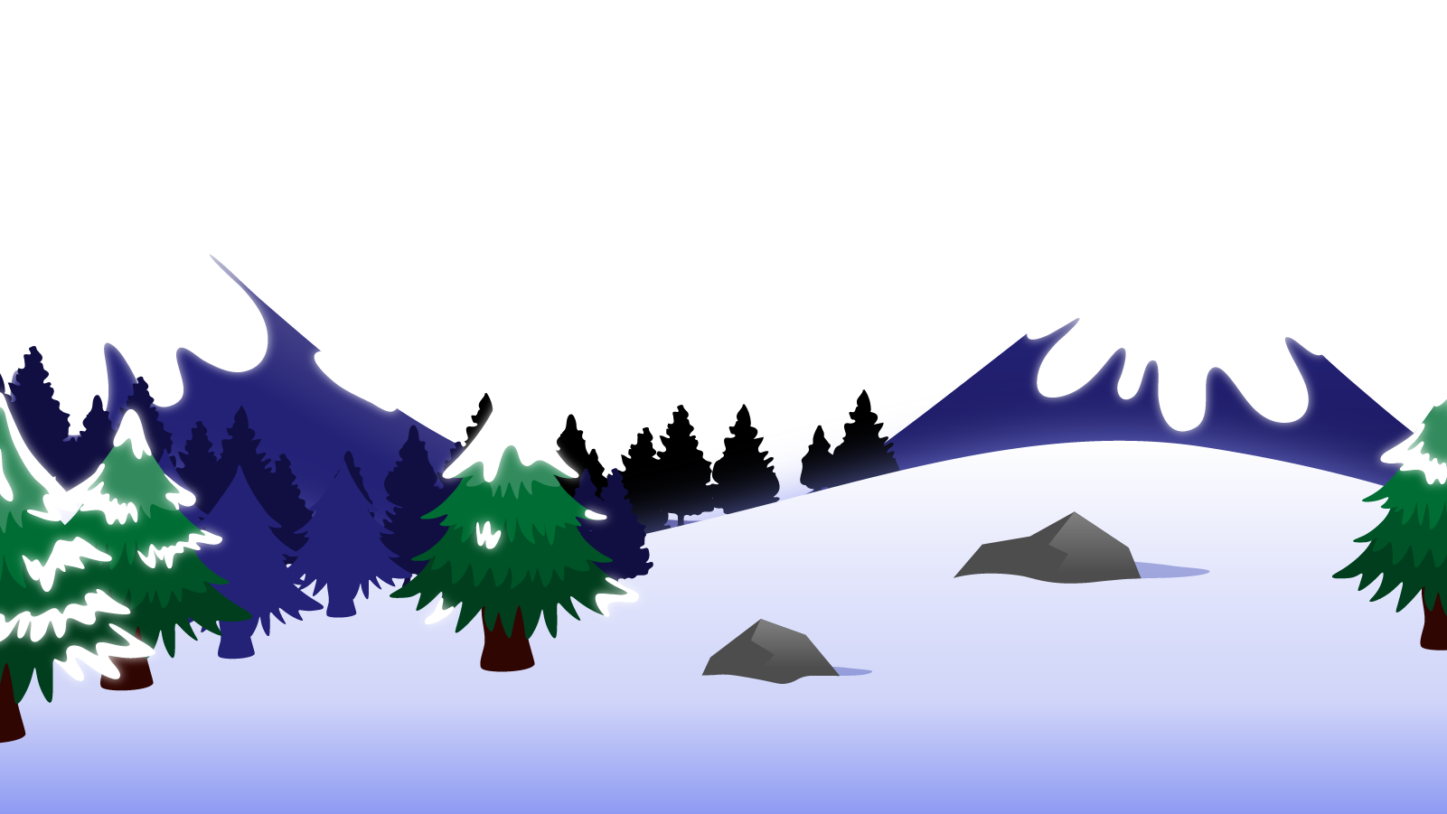
How to Use this Powerpoint
These slides have been designed to be used in Powerpoint as a Slide Show.
There are text and images that will overlap and cause confusion, if used in desktop mode.
To open this in Slide Show mode, please click “Slide Show” on the menu above and then “From Beginning”.
Thank you from the Emile Team.
If you have any feedback, or would just like to say “hello”, please email us at: hello@emile-education.com

Slide 2
Parentheses

Slide 3
Parentheses are:
brackets ()
dashes --
commas ,,
Parentheses:
add extra information to a sentence
but the sentence still makes sense without it.
For example:
I have three cats (Fluffy, Whiskers, and Mittens).
The movie (a thriller) kept me on the edge of my seat.
The boy (who was a fast runner) couldn’t sit still.
For example:
I have three cats (Fluffy, Whiskers, and Mittens).
The movie (a thriller) kept me on the edge of my seat.
The boy (who was a fast runner) couldn’t sit still.

Slide 4
Parentheses:
add extra information to a sentence
but the sentence still makes sense without it.
Spot the parentheses:
I have three cats (Fluffy, Whiskers, and Mittens).
I have three cats (Fluffy, Whiskers, and Mittens).
If you remove the words in brackets, the sentence still makes sense:
I have three cats (Fluffy, Whiskers, and Mittens).
I have three cats.

Slide 5
Parentheses:
add extra information to a sentence
but the sentence still makes sense without it.
Spot the parentheses:
The boy, who was a fast runner, couldn’t sit still.
The boy, who was a fast runner, couldn’t sit still.
If you remove the words in between the commas, the sentence still makes sense:
The boy, who was a fast runner, couldn’t sit still.
The boy couldn’t sit still.
This should be familiar as it is a relative clause.

Slide 6
Parentheses:
add extra information to a sentence
but the sentence still makes sense without it.
Spot the parentheses:
The movie - a thriller - kept me on the edge of my seat.
The movie - a thriller - kept me on the edge of my seat.
If you remove the words in between the dashes, the sentence still makes sense:
The movie - a thriller - kept me on the edge of my seat.
The movie kept me on the edge of my seat.

Slide 7
Let’s combine the 2 sentences into 1 sentence using parentheses:
1. The man was a great dancer.
+
2. The man walked confidently to the dance floor.
The man, who was a great dancer, walked confidently to the dance floor.
OR
The man (who was a great dancer) walked confidently to the dance floor.
OR
The man - who was a great dancer - walked confidently to the dance floor.
OR
The man (who walked confidently to the dance floor) was a great dancer .

Slide 8
Let’s combine the 2 sentences into 1 sentence using parentheses:
1. There was a lot of traffic.
+
2. There were mainly sports cars in the traffic.
No comma next to a full stop.
There was a lot of traffic (mainly sports cars).
OR
There was a lot of traffic, mainly sports cars.
OR
There was a lot of traffic - mainly sports cars -.
OR
There were mainly sports cars in the traffic (there was a lot of traffic).

Slide 9
YOUR TURN: Combine the 2 sentences into 1 sentence using parentheses in 3 ways:
1. The dog was big and scary.
+
2. The dog barked all day.
The dog, which was big and scary, barked all day.
OR
The dog - which was big and scary - barked all day.
OR
The dog (which was big and scary) barked all day.
OR
The dog, which barked all day, was big and scary.

Slide 10
You may have spotted that parentheses work alongside relative clauses.
Was the difference between parenthesis and parentheses?
One parenthesis – singular
Two parentheses - plural

