Slide 1
How to Use this Powerpoint
These slides have been designed to be used in Powerpoint as a Slide Show.
There are text and images that will overlap and cause confusion, if used in desktop mode.
To open this in Slide Show mode, please click “Slide Show” on the menu above and then “From Beginning”.
Thank you from the Emile Team.
If you have any feedback, or would just like to say “hello”, please email us at: hello@emile-education.com

Slide 2
Linking ideas across paragraphs using adverbials.

Slide 3
Does anyone know what a paragraph is?
A paragraph is a group of sentences that talk about the same idea or topic.

Slide 4
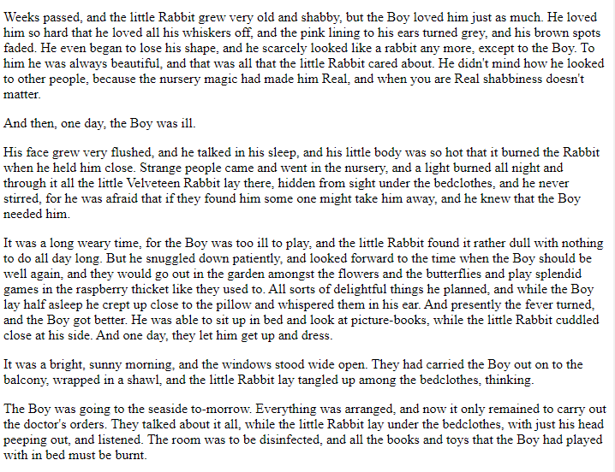
Does anyone know how to recognise when one paragraph has finished and the next has started?
Paragraphs are usually separated by a missing line.

Slide 5
A piece of writing flows when there are clear links between paragraphs.
These links can be:
(1) adverbials or
(2) the form of verbs.

Slide 6
Does anyone remember what an adverbial is?
An adverbial is a word or phrase that describes a verb.

Slide 7
What is the difference between an adverb and an adverbial?
An adverbial is a word or phrase that describes a verb.
An adverb is a word that describes a verb.

Slide 8
All adverbs are adverbials.
(But not all adverbials are adverbs!)
Adverbials (a word or phrase that describes a verb).
Adverbs (a word that describes a verb).

Slide 9
Adverb or adverbial?
in a minute
This is a phrase and so is an adverbial
boldly
This is a word and so is an adverb and an adverbial
near here
This is a phrase and so is an adverbial
to find gold
This is a phrase and so is an adverbial
frighteningly
This is a word and so is an adverb and an adverbial
surprisingly
This is a word and so is an adverb and an adverbial
in the corner
This is a phrase and so is an adverbial

Slide 10
Once you have mastered writing paragraphs, you can think about how to link ideas across paragraphs to help your writing flow.
If you think about how to begin a paragraph, you can choose words that will link the sentences in the new paragraph with the ideas in the previous paragraph.

Slide 11
Can you think of some adverbials we can use to link the three paragraphs below?
Football is one of the most popular and widely played sports globally.
Players primarily use their feet to control, pass, and shoot the ball, though they can also use their heads and other parts of their bodies. Played on a rectangular field with two teams of eleven players each, the objective of the game is to score goals by getting the ball into the opposing team’s net. Football requires a combination of skill, teamwork, and strategy, making it an exciting and dynamic sport loved by millions worldwide.
The beauty of football lies not only in its competitive nature but also in its ability to bring people together and foster a sense of unity and camaraderie. Football fans around the world passionately support their favourite teams, creating a vibrant atmosphere during matches that transcends language, culture, and borders.

Slide 12
How about adverbials of number?
Firstly, football is one of the most popular and widely played sports globally.
Secondly, players primarily use their feet to control, pass, and shoot the ball, though they can also use their heads and other parts of their bodies. Played on a rectangular field with two teams of eleven players each, the objective of the game is to score goals by getting the ball into the opposing team’s net. Football requires a combination of skill, teamwork, and strategy, making it an exciting and dynamic sport loved by millions worldwide.
Thirdly, the beauty of football lies not only in its competitive nature but also in its ability to bring people together and foster a sense of unity and camaraderie. Football fans around the world passionately support their favourite teams, creating a vibrant atmosphere during matches that transcends language, culture, and borders.

Slide 13
How about adverbials of time?
First of all, football is one of the most popular and widely played sports globally.
Currently, players primarily use their feet to control, pass, and shoot the ball, though they can also use their heads and other parts of their bodies. Played on a rectangular field with two teams of eleven players each, the objective of the game is to score goals by getting the ball into the opposing team’s net. Football requires a combination of skill, teamwork, and strategy, making it an exciting and dynamic sport loved by millions worldwide.
Finally, the beauty of football lies not only in its competitive nature but also in its ability to bring people together and foster a sense of unity and camaraderie. Football fans around the world passionately support their favourite teams, creating a vibrant atmosphere during matches that transcends language, culture, and borders.

