Slide 1



How to Use this Powerpoint
These slides have been designed to be used in Powerpoint as a Slide Show.
There are text and images that will overlap and cause confusion, if used in desktop mode.
To open this in Slide Show mode, please click “Slide Show” on the menu above and then “From Beginning”.
Thank you from the Emile Team.
If you have any feedback, or would just like to say “hello”, please email us at: hello@emile-education.com

Slide 2
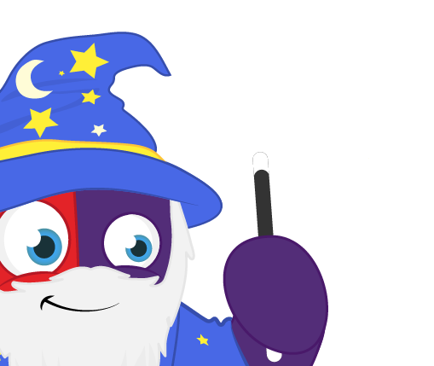
Using hyphens to avoid confusion

Slide 3

Can anyone remember what a hyphen is?
A hyphen - is a piece of punctuation that links two related words.

Slide 4

Can anyone remember what a
prefix is?

Slide 5



A prefix is a group of letters that go at the beginning of a root word and change the meaning of the word.
prefix
root word
dis
agree
dis + agree = disagree

Slide 6
Hyphens are commonly used to join a prefix ending in a vowel to join a root word starting with a vowel.

Slide 7

Aimee and Emile must co-ordinate their efforts in order to be successful.
co-ordinate
The prefix co- ends in the vowel o.
The root word ordinate begins with the vowel o.
When the prefix co- is added to the root word ordinate, a hyphen is used.

Slide 8

Emile and Aimee are preparing to re-enter the planet's orbit.
re-enter
The prefix re- ends in the vowel e.
The root word enter begins with the vowel e.
When the prefix re- is added to the root word enter, a hyphen is used.

Slide 9


Hyphens are also used to avoid confusion or ambiguity.
“Man eating shark” or “man-eating shark”
What’s the difference?

Slide 10



The rule is: if you think an expression could be confusing for a reader, use a hyphen.
“re-cover” or “recover”
What’s the difference?

Slide 11
The rule is: if you think an expression could be confusing for a reader, use a hyphen.
“small town gossip” or “small-town gossip”
What’s the difference?
Is it frivolous gossip or gossip about a small town?

Slide 12

The rule is: if you think an expression could be confusing for a reader, use a hyphen.
“heavy duty equipment” or “heavy-duty equipment”
What’s the difference?
Is it equipment which is heavy-duty or is it heavy equipment related to a duty?

Slide 13
The rule is: if you think an expression could be confusing for a reader, use a hyphen.
“short-tempered boss” or “short tempered boss”
What’s the difference?
Is it a short boss with a temper, or a quick to anger boss?

Slide 14
The rule is: if you think an expression could be confusing for a reader, use a hyphen.
“re-signed” or “resigned”
What’s the difference?
Has someone signed a contract twice or has someone quit their job?

Slide 15

The rule is: if you think an expression could be confusing for a reader, use a hyphen.
“little-used” or “little used”
What’s the difference?
Something that is used rarely or something that is small and useful?

