Slide 1
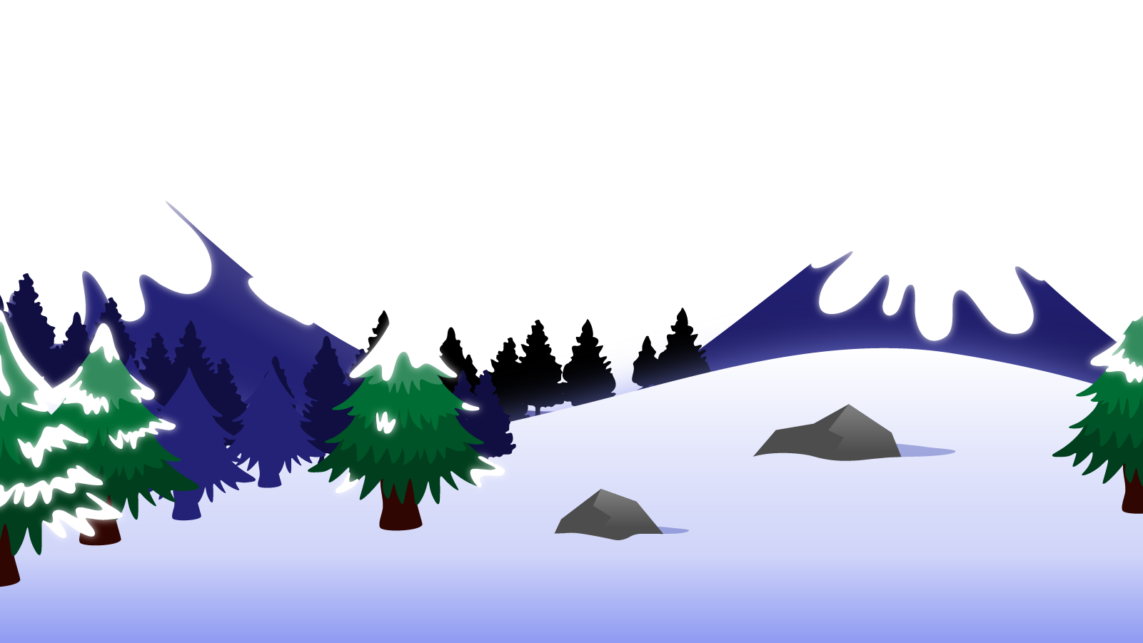
How to Use this Powerpoint
These slides have been designed to be used in Powerpoint as a Slide Show.
There are text and images that will overlap and cause confusion, if used in desktop mode.
To open this in Slide Show mode, please click “Slide Show” on the menu above and then “From Beginning”.
Thank you from the Emile Team.
If you have any feedback, or would just like to say “hello”, please email us at: hello@emile-education.com

Slide 2
Ellipses

Slide 3
Ellipses are three dots …
Ellipses have a few different purposes.
To show a word or words have been removed (usually from a quote).
To create suspense by adding a pause before the end of the sentence.
To show the trailing off of a thought.

Slide 4
1. To show a word or words have been removed from a quote.
In a famous speech in America, Dr. Martin Luther King Jr. proclaimed, "I have a dream that my four little children will one day live in a nation where they will not be judged by the colour of their skin but by the content of their ... character." This powerful statement encapsulates his vision for a future of equality and justice.
How do the ellipses help the author?
What sort/genre of writing commonly uses ellipses like this?
Ellipses like this are used a lot by journalists so they can report only the most important parts of a speech.

Slide 5
2. To create suspense by adding a pause before the end of the sentence.
The night was silent, the only sound being the rustling of leaves in the gentle breeze... Suddenly, a faint, eerie whisper echoed from the darkness, sending shivers down their spines... They strained their eyes, trying to pierce through the blackness, heartbeats quickening... What could be lurking out there, just beyond the edge of their vision...?
How do the pauses help the author?
What sort/genre of writing commonly uses ellipses like this?
Scary stories usually have ellipses to help create tension.

Slide 6
3. To show the trailing off of a thought.
The streets below were alive with the hurried footsteps of strangers, each one carrying a story... a story that I would never know, but that was interwoven with mine for this fleeting moment. And as the night deepened, a sense of introspection washed over me, making me ponder the paths untaken, the choices unmade...
How do the pauses help the author?
They allow an author to change focus without giving a complete picture of what they are currently describing.
Scary stories usually have ellipses to help create tension.

Slide 7
Where should we put the ellipsis?
How about?
At any rate, that is what we are going to try to do. That is the resolve of His Majesty's Government, every man of them. That is the will of Parliament and the nation. The British Empire and the French Republic, linked together in their cause and their need, will defend to the death their native soils, aiding each other like good comrades to the utmost of their strength, even though a large tract of Europe and many old and famous States have fallen or may fall into the grip of the Gestapo and all the odious apparatus of Nazi rule.
We shall defend our island, whatever the cost may be, we shall fight on the beaches, we shall fight on the landing grounds, we shall fight in the fields and in the streets, we shall fight in the hills; we shall never surrender.
At any rate, that is what we are going to try to do. That is the resolve of His Majesty's Government, every man of them. That is the will of Parliament and the nation. The British Empire and the French Republic, linked together in their cause and their need, will defend to the death their native soils, aiding each other like good comrades to the utmost of their strength, even though a large tract of Europe and many old and famous States have fallen or may fall into the grip of the Gestapo and all the odious apparatus of Nazi rule.
We shall defend our island, whatever the cost may be, we shall fight on the beaches, we shall fight on the landing grounds, we shall fight in the fields and in the streets, we shall fight in the hills; we shall never surrender.
At any rate, that is what we are going to try to do. That is the resolve of His Majesty's Government, every man of them. That is the will of Parliament and the nation. The British Empire and the French Republic, linked together in their cause and their need, will defend to the death their native soils, aiding each other like good comrades to the utmost of their strength, even though a large tract of Europe and many old and famous States have fallen or may fall into the grip of the Gestapo and all the odious apparatus of Nazi rule.
We shall defend our island, whatever the cost may be, we shall fight on the beaches, we shall fight on the landing grounds, we shall fight in the fields and in the streets, we shall fight in the hills; we shall never surrender.
…The British Empire and the French Republic, linked together in their cause and their need, will defend to the death their native soils, aiding each other like good comrades to the utmost of their strength, even though a large tract of Europe and many old and famous States have fallen or may fall into the grip of the Gestapo and all the odious apparatus of Nazi rule.
We shall defend our island, whatever the cost may be, we shall fight on the beaches, we shall fight on the landing grounds, we shall fight in the fields and in the streets, we shall fight in the hills; we shall never surrender.
…The British Empire and the French Republic, linked together in their cause and their need, will defend to the death their native soils, aiding each other like good comrades to the utmost of their strength...
We shall defend our island, whatever the cost may be, we shall fight on the beaches, we shall fight on the landing grounds, we shall fight in the fields and in the streets, we shall fight in the hills; we shall never surrender.
Winston Churchill

Slide 8
Where should we put the ellipsis?
How about?
I think the big mistake in schools is trying to teach children anything, and by using fear as the basic motivation. Fear of getting failing grades, fear of not staying with your class. Interest can produce learning on a scale compared to fear as a nuclear explosion to a firecracker.
I think the big mistake in schools is trying to teach children anything, and by using fear as the basic motivation. Fear of getting failing grades, fear of not staying with your class... Interest can produce learning on a scale compared to fear as a nuclear explosion to a firecracker.
Stanley Kubrick

Slide 9
Where should we put the ellipsis?
How about?
The last man on Earth sat alone in a room.
There was a knock at the door.
The last man on Earth sat alone in a room.
There was a knock at the door…
Fredric Brown

