Slide 1
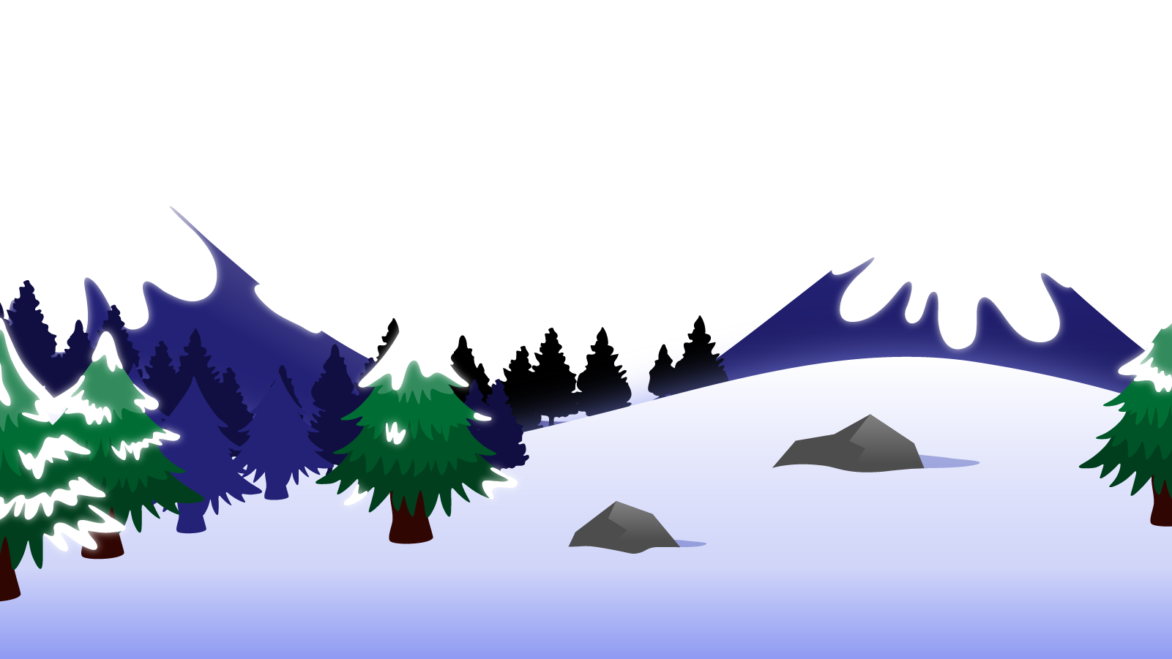
How to Use this Powerpoint
These slides have been designed to be used in Powerpoint as a Slide Show.
There are text and images that will overlap and cause confusion, if used in desktop mode.
To open this in Slide Show mode, please click “Slide Show” on the menu above and then “From Beginning”.
Thank you from the Emile Team.
If you have any feedback, or would just like to say “hello”, please email us at: hello@emile-education.com

Slide 2
Synonyms & Antonyms

Slide 3
Synonyms are words with the same or similar meaning:
happy, cheerful, merry
fast, quick, rapid
big, grand, large
Can you think of any?

Slide 4
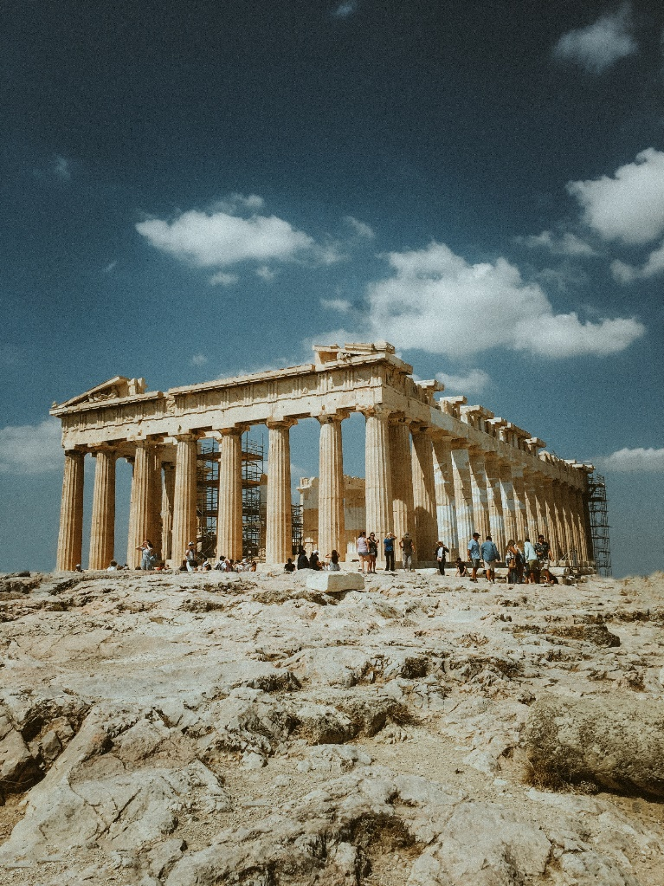
The word synonym comes from the ancient Greek.
syn means together or same
nym means name
The Parthenon

Slide 5
add
total
tally
combine
count

Slide 6
begin
start
initiate
commence
activate

Slide 7
Can you write three sentences, each sentence using any two synonyms?
eg: The movie was frightening and scary.
1. add
2. total
3. tally
4. combine
5. count
6. begin
7. start
8. initiate
9. commence
10. activate

Slide 8
Antonyms are words with the opposite meaning:
happy & sad
fast & slow
big & small
Can you think of any?

Slide 9
The word antonym comes from the ancient Greek.
“Ant” (or “anti”) means “opposite” (like anti-clockwise).
“nym” means “name”.
The Parthenon

Slide 10
What is an antonym of “angry”?
An antonym of “angry” is “calm”.

Slide 11
What is an antonym of “full”?
An antonym of “full” is “empty”.

Slide 12
Antonyms or synonyms?

Slide 13
Are “play” and “work” antonyms or synonyms?
“Play” and “work” are opposites and so antonyms.

Slide 14
Are “friend” and “enemy” antonyms or synonyms?
“Friend” and “enemy” are opposites and so antonyms.

Slide 15
Are “adjacent” and “bordering” antonyms or synonyms?
“Adjacent” and “bordering” can mean the same thing and so are synonyms.

Slide 16
Are “awful” and “terrible” antonyms or synonyms?
“Awful” and “terrible” can mean the same thing and so are synonyms.

Slide 17
Are “driving” and “walking” antonyms or synonyms?
“Driving” and “walking” are opposites and so antonyms.

Slide 18
Are “chilly” and “frosty” antonyms or synonyms?
“Chilly” and “frosty” can mean the same thing and so are synonyms.

Slide 19
Are “night” and “day” antonyms or synonyms?
“Night” and “day” are opposites and so antonyms.

Slide 20
Are “big” and “large” antonyms or synonyms?
“Big” and “large” can mean the same thing and so are synonyms.

