Slide 1
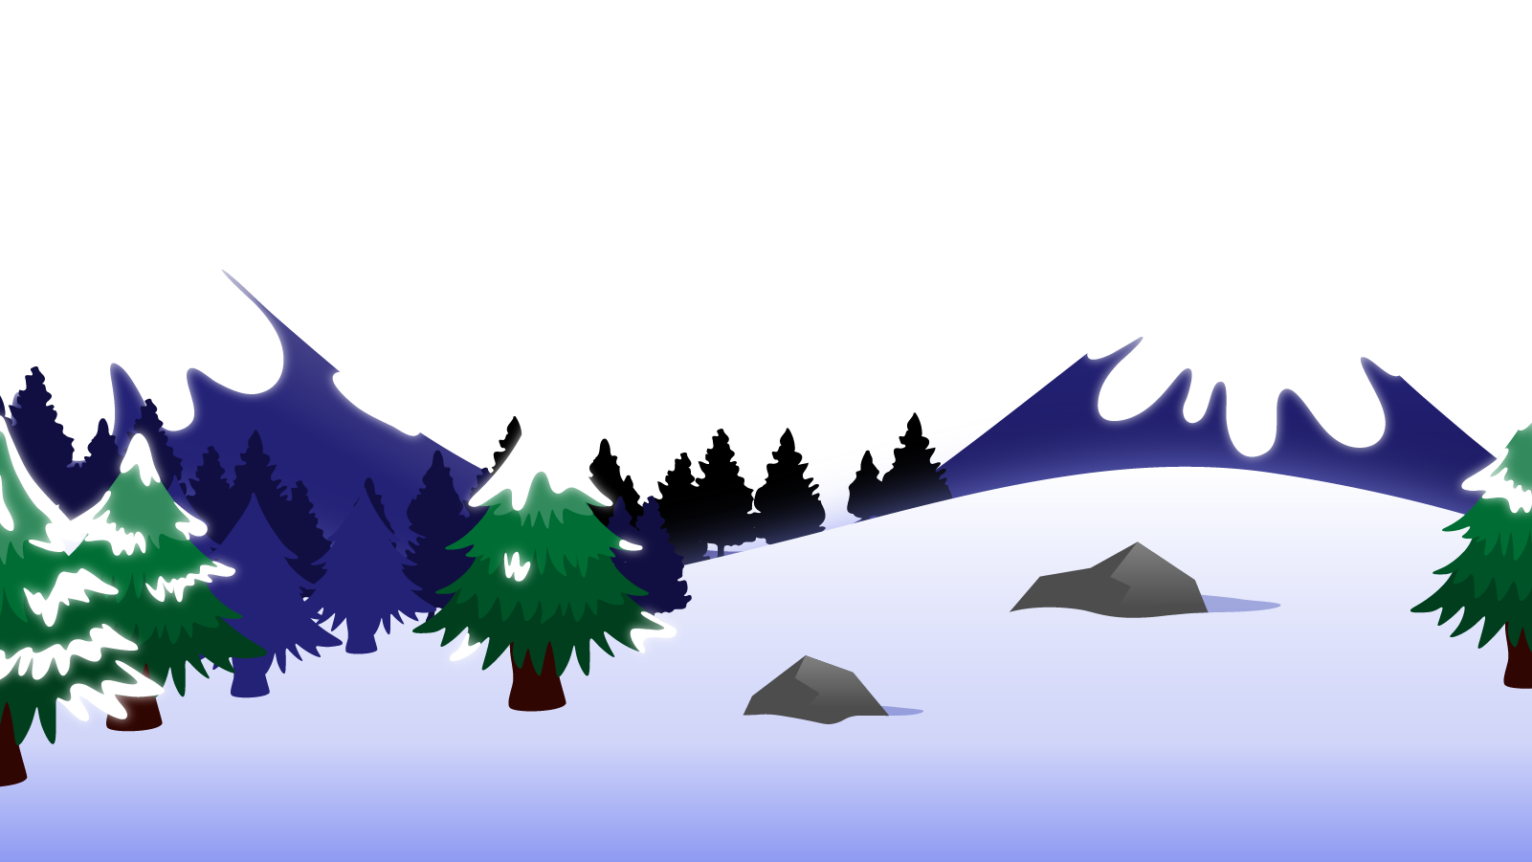
How to Use this Powerpoint
These slides have been designed to be used in Powerpoint as a Slide Show.
There are text and images that will overlap and cause confusion, if used in desktop mode.
To open this in Slide Show mode, please click “Slide Show” on the menu above and then “From Beginning”.
Thank you from the Emile Team.
If you have any feedback, or would just like to say “hello”, please email us at: hello@emile-education.com

Slide 2
Pronouns

Slide 3
Does anyone remember what a noun is?
A noun is a thing or an object.
Can you think of
any examples of nouns?

Slide 4
These words are ALL nouns.
table
Monday
bravery
pride of lions
chair
England
loneliness
pack of lies
room
December
courage
school of fish
brother
London
sadness
gaggle of geese
teacher
Emile
happiness
army of ants
Nouns can be quite dull and uninteresting.

Slide 5
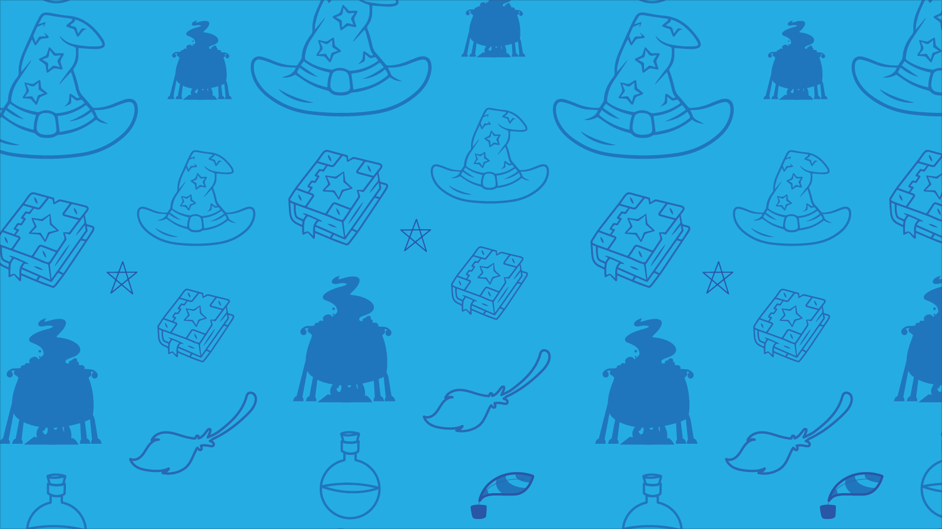
Which of these words are nouns?
teacher - noun
student - noun
walk
student
listen
computer - noun
listen - verb
computer
TV - noun
TV
like
girl
like - verb
girl - noun
boy- noun
boy
courage
sea - noun
courage - noun
sea
learn
learn - verb
collect - verb
collect
brother
brother - noun
London
Aimee
London - noun
Aimee - noun
whiteboard- noun
whiteboard
confidence - noun
teacher
Emile
confidence
teacher - noun
Emile - noun
army of ants
army of ants - noun

Slide 6
Can you spot the nouns in this sentence?
Can you spot two things in this sentence?
Students like school.
The word “students” is a noun.
The word “school” is a noun.
Teachers drive cars.
The word “teachers” is a noun.
The word “cars” is a noun.

Slide 7
Does anyone remember what a pronoun is?
A pronoun is a word that takes the place of a noun.
Examples of pronouns include:
I, you, she, they, me, us, who, anybody, this, and that.

Slide 8
Can you spot the pronouns in this sentences?
Can you spot two things in this sentence?
Students like school. They have fun every single day!
The word “they” is a pronoun.
The word “they” is there to replace the noun “students”.
The teacher liked cars. She would like to drive a fast car.
The word “she” is a pronoun.
The word “she” is there to replace the noun “teacher”.

Slide 9
Can you spot the pronouns in this sentences?
Can you spot two things in this sentence?
The boys didn’t like football. They liked cricket.
The word “they” is a pronoun.
The word “they” is there to replace the noun “boys”.
The girl ran. She was very fast.
The word “she” is a pronoun.
The word “she” is there to replace the noun “girl”.

Slide 10
Can you spot the pronouns?
These are pronouns
I
What type of words are on red blocks?
I
old
old
old
people
people
people
you
you
What type of words are on purple blocks?
she
table
she
table
table
They are adjectives.
girl
girl
girl
he
he
they
they
young
young
young
They are (singular) nouns.

Slide 11
Why use pronouns in your writing?
Dave liked to take risks, but sometimes Dave got into trouble because what Dave did was dangerous.
Dave liked to take risks, but sometimes he got into trouble because what he did was dangerous.
Which one sounds best and why?

Slide 12
Pronouns need to be used carefully as they can create ambiguity (two meanings).
The girl ran towards friends. They cheered.
Who cheered?
The girl only? The friends? Or the girl and her friends?
The reader can’t tell.
It’s ambiguous.
Make sure the reader knows which noun has been replaced by the pronoun.

Slide 13
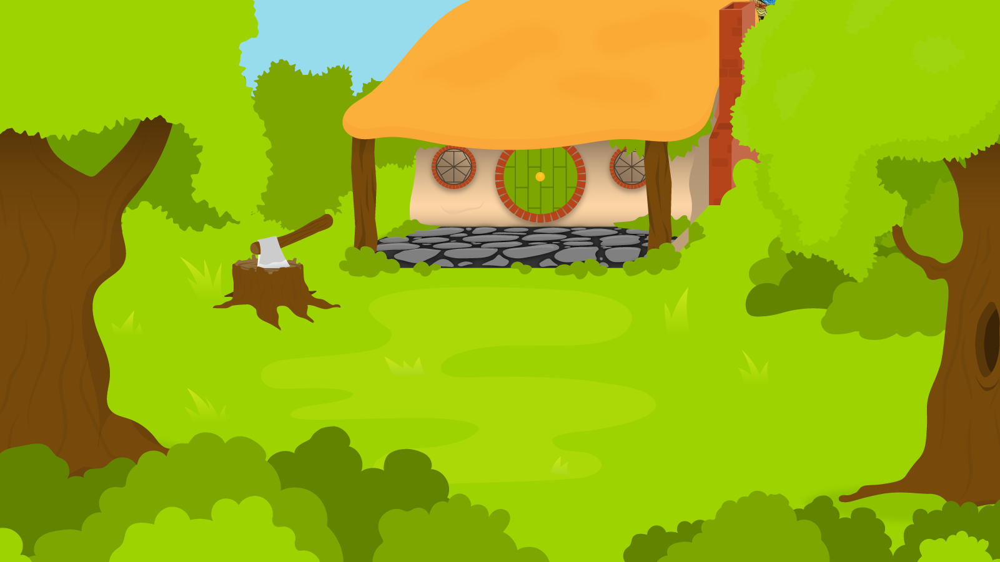
Below are three sentences. You have one minute to spot all the pronouns!
1 Minute Timer
GO!
Time’s Up!
1. I am excited to start a new job next week.
2. She asked me for an opinion on the matter.
3. They went on holiday and had a fantastic time.
GO!
Last 15 seconds!
TIME’S UP!
Start

Slide 14
How about?
1 Minute Timer
1. I am excited to start a new job next week.
2. She asked me for an opinion on the matter.
3. They went on holiday and had a fantastic time.
TIME’S UP!

