Slide 1

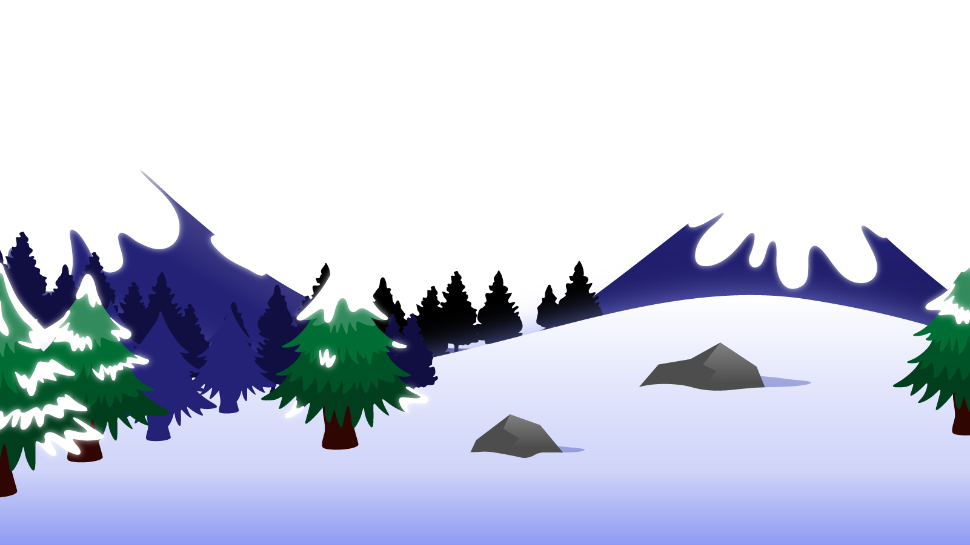

How to Use this Powerpoint
These slides have been designed to be used in Powerpoint as a Slide Show.
There are text and images that will overlap and cause confusion, if used in desktop mode.
To open this in Slide Show mode, please click “Slide Show” on the menu above and then “From Beginning”.
Thank you from the Emile Team.
If you have any feedback, or would just like to say “hello”, please email us at: hello@emile-education.com

Slide 2
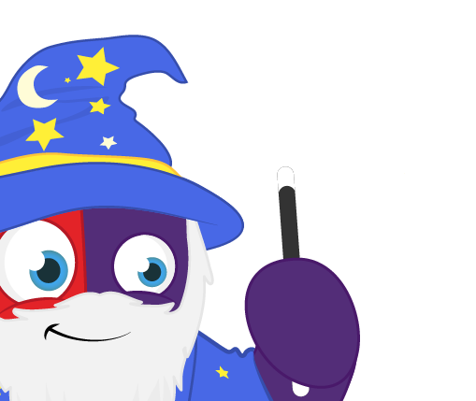
Determiners

Slide 3


Does anyone know what a determiner is?
A determiner comes before a noun and gives information about the noun.

Slide 4

Some examples of determiners are:
a
this
my
some
one
an
that
her
many
two
the
those
his
few
three
Without using determiners, things may become confusing!

Slide 5
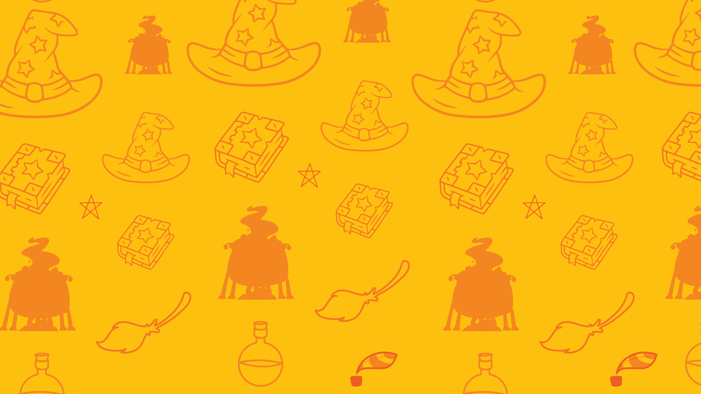
Identify the determiners!
The class went quiet.
The class went quiet.
A dog ran into the school.
A dog ran into the school.
The girls’ team was better at football than the boys’ team.
The girls’ team was better at football than the boys’ team.
A ball bounced into that goal.
A ball bounced into that goal.
That boy threw the ball.
That boy kicked the ball.

Slide 6

Identify the determiners!
A ball bounced into that goal.
A ball bounced into that goal.
My ball bounced into his goal.
My ball bounced into his goal.
Her ball bounced into their goal.
Her ball bounced into their goal.
Three balls bounced into my goal.
Three balls bounced into my goal.
Many balls bounced into a goal.
Many balls bounced into a goal.

Slide 7
Identify the determiners!
A ball bounced into that goal.
Can you see how the determiners give information about the ball and the goal?
My ball bounced into his goal.
Her ball bounced into their goal.
Three balls bounced into my goal.
Many balls bounced into a goal.

Slide 8

Identify the determiners!
Flopsy, Mopsy, and Cottontail, who were good little bunnies, went
down the lane to gather blackberries:
But Peter, who was very naughty, ran straight away to Mr. McGregor's
garden, and squeezed under the gate!
Flopsy, Mopsy, and Cottontail, who were good little bunnies, went
down the lane to gather blackberries:
But Peter, who was very naughty, ran straight away to Mr. McGregor's
garden, and squeezed under the gate!

Slide 9

Identify the determiners!
There was once a velveteen rabbit, and in the beginning he was really splendid. He was fat and bunchy, as a rabbit should be; his coat was spotted brown and white, he had real thread whiskers, and his ears were lined with pink sateen. On Christmas morning, when he sat wedged in the top of the Boy's stocking, with a sprig of holly between his paws, the effect was charming.
There was once a velveteen rabbit, and in the beginning he was really splendid. He was fat and bunchy, as a rabbit should be; his coat was spotted brown and white, he had real thread whiskers, and his ears were lined with pink sateen. On Christmas morning, when he sat wedged in the top of the Boy's stocking, with a sprig of holly between his paws, the effect was charming.

