Slide 1
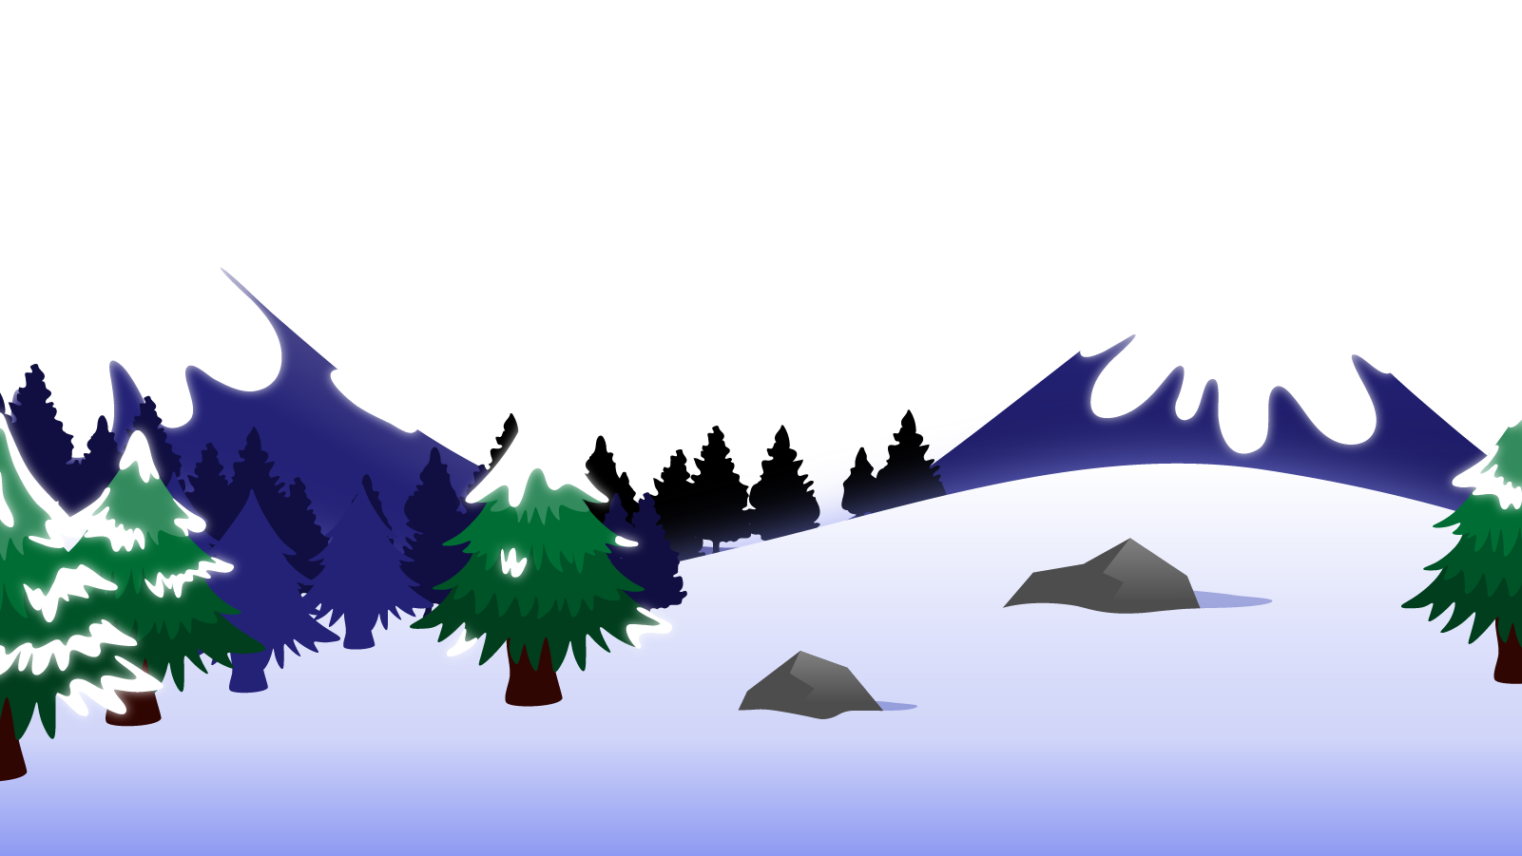
How to Use this Powerpoint
These slides have been designed to be used in Powerpoint as a Slide Show.
There are text and images that will overlap and cause confusion, if used in desktop mode.
To open this in Slide Show mode, please click “Slide Show” on the menu above and then “From Beginning”.
Thank you from the Emile Team.
If you have any feedback, or would just like to say “hello”, please email us at: hello@emile-education.com

Slide 2
Informal Speech & Formal Speech

Slide 3
Choosing how we say something can be hugely important.
We can say the same thing:
using different words; or
with a different tone.

Slide 4
Can you think of any examples where the tone changes how a sentence is understood?
“What do you mean?”
Can you say it nicely?
“What do you mean?”
Can you say it aggressively?
Same words. Different tone.
Different impact.
The tone of a sentence can be very important.

Slide 5
Can you think of any examples where the same thing is said using different words?
“I am a solid fuel extraction agent.”
What job is this?
“I am a coal miner.”
Different words, same meaning, but different impact.
Choosing the right type of words for the audience can be extremely important.

Slide 6
Formal and Informal
Informal Words
Formal Words
can’t
ask
get
shouldn’t
I’m
they’re
can not
enquire
receive
should not
I am
they are
What do you think is the difference?

Slide 7
Can you think who you use informal language with?
Informal language is used with people we know.
Can you think who you use formal language with?
Formal language is used with people we don’t know.

Slide 8
Formal language is used with people we don’t know.
Formal language is used to:
Talk or write with someone new,
Write non-fiction such as instructions, explanations or reports,
Write formal letters.
Informal language is used with people we know.
Informal language is used to:
Talk or write with someone we know well,
Write letters to friends and close family,
Write emails and texts to people we know.

Slide 9
Oi! My meal the other day was rubbish!
Subject: Complaint regarding an unsatisfactory meal
Dear Sirs,
I am writing to express my disappointment with the dining experience I recently had at your esteemed restaurant. I visited your establishment on Saturday for a meal with high expectations, considering the positive reviews and reputation your restaurant holds. However, I regret to inform you that my experience fell far below my expectations.
The quality of the food was subpar. The dish I ordered was badly overcooked and lacked the freshness and flavour that I anticipated.
Moreover, the service I received was equally disappointing. The staff appeared inattentive and disinterested, failing to provide prompt and courteous service throughout the duration of my visit.
I look forward to hearing from you regarding the actions you intend to take to resolve this matter. Please contact me at your earliest convenience to discuss this further.
Thank you for your attention to this matter.
Yours sincerely,
Is this formal or informal?
How do you know?
Subject: Complaint regarding an unsatisfactory meal
Dear Sirs,
I am writing to express my disappointment with the dining experience I recently had at your esteemed restaurant. I visited your establishment on Saturday for a meal with high expectations, considering the positive reviews and reputation your restaurant holds. However, I regret to inform you that my experience fell far below my expectations.
The quality of the food was subpar. The dish I ordered was badly overcooked and lacked the freshness and flavour that I anticipated.
Moreover, the service I received was equally disappointing. The staff appeared inattentive and disinterested, failing to provide prompt and courteous service throughout the duration of my visit.
I look forward to hearing from you regarding the actions you intend to take to resolve this matter. Please contact me at your earliest convenience to discuss this further.
Thank you for your attention to this matter.
Yours sincerely,
Can you spot any “formal” words?
Can you think how you might say the same thing with “informal” words?
What would the difference in reaction be?

Slide 10
Formal or informal?
How’s it going?
Correct - Informal
Formal
Informal
Wrong

Slide 11
Formal or informal?
How are you faring today?
Correct - Formal
Wrong
Formal
Informal

Slide 12
Formal or informal?
What’s up?
Correct - Informal
Formal
Informal
Wrong

Slide 13
Formal or informal?
Is there something the matter?
Correct - Formal
Wrong
Formal
Informal

Slide 14
Think of a formal and informal way to tell someone you will see them later.
30 Second Timer
Informally:
“See ya laters.”
Formally:
“I look forward to seeing you later.”
TIME’S UP!
TIME’S UP!
Last 15 seconds!
GO!
Start

