Slide 1
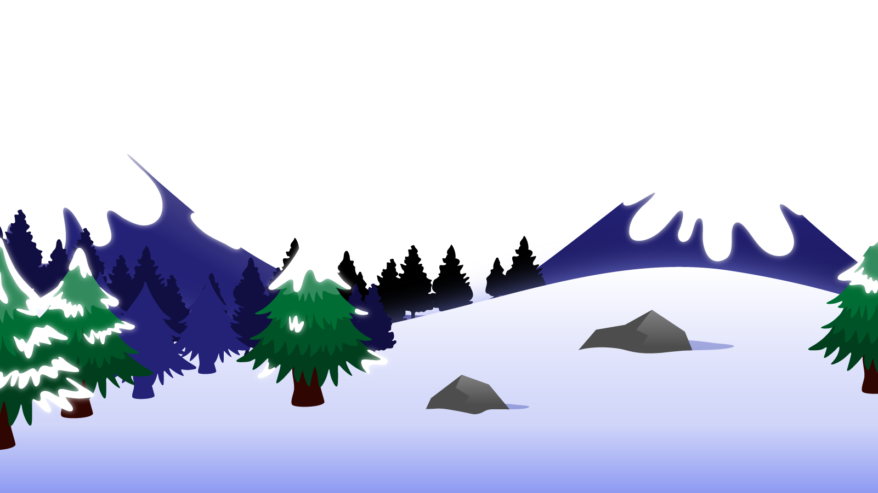
How to Use this Powerpoint
These slides have been designed to be used in Powerpoint as a Slide Show.
There are text and images that will overlap and cause confusion, if used in desktop mode.
To open this in Slide Show mode, please click “Slide Show” on the menu above and then “From Beginning”.
Thank you from the Emile Team.
If you have any feedback, or would just like to say “hello”, please email us at: hello@emile-education.com

Slide 2
Prefixes & Suffixes

Slide 3
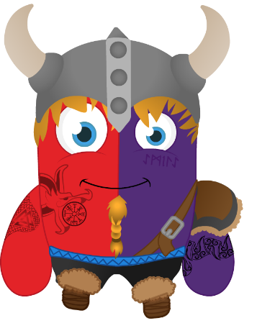
Can anyone remember what a
prefix is?

Slide 4
A prefix is a group of letters that go at the beginning of a root word and change the meaning of the word.
prefix
root word
dis
agree
dis + agree = disagree

Slide 5
A suffix is a group of letters that go at the end of a root word and change the meaning of the word.
Root word
ing
Suffix
do
do + ing = doing

Slide 6
Remember: a prefix goes before and a suffix goes after the root word
dis
agree
ing
prefix +
root
word
+ suffix
dis + agree + ing = disagreeing

Slide 7
You have met quite a few prefixes over the years….
un
+
happy
=
unhappy
dis
+
appoint
=
disappoint
mis
+
behave
=
misbehave
il
+
legal
=
illegal
im
+
mature
=
immature
re
+
verse
=
reverse
sub
+
heading
=
subheading

Slide 8
You have met quite a few prefixes over the years….
inter
+
city
=
intercity
aqua
+
rium
=
aquarium
aero
+
plane
=
aeroplane
anti
+
clockwise
=
anticlockwise
auto
+
biography
=
autobiography
bi
+
lingual
=
bilingual

Slide 9
You have met quite a few prefixes over the years….
micro
+
scope
=
microscope
audi
+
ence
=
audience
trans
+
fer
=
transfer
tele
+
port
=
teleport
pre
+
date
=
predate
in
+
active
=
inactive

Slide 10
You have met quite a few suffixes over the years….
jump
+
ing
=
jumping
jump
+
ed
=
jumped
quiet
+
er
=
quieter
quiet
+
est
=
quietest
quiet
+
ly
=
quietly
pain
+
ful
=
painful

Slide 11
You have met quite a few suffixes over the years….
inform
+
ation
=
information
fame
+
ous
=
famous
bi
+
ology
=
biology
auto
+
graph
=
autograph
child
+
hood
=
childhood
enjoy
+
able
=
enjoyable
entertain
+
ment
=
entertainment

Slide 12
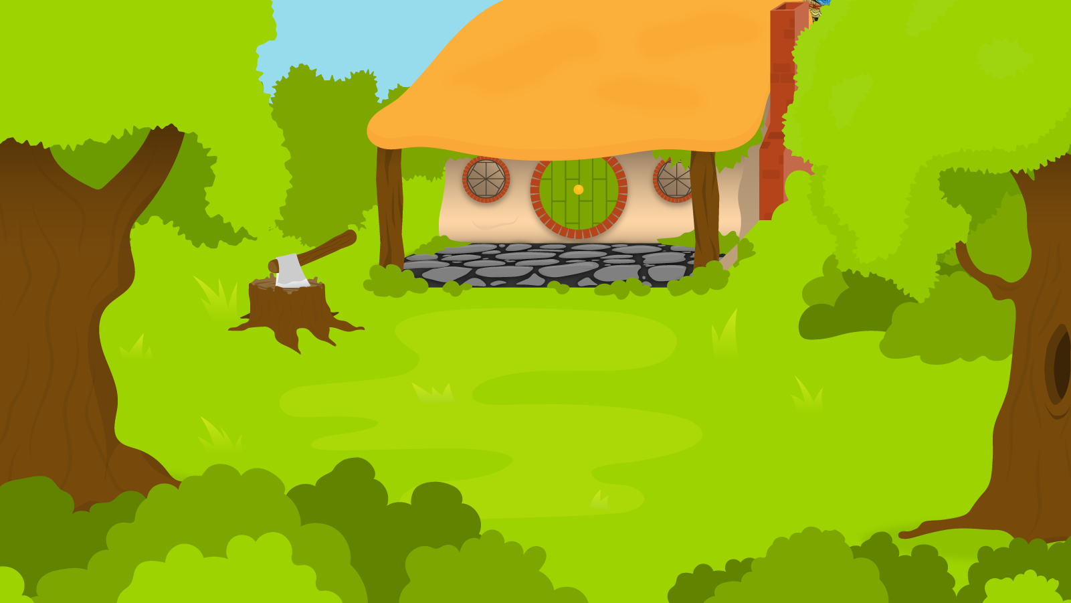
Below are 5 words. Turn these into adjectives using the suffixes “ful” or “less”.
1 Minute Timer
GO!
Time’s Up!
Power
Wonder
Thank
End
Truth
GO!
Last 15 seconds!
TIME’S UP!
Start

Slide 13
What’s the point?
Knowing the root word, means we can figure out the meaning of an unknown word.
It also helps us know spellings without having to be taught them!

