Slide 1
We’ve identified spelling as a focus to improve in our school.
Here's how you can help at home.

Slide 2
Why is spelling important?
COMMUNICATION
Spelling helps children express themselves clearly and confidently, laying the foundation for strong communication skills throughout life.
READING
Recognising spelling patterns helps children become more fluent readers.
WRITING
When spelling becomes more automatic, children can concentrate on what they want to say.

Slide 3
How we teach spelling in school.
In school, children:
• are explicitly taught spelling patterns every week;
• practise and apply their spellings;
• use Emile activities to reinforce classroom learning;
• revisit previous learning through Battles;
• celebrate progress through certificates and competitions.

Slide 4
What can you do to help?
When parents show interest in school and homework, it sends a powerful message.
It tells children that their learning matters and encourages them to keep trying, even when it’s tricky.
With your support, spelling practice can become a positive routine that boosts children’s confidence and success at school.

Slide 5
What does good spelling practice look like at home?
Keep it short. A little practice regularly is better than one long session.
Don't give them the answer immediately. Allow children to think about the spelling pattern and have a go.
Talk about the pattern. Ask:"What spelling pattern are you practising?“
Celebrate effort. Praise persistence rather than perfection.
Don't worry if you can't teach the rule. The pattern is taught in school. Your role is to encourage practice.

Slide 6

What is Emile?
Emile is a free app that can be installed on almost any device.
Children already know how to use Emile.
It is full of games and characters designed to make practice engaging.
The games are aligned to and support classroom activities.
Teachers regularly set work which appears under “Tasks”.

Slide 7
Why use an app?
Immediate feedback
Children find out straight away when they've made a mistake.
Independent practice
Children can practise without needing an adult to mark every answer.
Helps teachers
Teachers can see which spelling patterns children are finding difficult.
Research* has shown that online homework has a positive effect on students’ academic achievement
Notes:
"The effects of online education on academic success: A meta-analysis study” analysed research conducted between 2010 and 2021 across several countries. The findings conclude that online education has a positive effect on students' academic achievement.

Slide 8

Why use Emile?
Made to support class work
Activities support, reinforce and are aligned to what children are learning in school.
Made to engage
Games, rewards, characters and competitions encourage regular practice.
Made to inform teaching
Teachers can see progress and identify areas where children need more support.

Slide 9
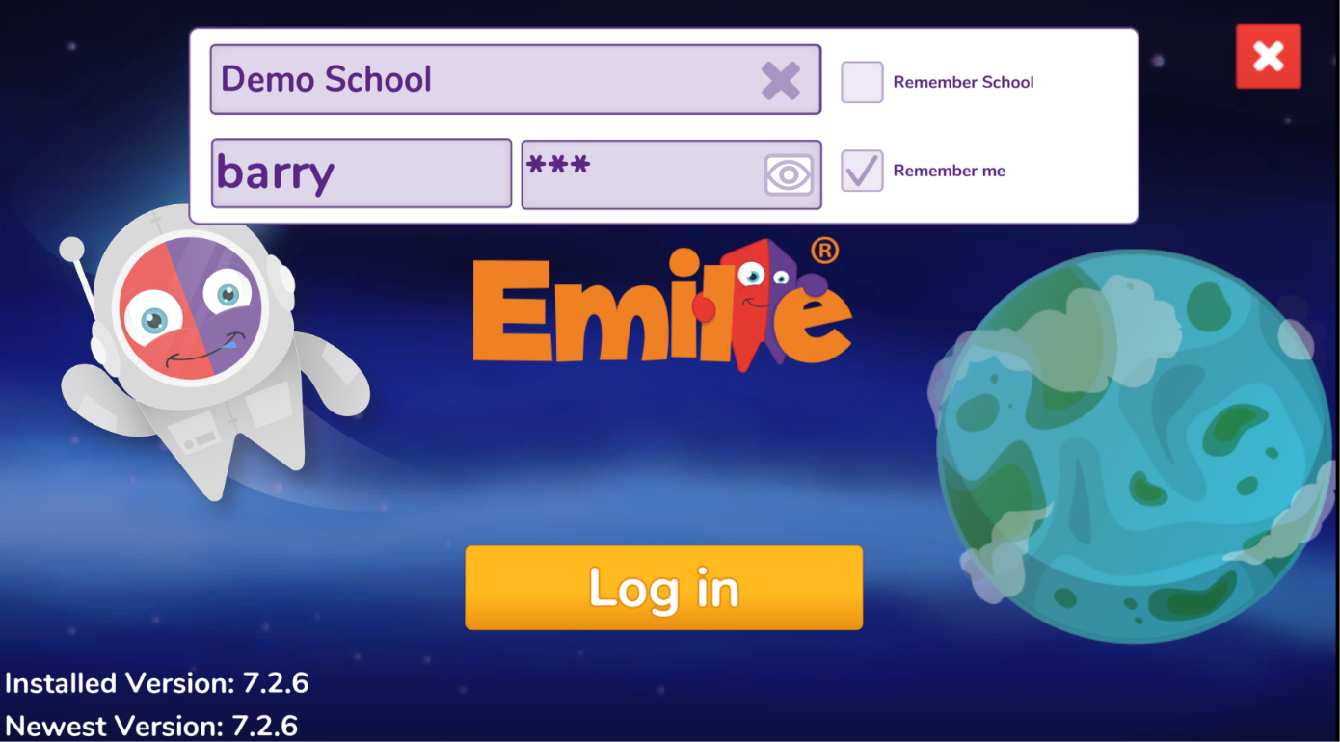
How to use Emile
Download the app “Learn with Emile” from the app stores.
Children need to select the school from the dropdown menu and use their username/password to log in.

Slide 10
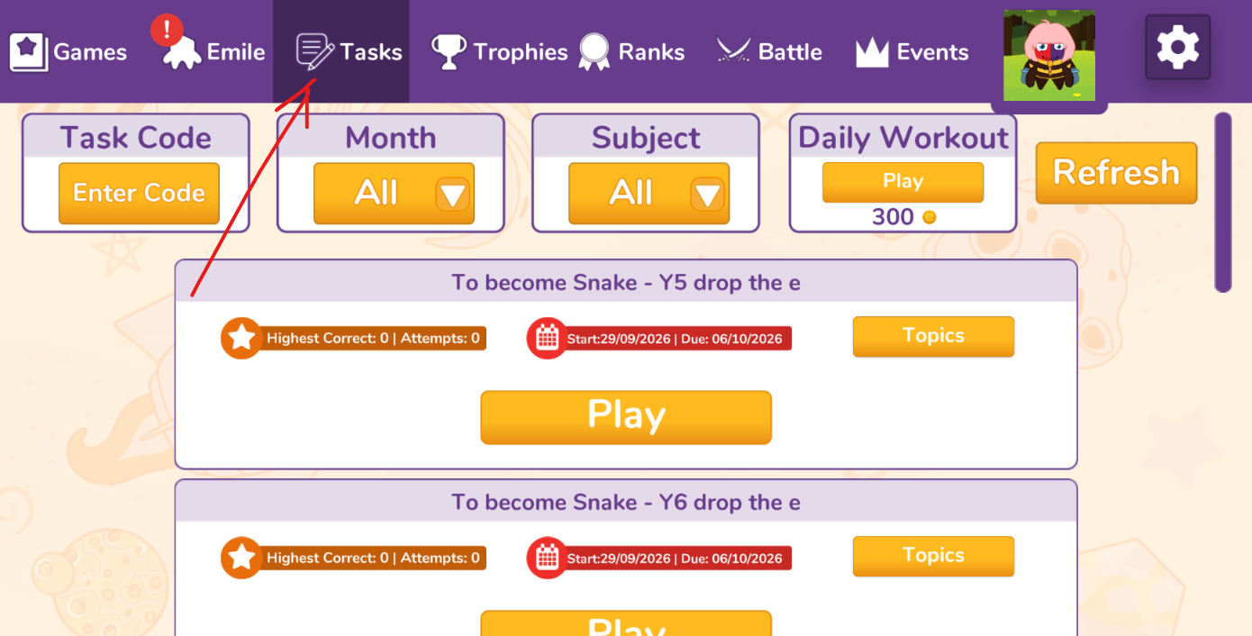
How to use Emile
Work set by teachers will appear under Tasks.

Slide 11
Please encourage your child to use Emile twice each week.

