Slide 1
End of year picture quiz
With Emile

Slide 17
ANSWERS
It’s time to check over your answers, did you get them all right?

Slide 18
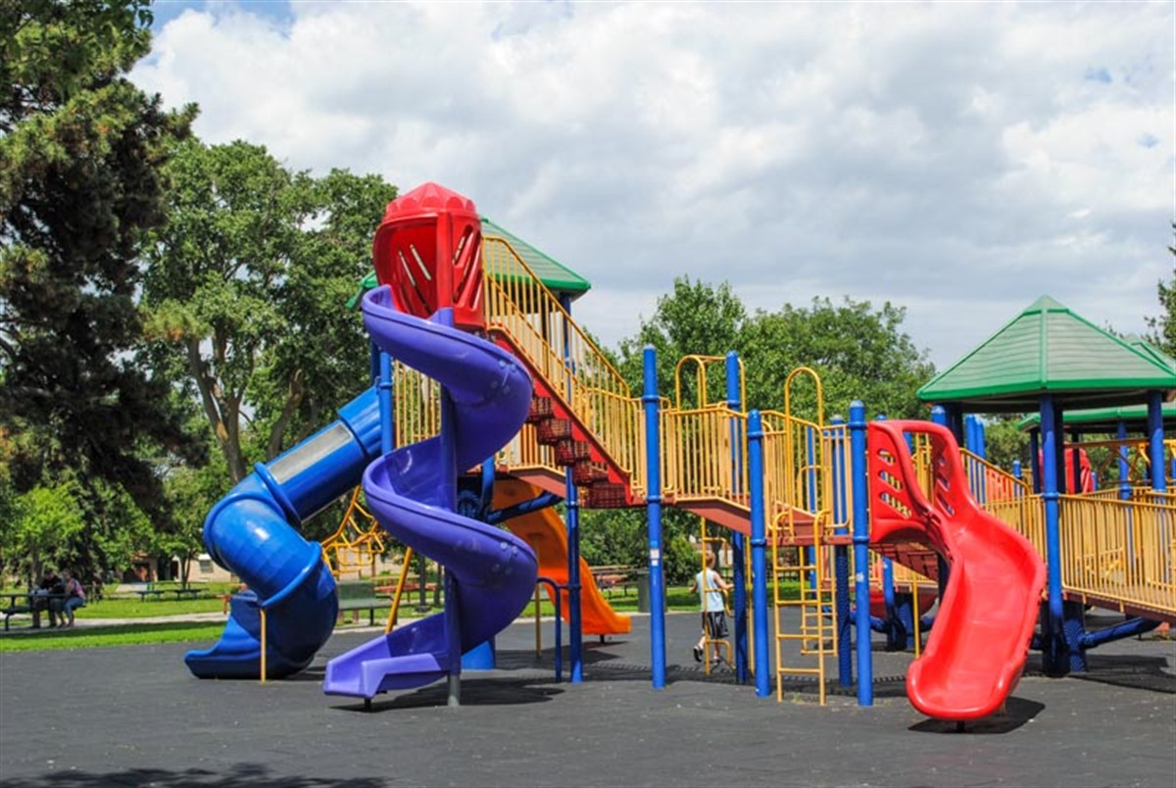
SLIDES

Slide 19
Strawberries

Slide 20
Cat

Slide 21
Scooby-Doo

Slide 22
Panda

Slide 23
Lights

Slide 24
Banana

Slide 25
Giraffe

Slide 26
Cake

Slide 27
Frozen

Slide 28
Disco Balls

Slide 29
Balloons

Slide 31
Boats

Slide 32
Spiderman

