Slide 2
What is Emile?
Developed with MMU’s Faculty of Education to get students answering questions – fluency & recall.
Massive student engagement using Tamagotchis, multiplayer games, competitions, ranks, trophies,…
Teachers can set work, track progress, access useful reports, use the PowerPoints,., all with ease
Robust pedagogy & demonstrable impact.
Covers Years 1-6 of the UK national curriculum maths and GPS.

Slide 3
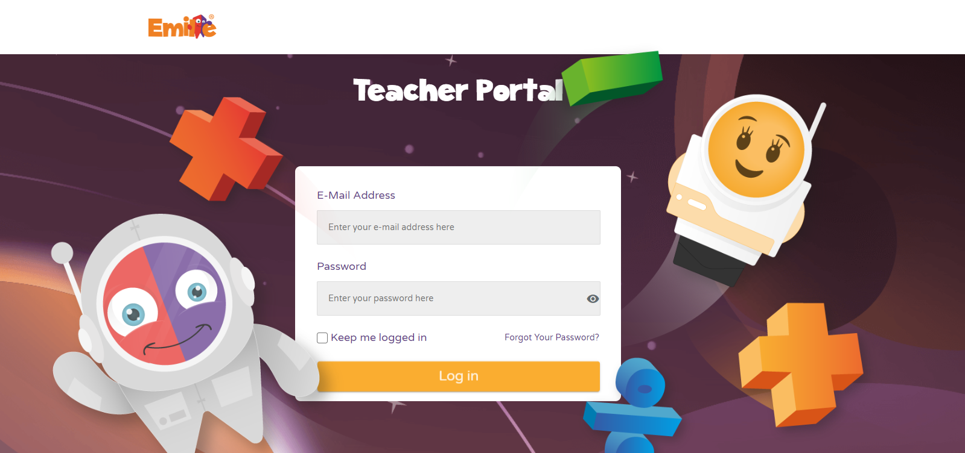
Student Resource
App or Online version.
The App is free to download so parents have no issue accessing.
The App works on Windows, Chromebooks, Android phones, iPads and iPhones.
Teacher Portal
Browser based.

Slide 4
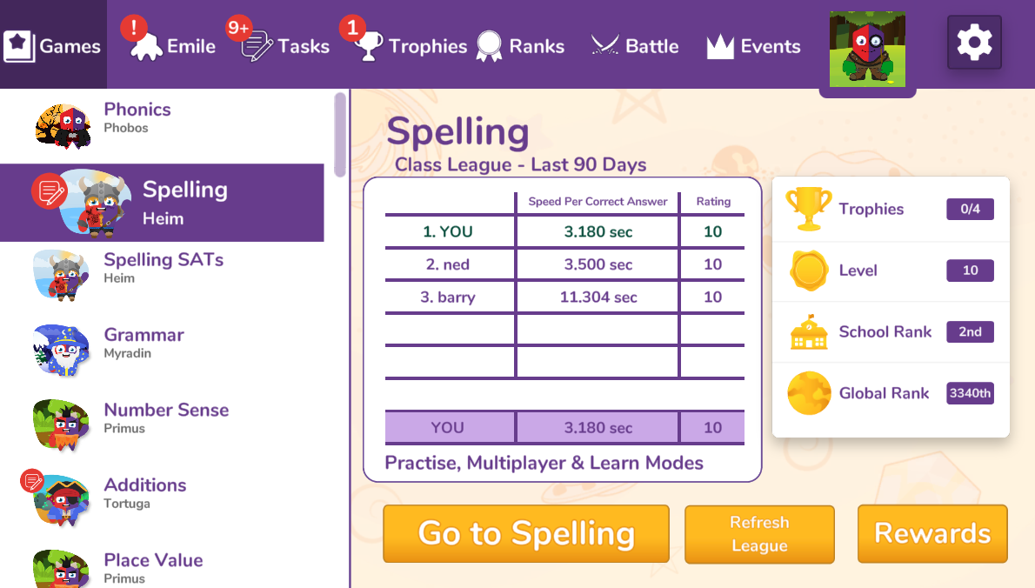
Student Resource – Hub Screen
Student’s own tamagotchi
Work set by Teachers
Competition within a Class
Competitions between Classes or Schools
Different Strands Covered

Slide 5
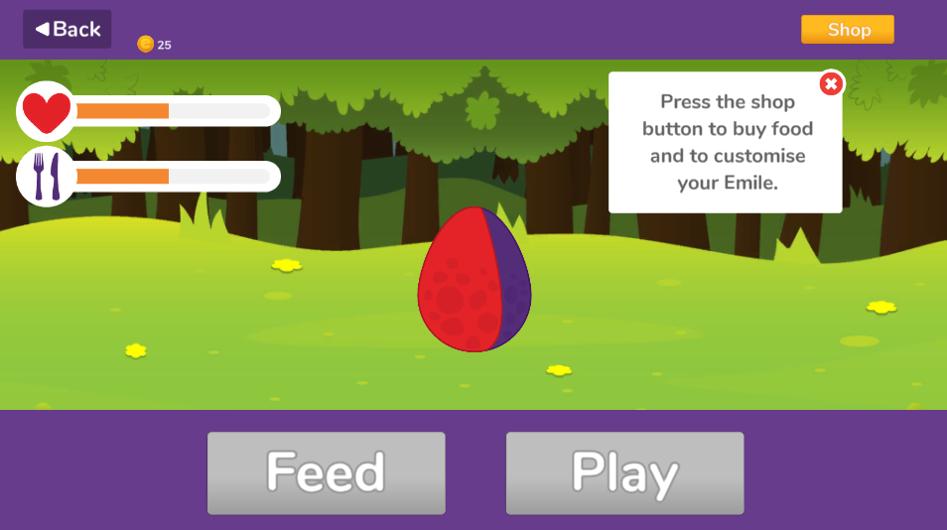
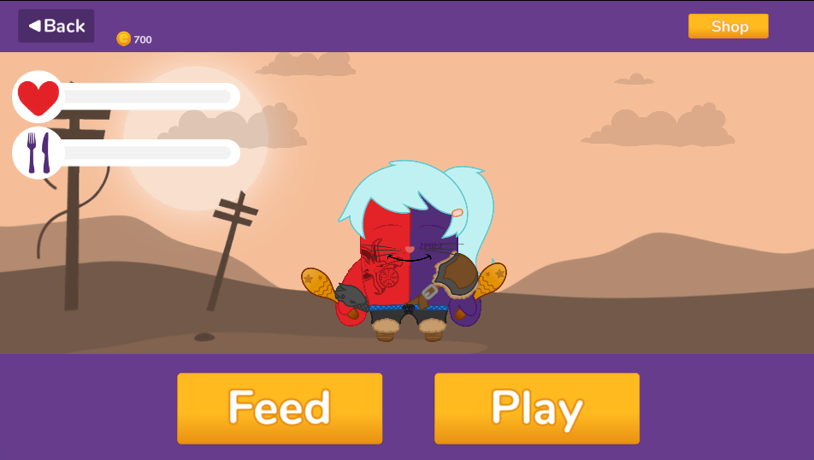
Student Resource – Tamagotchi
In the App, all students get their own Tamagotchi who grows from an egg to a baby to a toddler to a teenager to an adult (usually within 7 days).
Students use coins earned in games to buy outfits, backgrounds, games ,…., for their Tamagotchi.

Slide 6
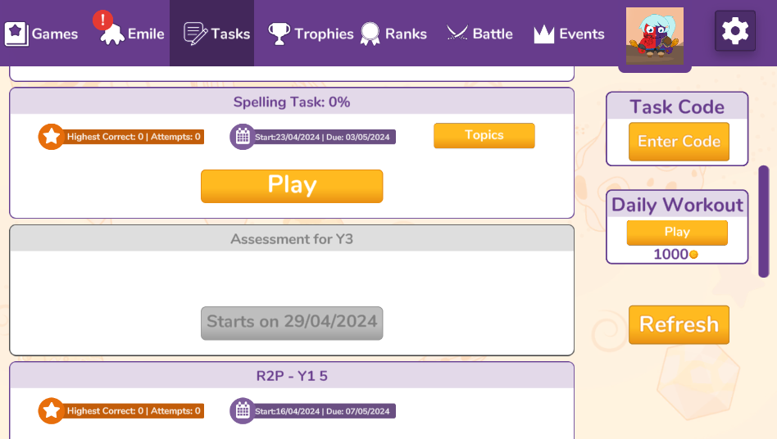
Student Resource – Tasks
Task Codes are listed on our website, in our planning documents and in our powerpoints. They allow teachers to set work without logging in to the Teacher Portal.
Work set by teachers, will appear under Tasks.
Students can also enter a Task Codes on this screen.
Tasks that start in the future are greyed out until the start date.

Slide 7
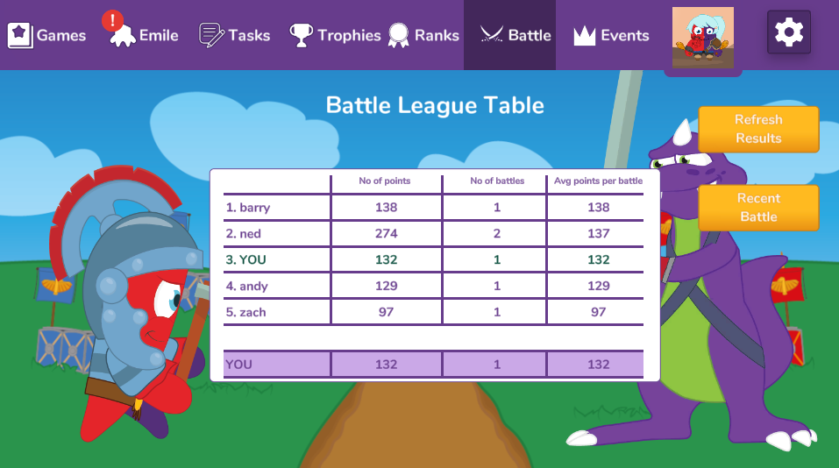
Student Resource – Battles
Battles are competitions within a class.
Teachers set a time period and any student in that class has to play a set game once. It builds up a league table over the school year.
They are commonly used like a quick fun assessment to confirm students know recently taught topics.

Slide 8
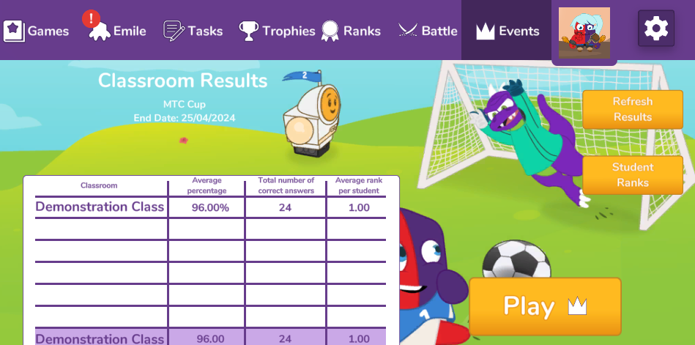
Student Resource – Events
Battles are competitions between classes or schools.
Events run from 9am on the first day to 3pm on the last day.
Students are ranked according to the number of correct answers given. Classes are ranked based on the average rank of their students.
Emile organises half termly competitions between schools. To enter, simply complete the form on the website.
To compete against schools in your MAT, federation or area free of charge for all, please email: hello@emile-education.com

Slide 9
Impact of Emile - Competitions
The University of Manchester studied the impact of Emile's National Primary School competitions.
All the Emile competitions were found to have a
"significant effect on recall and fluency“.
One of the easiest and most understandable results was that over the period of 1 week the proportion of students getting 25/25 increased from 25.7% to 49.7%.

Slide 10
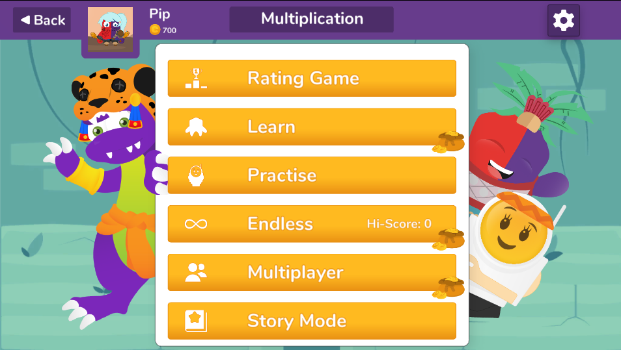
Student Resource - Strands
Rating Game:
Baseline assessment to help Emile adapt to the student.
Most strands are structured like shown below.
The Learn Games in particular have been shown to have a big impact on recall and fluency.
Learn Game:
Multiple round game with scaffolded learning in the first few rounds.
Practise Game:
Allows students to test themselves at an appropriate difficulty level.
Endless Game:
Game with no competition and no time aspect.
Multiplayer Game:
Allows students to play against classmates.
Story Mode:
Fun games to improve fluency.

Slide 11
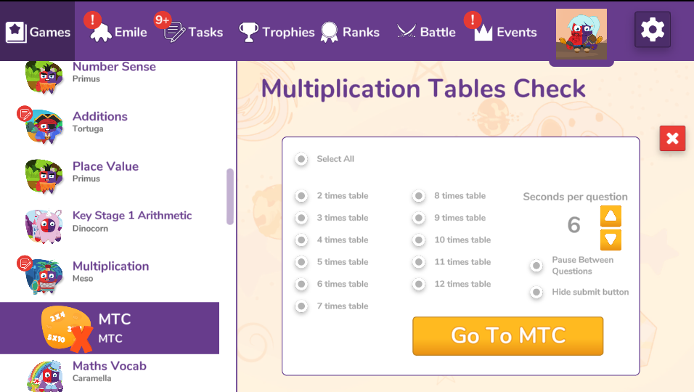
Student Resource – MTC Strand
The MTC Strand is identical to the Year 4 DfE test.
It allows students to practise for the MTC using an identical layout.
It also allows students (and teachers) to select the times tables, how long they have to answer and to turn off the enter button (to slow students down).

Slide 12
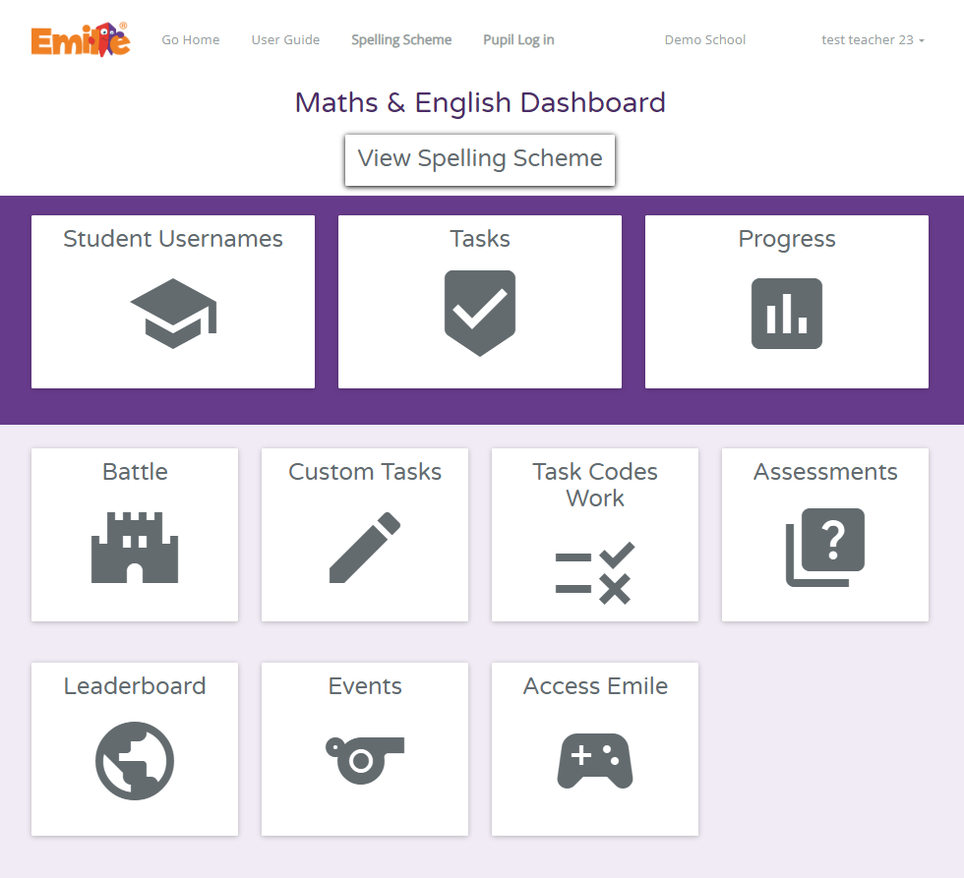
Teacher Portal
The Teacher Portal is browser based.
Teachers after logging in can:
Access our Spelling Scheme (including planning, activities, Powerpoints & worksheets);
Allocate work as a Task, Battle, Custom Task, Task Code, Assessment or an Event to students in their classes; and
Track progress of students in their classes (including times table heat maps, knowledge gap analyses and spelling moderation reports).
School Admins after logging in can:
Add classes and teachers; and
See all work set and progress by all students in a school.
Trust Admins after logging in can:
See all students in all schools and all their work;
Export data for all year groups centrally; and
Organise Trust wide competitions and assessments.

Slide 13
Teacher Portal – Allocate Work
Teachers can allocate work in a number of ways:
Tasks:
Set a piece of work that aligns with work done in class to specific students.
Assessments:
Set a piece of work that aligns with work done in class to specific students.
Battles:
A competition within a class where each students plays the same game once.
Task Codes:
Results from Task Codes used by students.
Events:
Competitions between classes or schools.
Custom Tasks:
Upload your own spelling list.

Slide 14
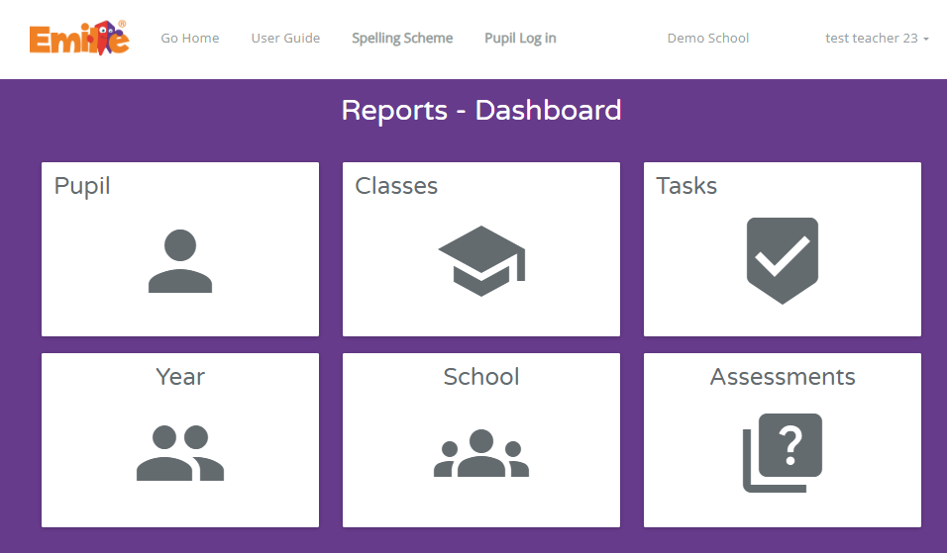
Teacher Portal – Tracking
Teachers can track work in a large number of ways:
Teachers can track by:
Pupil, Class, Year or School; or
Task or Assessment.

Slide 15
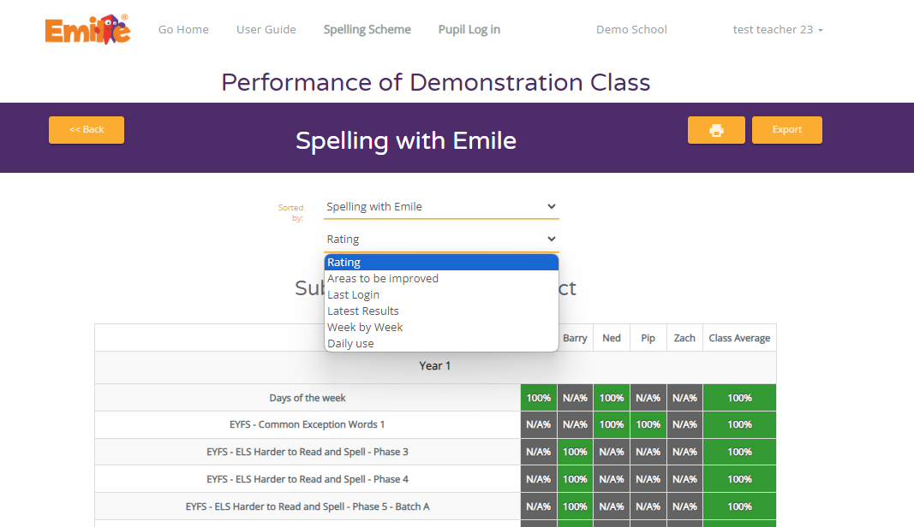
Teacher Portal – Tracking by Class
Rating shows a knowledge gap analysis of a class.
Students’ names are shown across the top and their correct percentage from the last 120 days for each learning outcome is shown.
This can be hugely helpful for intervention work, where specific weaknesses can be spotted and targeted.

Slide 16
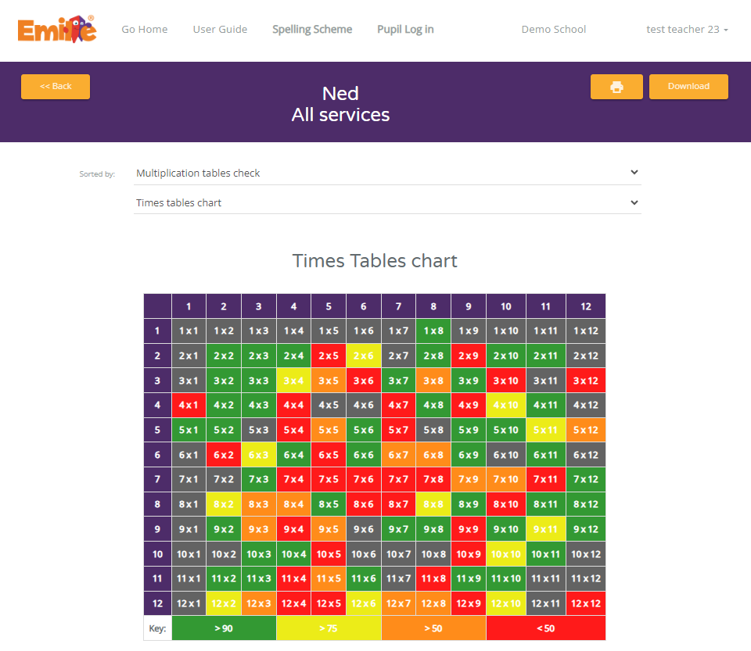
Teacher Portal – Tracking by Pupil - MTC
When tracking pupil, a teacher can access a pupil’s times table heat map under Multiplication Tables Check.
The chart shows the percentage correct for each times table over the last 120 days given when they had 6 seconds to answer.
Whole class reports can be exported.

Slide 17
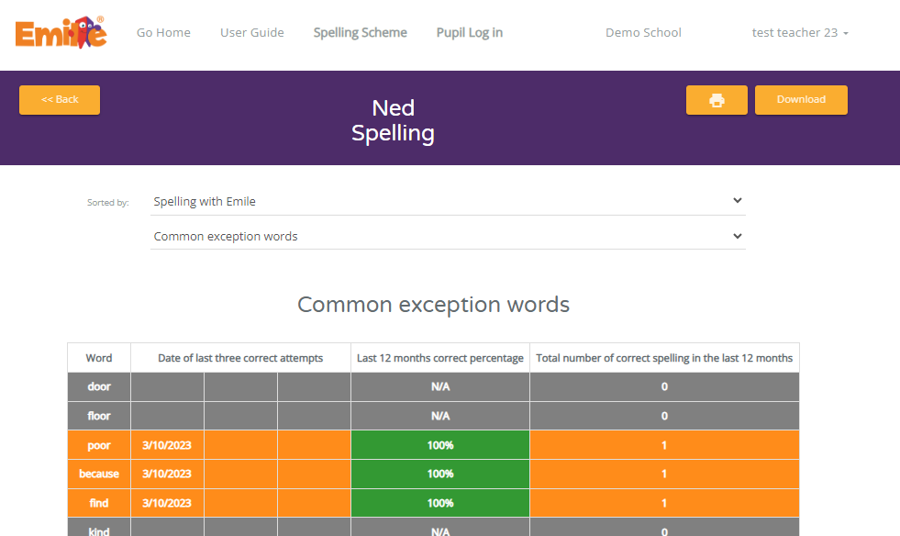
Teacher Portal – Tracking by Pupil – Spelling Moderation Reports
When tracking pupil, a teacher can access a pupil’s moderation reports under Spelling.
The charts show whether the student knows how to spelling the Common Exception Words, Y3/4 Word List Words or Y5/6 Word List Words.
Whole class reports can be exported.

Slide 18
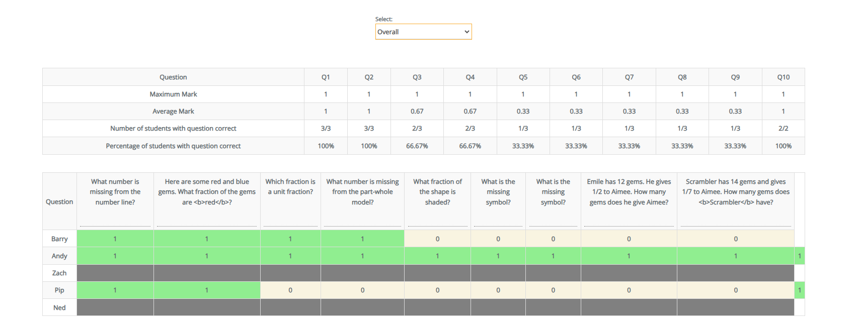
Teacher Portal –
Tracking by Task or Assessment
Tracking by Task or Assessment, confirms who has completed the work, their score and any areas of common weakness.
The reports can be exported to excel or printed.

Slide 19
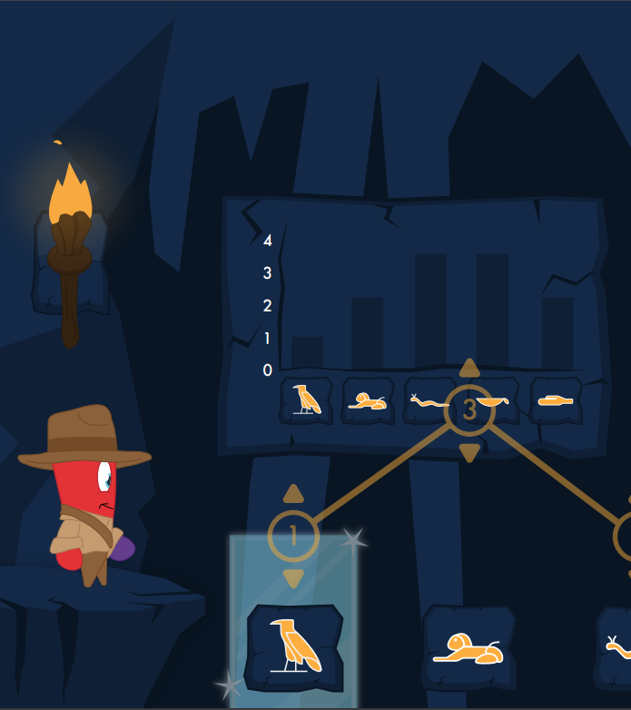
Support
Of course, there is a lot more to Emile than shown here!
If you are looking for a particular feature, have a question or need support, please get in touch and we would be delighted to help.
Hello@Emile-Education.com

